Slide 1

WELCOME
DEALER SALES SCHOOL 2023
VILLAMOURA ALGARVE
25 –26 APRIL 2023

Slide 2
Advancer
Solution Sale
Product Overview
  AST and MT Line Up
  Key Specs
Technology & Innovation & Sustainability
  Temperature Mgt
  Fuel Consumption
  Carbon Neutral Production Line, CO2
Competitor Comparison
Solutions & Services & Aftermarket
  Telematics +, iBox
  EBTS improvement
  Diagnostic tool for quicker service – Service TAP
Key Take-Aways: Unique Selling Point
Sales tools & Marketing Materials available
Practical information
  MT Configurations available
Case Study – Value Selling Workshop

Slide 3

A solution sale secures future embedded revenues
Extended Warranty
Upgrades &
Accessories
UNIT SALE
SOLUTION SALE
Service Contracts
Spare Parts
Packages
VS.
Connectivity
Services
Connected
Assets
Notes:
let's talk about what the solution sale is.
Consider you have 2 scenarios for sales. Selling a unit only then lose the customer as soon as the standard factory warranty expires vs. selling a solution to the customer which includes not only the unit, but also different services and solutions tailored for the specific needs of the customer.
A solution sale also means a value sale. Based on the customer's specific needs and concerns, you can come up with different solution by combining different services and solutions.
For example, for the customer who is concerned about unexpected downtime over international transportation, you can offer the unit with a ComfortPlus combined with 24/7 Fleet Monitoring, while you can offer ThermoLite solar panel and fuel sensor for the customer who is interested in maximising the fleet efficiency.

Slide 4



Addressing the full lifecycle of a transport refrigeration unit
New Unit Purchase
& Warranty Service
Uptime Services
New Life
Year 0 – 2
Year 3 – 6
Year 7 +
“Purchase a complete solution from a single supplier”
“Maximize unit availability,
efficiency, 100% plannability”
“Increase value of used units, upgrade to latest technology”
Customer
“Grow share and services revenue by offering a solution at POS”
“Grow parts and services revenue
by improving customer retention
and TK dependency”
“Grow parts and services revenue by offering modernization solutions”
Thermo King
Notes:
We'd like to remind you about the full lifecycle of a transport refrigeration unit. The life duration may vary depending on customer or market or application, but we can think of 3 phases.
The first phase starts with the delivery of the unit. During this phase, customer would purchase our solution and would want to ensure that they have competitive pricing and comprehensive solution for their business. At this stage, we have our opportunity to offer a tailored solution for our customers per their needs, which can help us to grow the share in the market and secure the long term relationship with the customer that can reward you with more business for longer period, instead of only stopping at selling the unit.
The second phase is what we can call as first life of the unit where customer would want to ensure that they make the best use out of their investment. Therefore the uptime of the unit becomes an important aspect as well as operation efficiency. By fully capturing this phase, we can secure customer loyalty and also increase the potential service opportunity within our network that we can maximise customer satisfaction as well as profit at your workshop and service teams.
After serving the first life, typically in line with end of the first ATP certificate, the unit may face the next phase where the needs of the customer becomes somewhat different from previous phases. Dealers can offer the customer different solutions to maximise customer's value out of the unit in the second life such as ATP re-certification, Thermo King Select Parts portfolio, upgrade with accessories or extension of service agreements.
It is very important that we recognise those different phases of unit lifecycle that we can propose right solution to our customers along with their specific needs

Slide 5

Advancer
The Landmark in Transport Refrigeration

Slide 6
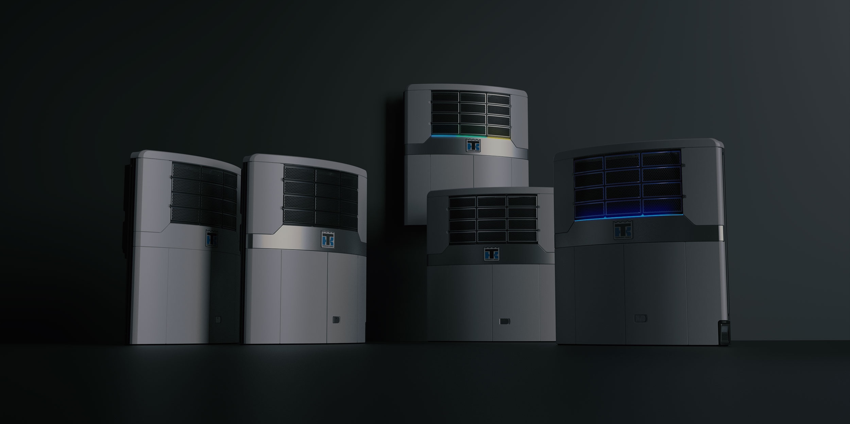
THE ADVANCER SERIES IS
GROWING

Slide 7


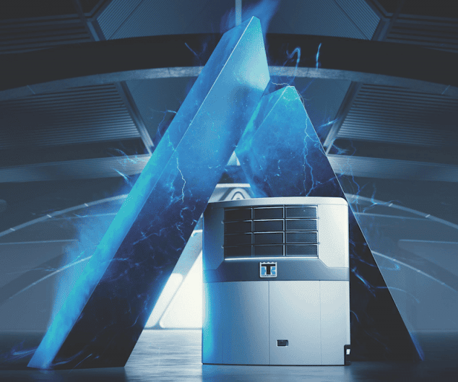
Advancer
ADVANCER

Slide 8
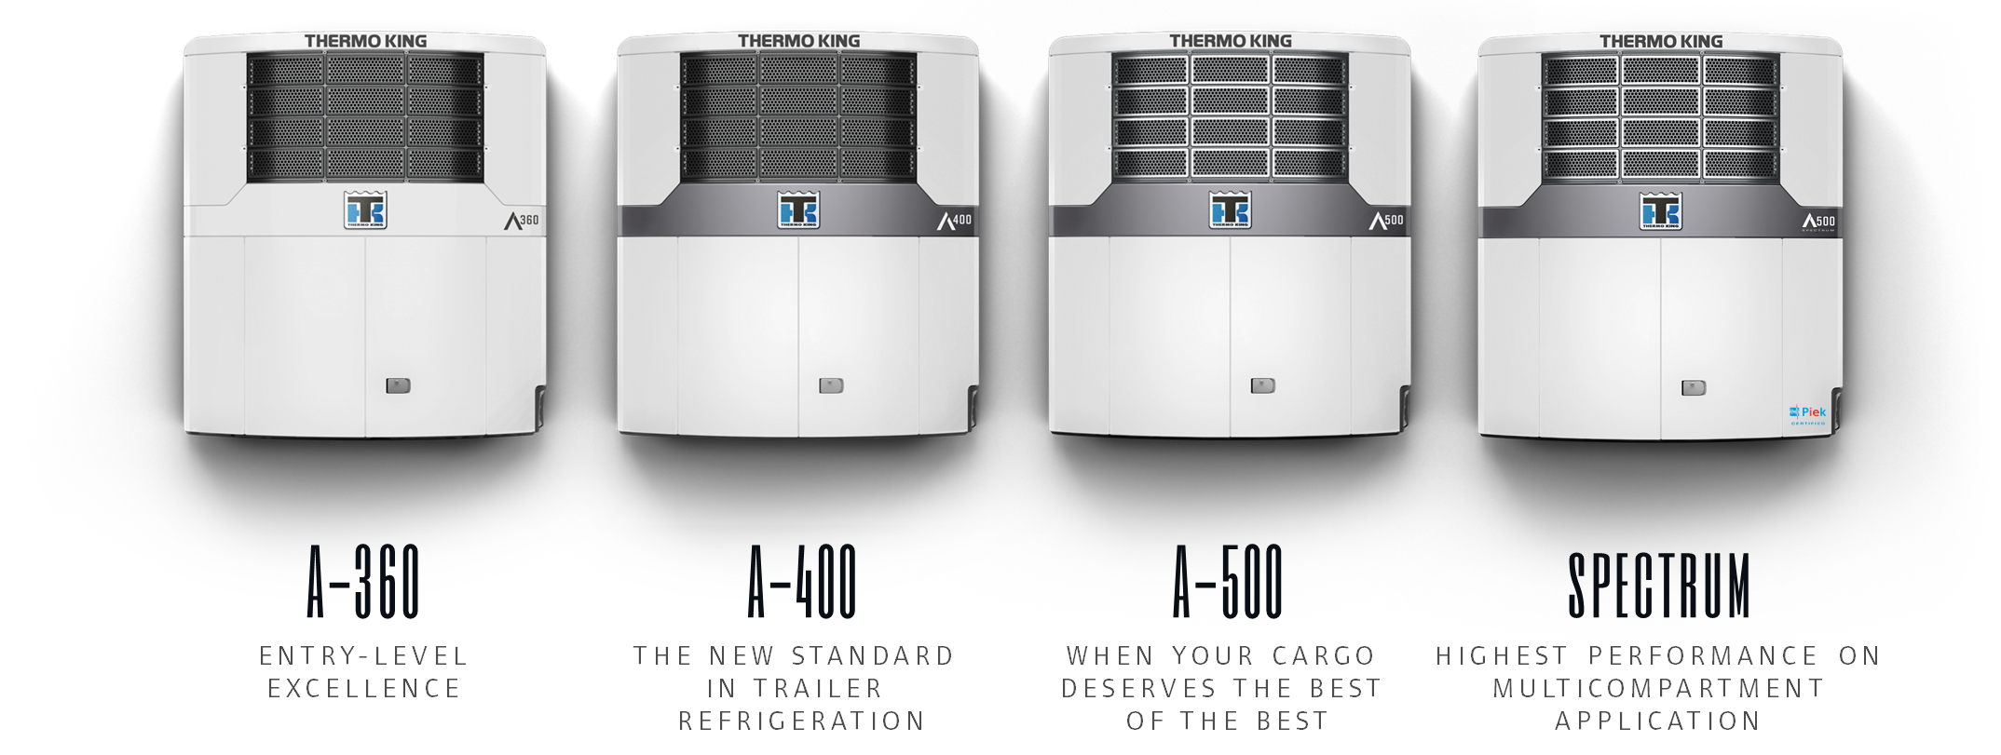
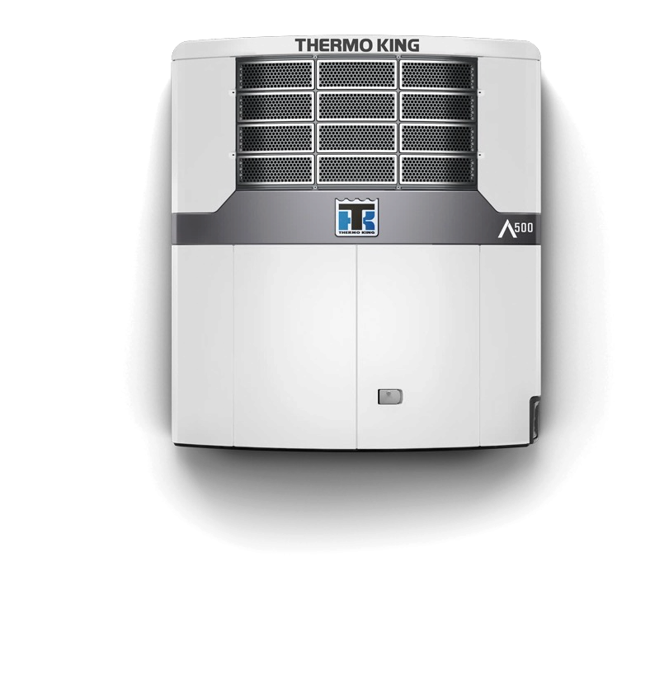

Advancer
THE LINE UP - THE BENCHMARK IN TRANSPORT REFRIGERATION
Emissions Free
Refrigeration

Slide 9
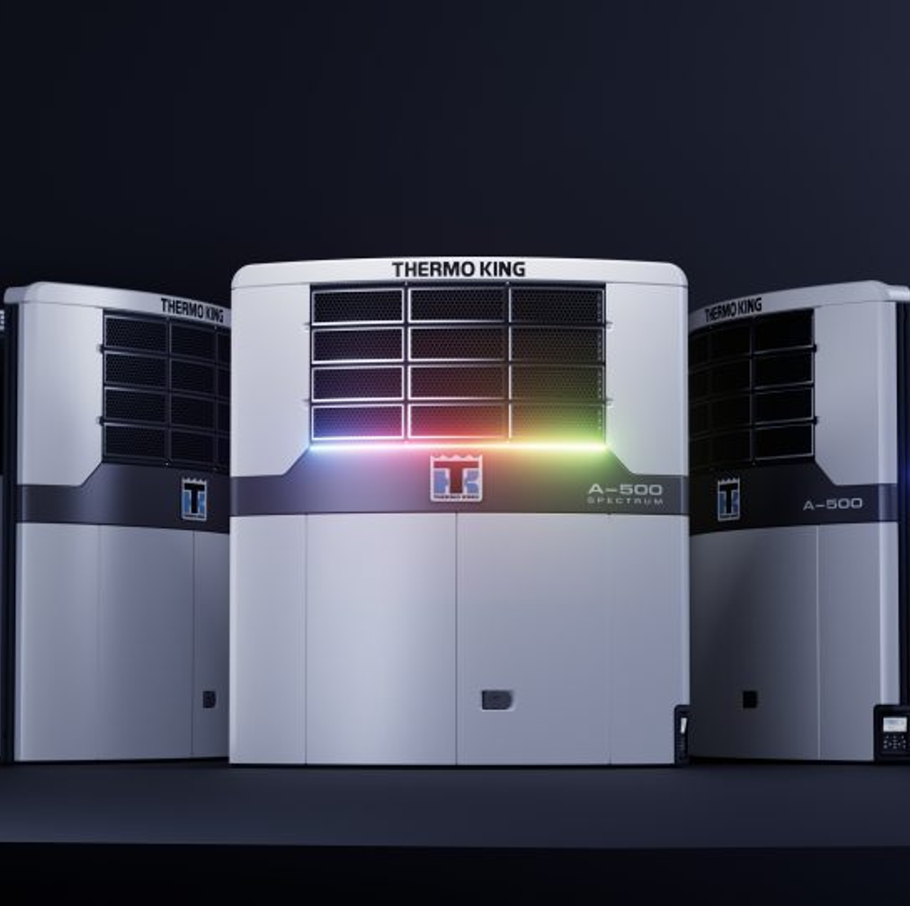
Advancer
NO MATTER WHAT ADVANCER YOU SELECT
Exceptional Performance
Unrivalled Uptime
Lower Total Cost of Ownership
Future Proof Intelligence
Sustainable Innovation

Slide 10
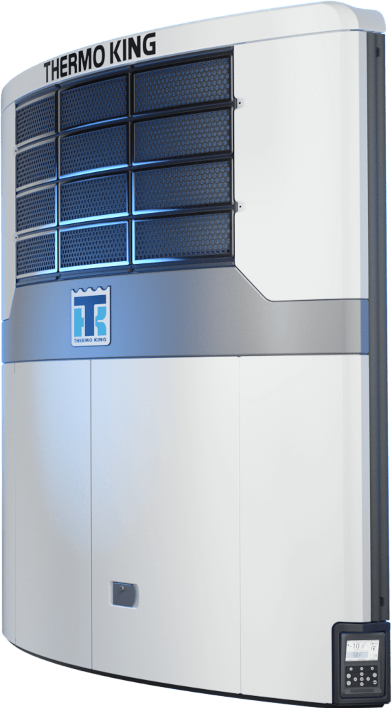
Advancer
TOP PERFORMANCE IN THE MARKET
Fastest Pulldown
Lowest Fuel Consumption
Tightest Temperature Control
Highest Airflow
Lowest Noise

Slide 11

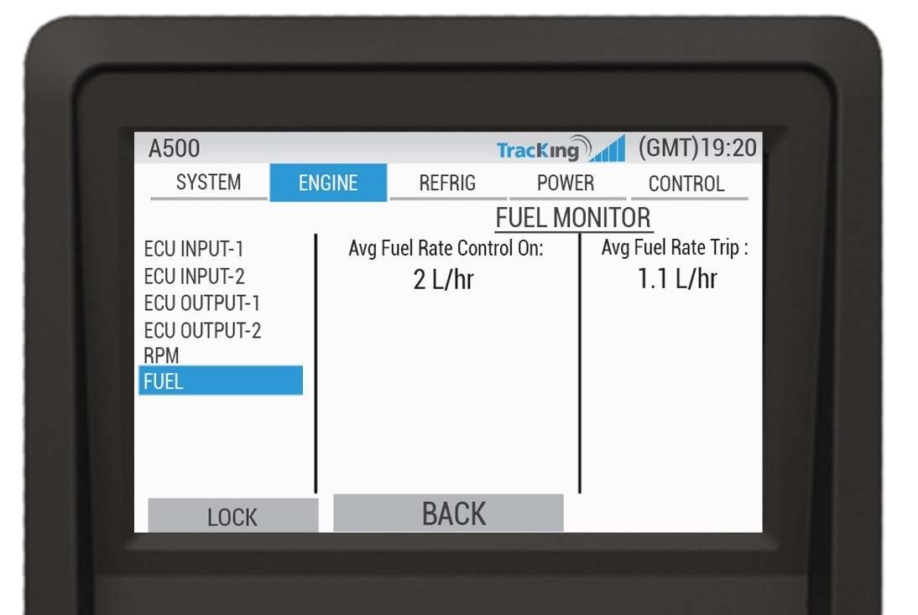
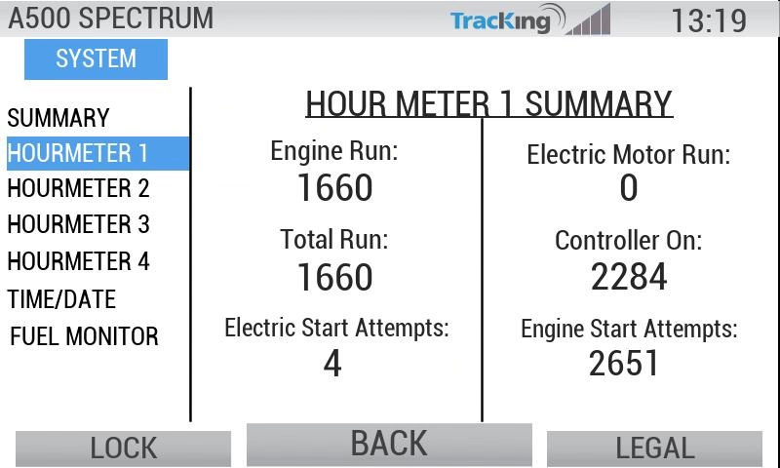


Advancer
TRANSPORT REFRIGERATION INDUSTRY FIRSTS
48V Mild Hybrid Architecture
Fully Variable Airflow
On Board Fuel Monitoring
2 Years connectivity with Fuel Monitoring through Tracking

Slide 12

Advancer
Why is it important?
System Efficiency and operational flexibility
48V DC MILD HYBRID ARCHITECTURE
Mechanical belt-driven airflow replaced by a 48V DC electrical architecture:
  48V DC mild hybrid architecture
  Shore power & hybrid ready
  Power agnostic for future sources
What is it and Why is it important?
  Lets the customer use the airflow they need when they need it.
VARIABLE AIR FLOW

Slide 13
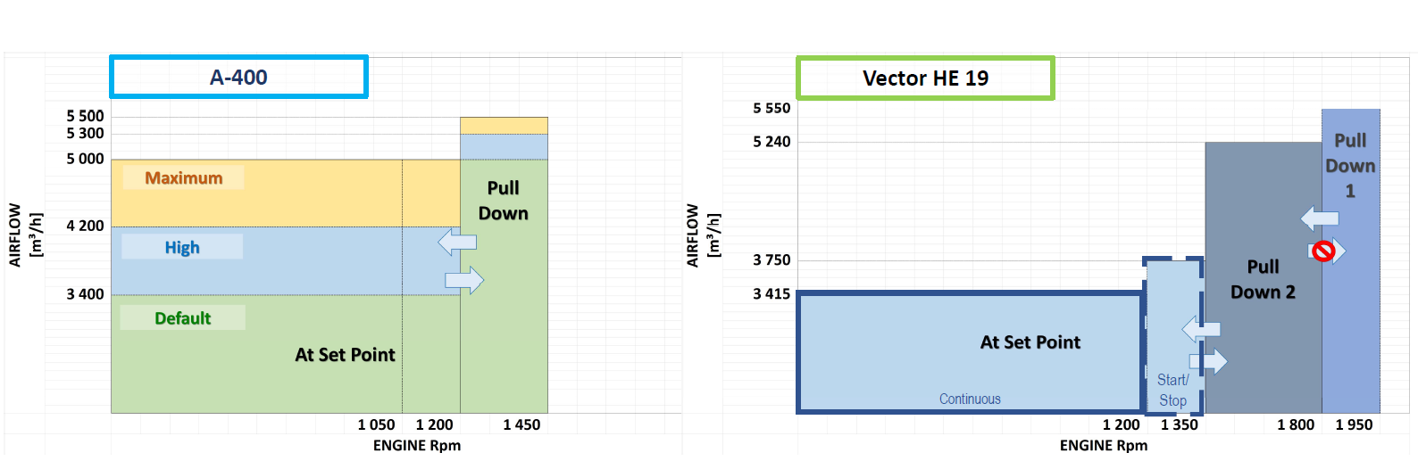
Advancer
VARIABLE AIRFLOW
Using only what airflow is needed when it’s needed increases operational efficiency
Save Fuel
  Save Money
  Save CO2
Deep dive Competitive Hotsheet – Advancer Airflow available on Infocentral
Notes:
— Wider choice on airflow
— 5500 to 6000 m3/h during pull-down (Pre-set value: 5500 m3/h)
— 3400 to 5500 m3/h at set point (Pre-set value: 3400 m3/h)
— 3 different regimes can be selected: Default, High, Maximum
— A-500 provides the highest airflow in the market
— A-Series airflow independent from engine speed – whereas Vector provides one only airflow
volume for one engine speed
— A-500 introducing the Eco engine speed, as low as 1050 rpm for improved fuel efficiency
— Vector maximum airflow is available only during first pull-down phase (once per trip) – all other
unit operation modes provide lower airflow volumes
— Vector airflow at set point is lower on continuous operation (3415 m3/h)

Slide 14
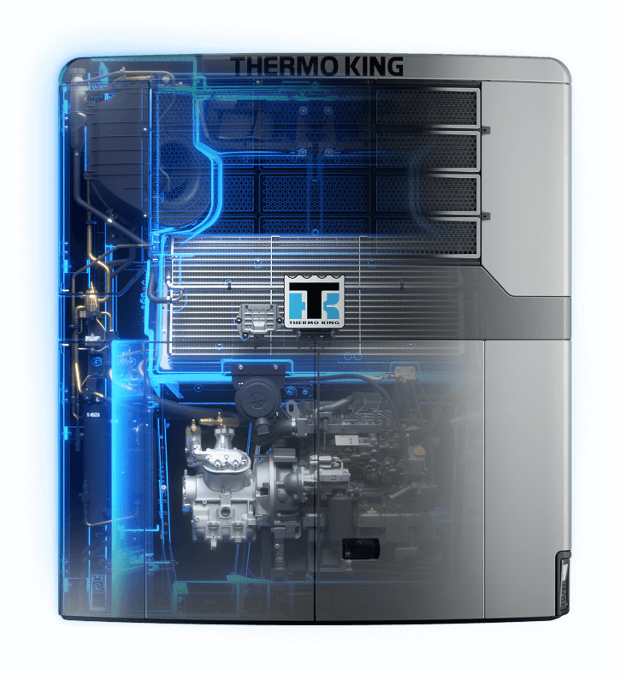
Advancer
DESIGNED FOR EASE OF SERVICE AND MAINTENANCE
30% Less overall Servicing required
33% Reduction in number of refrigeration Joints
38% reduction in Number of Parts
Service interval of 3,000 hours

Slide 15
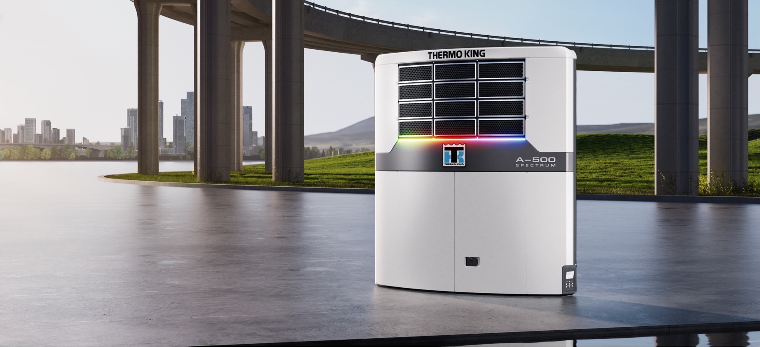
ADVANCER SPECTRUM
Mastering Multi-temp

Slide 16
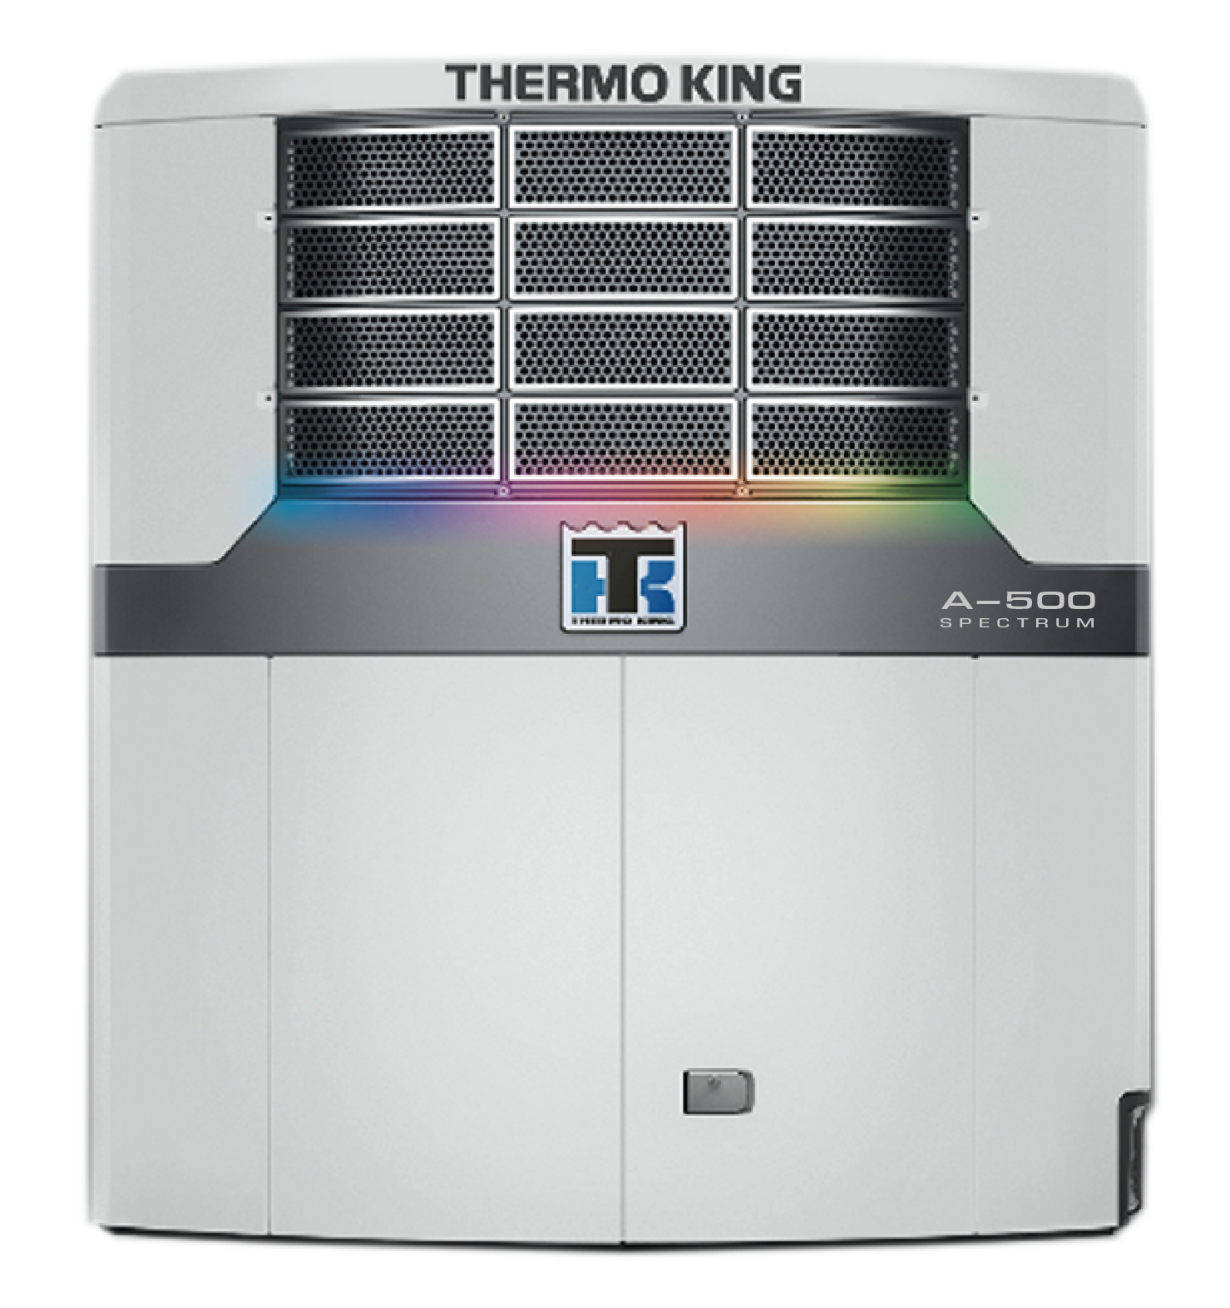
Advancer Spectrum
NEW PRODUCT INTRODUCTION
The ALL NEW Benchmark in multi temp transport
The Best Temperature Control
Quickest Pulldown
Lowest Fuel Consumption
Quietest standard unit on the market (+ Piek)
Advancer build quality
Lower servicing costs
Telematics as standard (with 2 years)

Slide 17
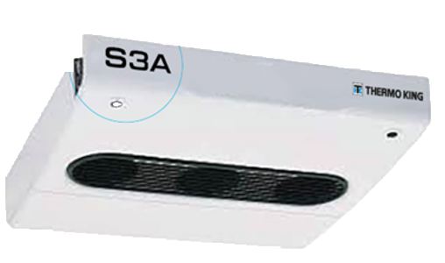
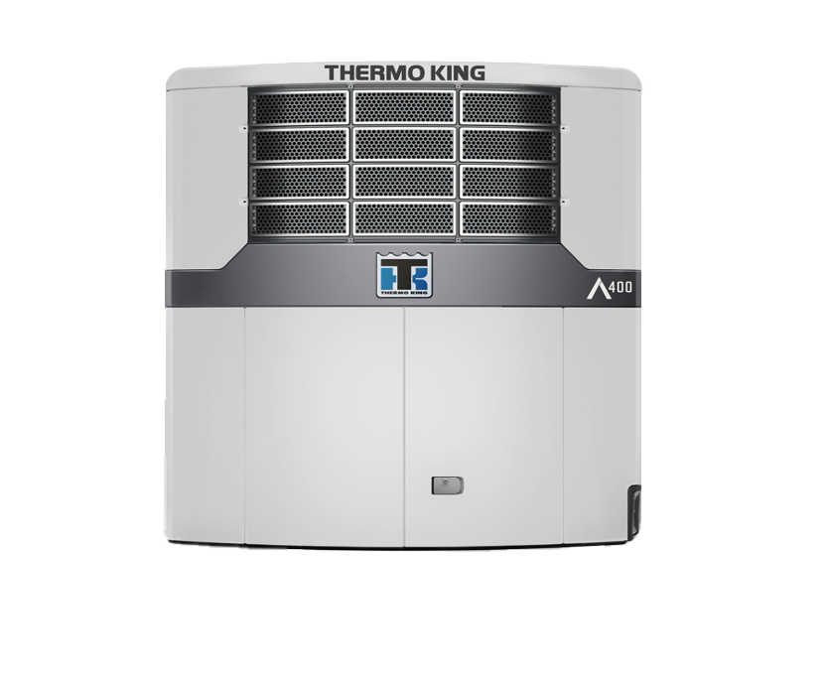
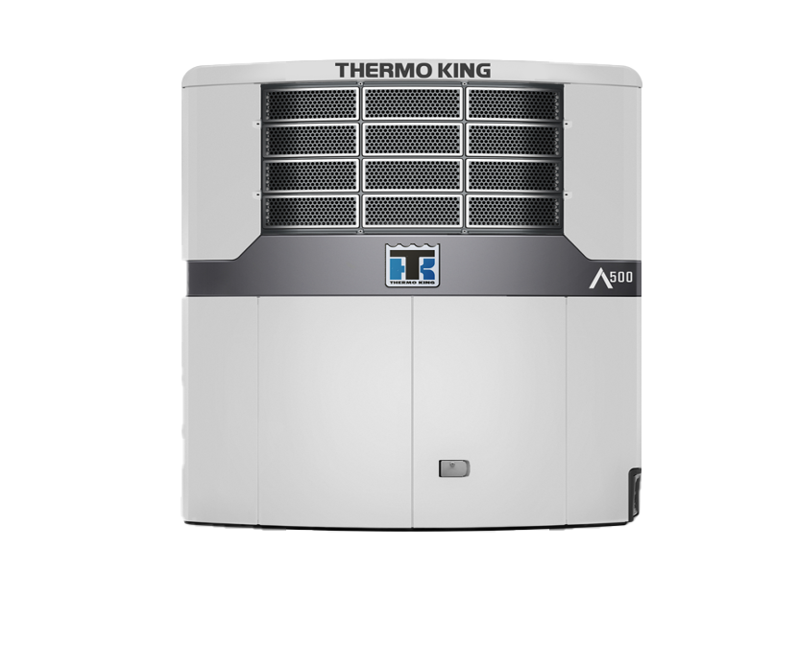

Advancer Spectrum – Unit Offering
New Remote Evaps for Advancer
S3A & S6A
2 Multi-Temp Offerings:
Standard model
Whisper Pro - Piek compliant
A-500 Spectrum
A500 Spectrum Whisper Pro
July 2023

Slide 18
Advancer Spectrum - THE NEW BENCHMARK IN MULTI TEMP TRANSPORT
A-500 Spectrum:
Highest Performance Multi Temp unit
Increased temperature control accuracy
Fastest pulldown
Electronically governed NRMM engine
Up to 30% fuel efficiency over SLXi MT
Fuel consumption monitoring
Quietest standard unit in the Market
Variable airflow (Host Only op)
Specification​ | A-500 Spectrum​
Capacity (W) 0/30C​ | 18,600 W​
Capacity (W) -20/30C​ | 10,000 W​
Electric Capacity 0/30C​ | 15,800 W​
Electric Capacity -20/30C​ | 7,750 W​
Airflow (m3/hr) (HSD) Host​ | 5,300 m³/hr​
Sound Pressure (dB(A))​ | 67 (HSD), 64 (Elec)​
Engine​ | High Efficiency Eco​
Connectivity Package​ | 2-YEAR​
Electric Standby​ | YES​
Variable Airflow (Host Only Op)​ | YES​

Slide 19
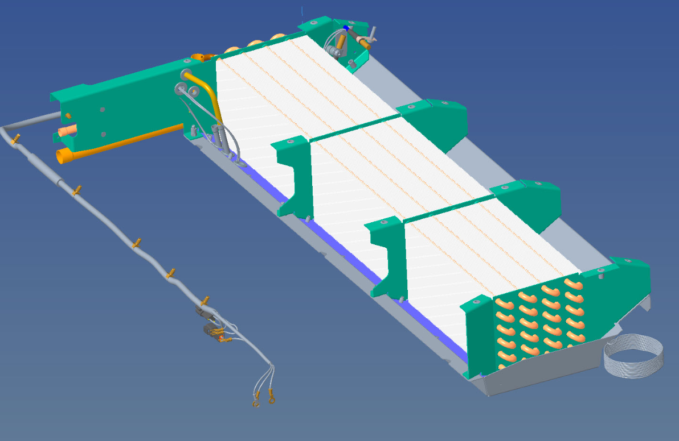
NEW REMOTE EVAPORATORS
New S3A & S6A Remote Evaporators
New 6x8 row coil
Additional capacity when running on diesel and electric
Advancer MT must be fitted with NEW S3A or S6A remote evap in Zone 2
Exclusive to A – 500 Spectrum
Additional Capacity and Efficiency in the Remote Zone

Slide 20
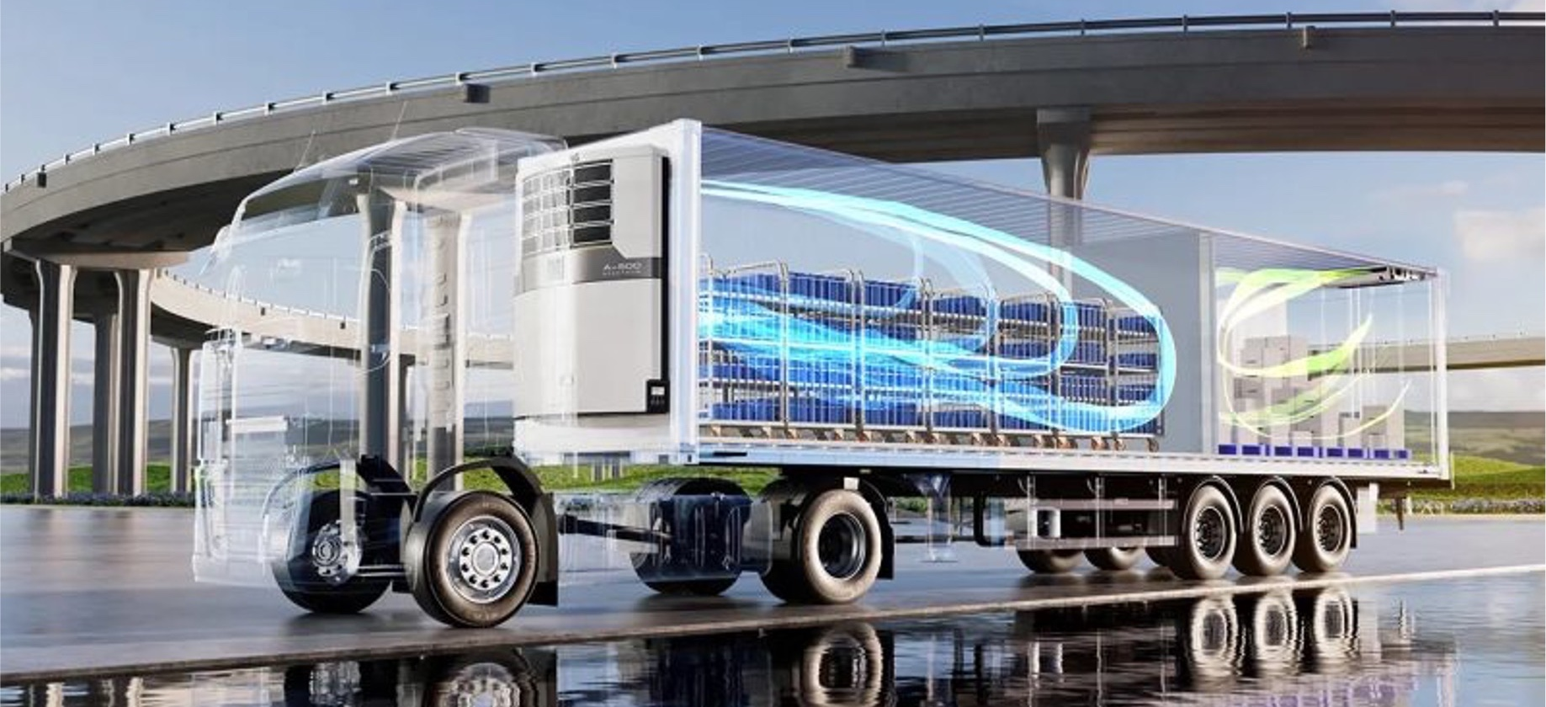
ADVANCER SPECTRUM
Temperature Management

Slide 21
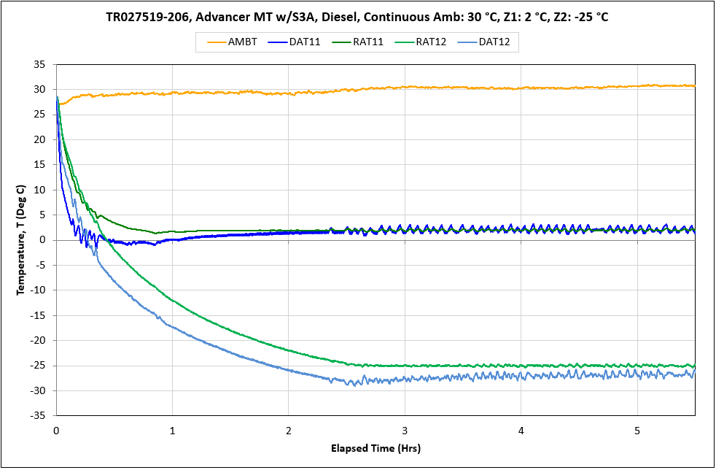
Advancer Spectrum
CONTINUOUS RUN, DUTY CYCLE TEST
Superior Temperature Control for better cargo protection, delivering better quality cargo

Slide 22
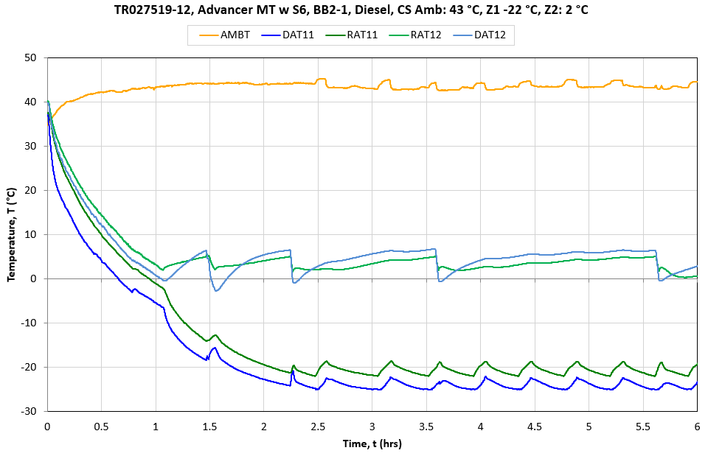
Advancer Spectrum
CYCLE SENTRY DUTY CYCLE TEST
Option to have tighter temperature control or save fuel for less sensitive product – but still in total control

Slide 23
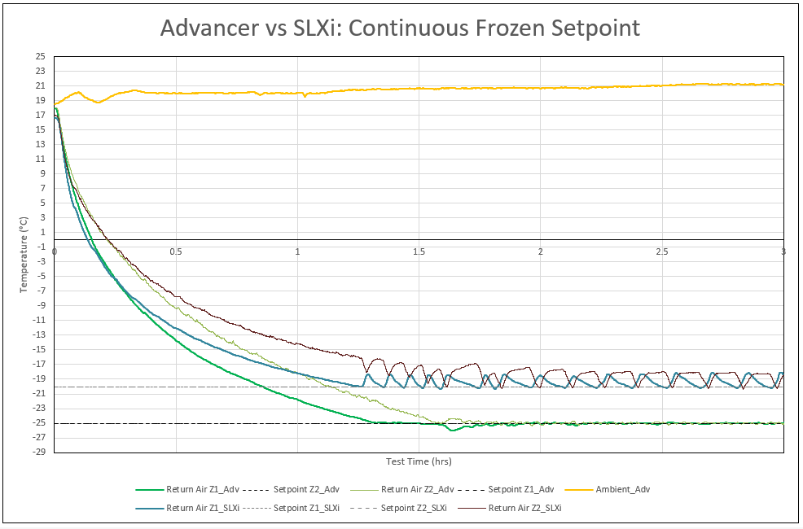
Advancer Spectrum
CONTINUOUS RUN VS SLXI SPECTRUM
Get to setpoint quicker to protect the load and save fuel

Slide 24
Advancer Spectrum
CONTINUOUS RUN VS SLXI SPECTRUM
Time to – 20ºC
30 mins less
Get to setpoint quicker to protect the load and save fuel
Precision of Temp control

Slide 25
Advancer Spectrum
UNIT EFFICIENCY
Individual Evaporator Capacity, Diesel Operation
Advancer Spectrum Evaporator efficiency vs. SLX Spectrum

Slide 26
Advancer Spectrum
UNIT EFFICIENCY
Individual Evaporator Capacity, Electric
Higher COP across all evaporators on electric

Slide 27
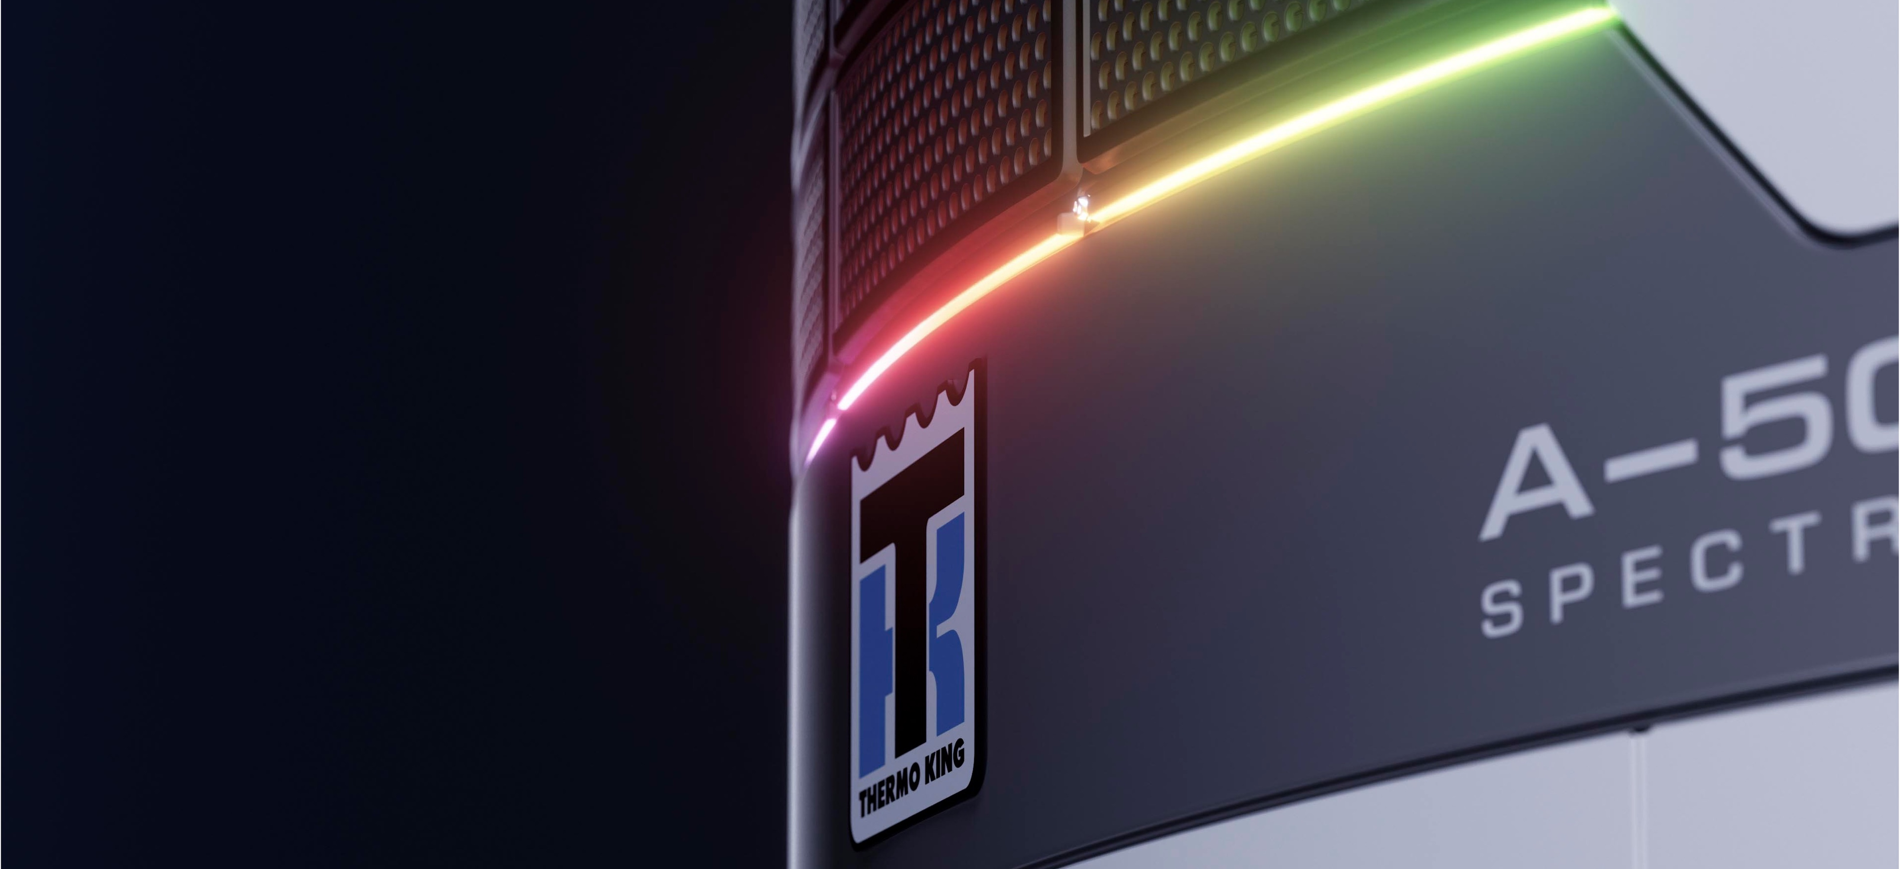
ADVANCER SPECTRUM
A-Series Controller

Slide 28
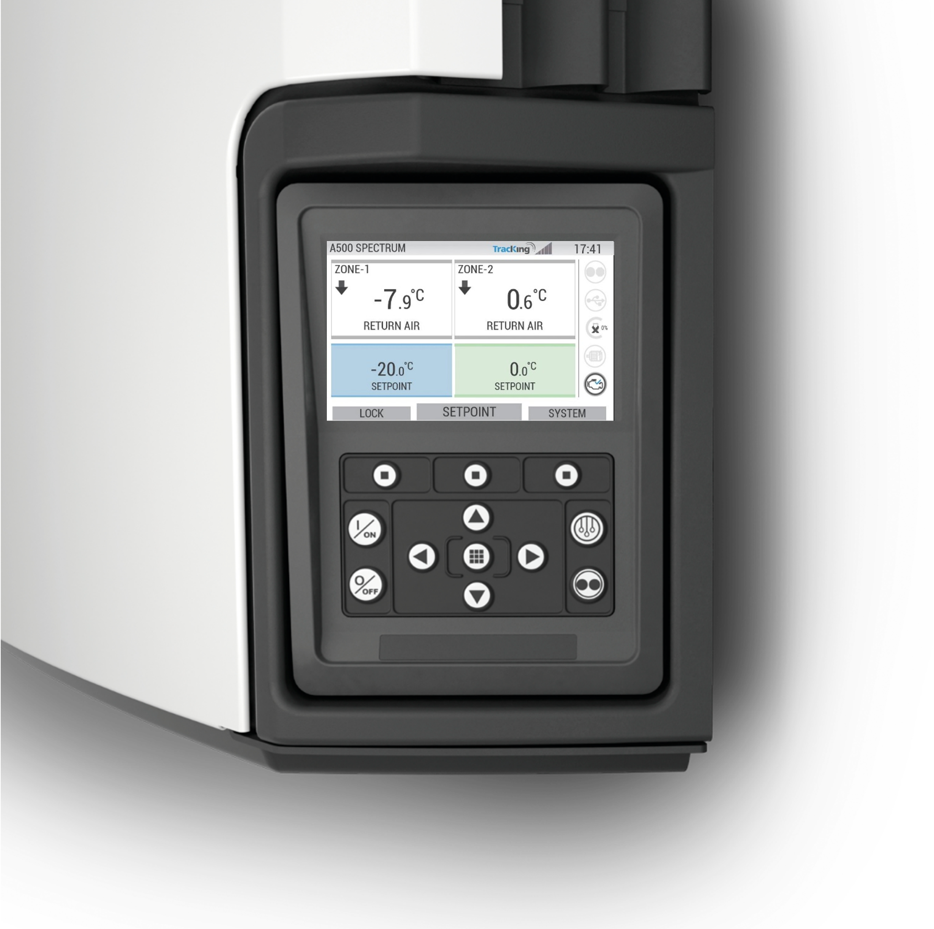

Advancer Spectrum
THE NEW A-SERIES CONTROLLER
Intelligence: All New A-Series Multi-Temp Controller
Driver-friendly interface
Large high-resolution
color screen
Rugged design, can withstand
any environment
Support for 23 languages

Slide 29
THE NEW A-SERIES SPECTRUM CONTROLLER
Full visibility of average fuel consumption rate (l/HR)
Fuel Efficiency
  For enhanced total
  life cost management.
Customer Choice​
  Customer can choose between:​
    Fuel Efficiency and​
    Pull down Speed ​

Slide 30
Advancer Spectrum
CONTROLLER & CONNECTIVITY: VALUE PROPOSITIONS
A-500 Spectrum Controller:
As a result, our customers benefit from:
Driver-friendly interface
Rugged design to withstand any environment
Fuel & cargo monitoring
Optimized functionalities (2022-2023)
Advanced temperature control
Intelligence & adaptability
Connectivity & TracKing
23 languages
Reduced TCO
Increased Uptime
Reduction of driver error
Greater Peace of Mind!

Slide 31
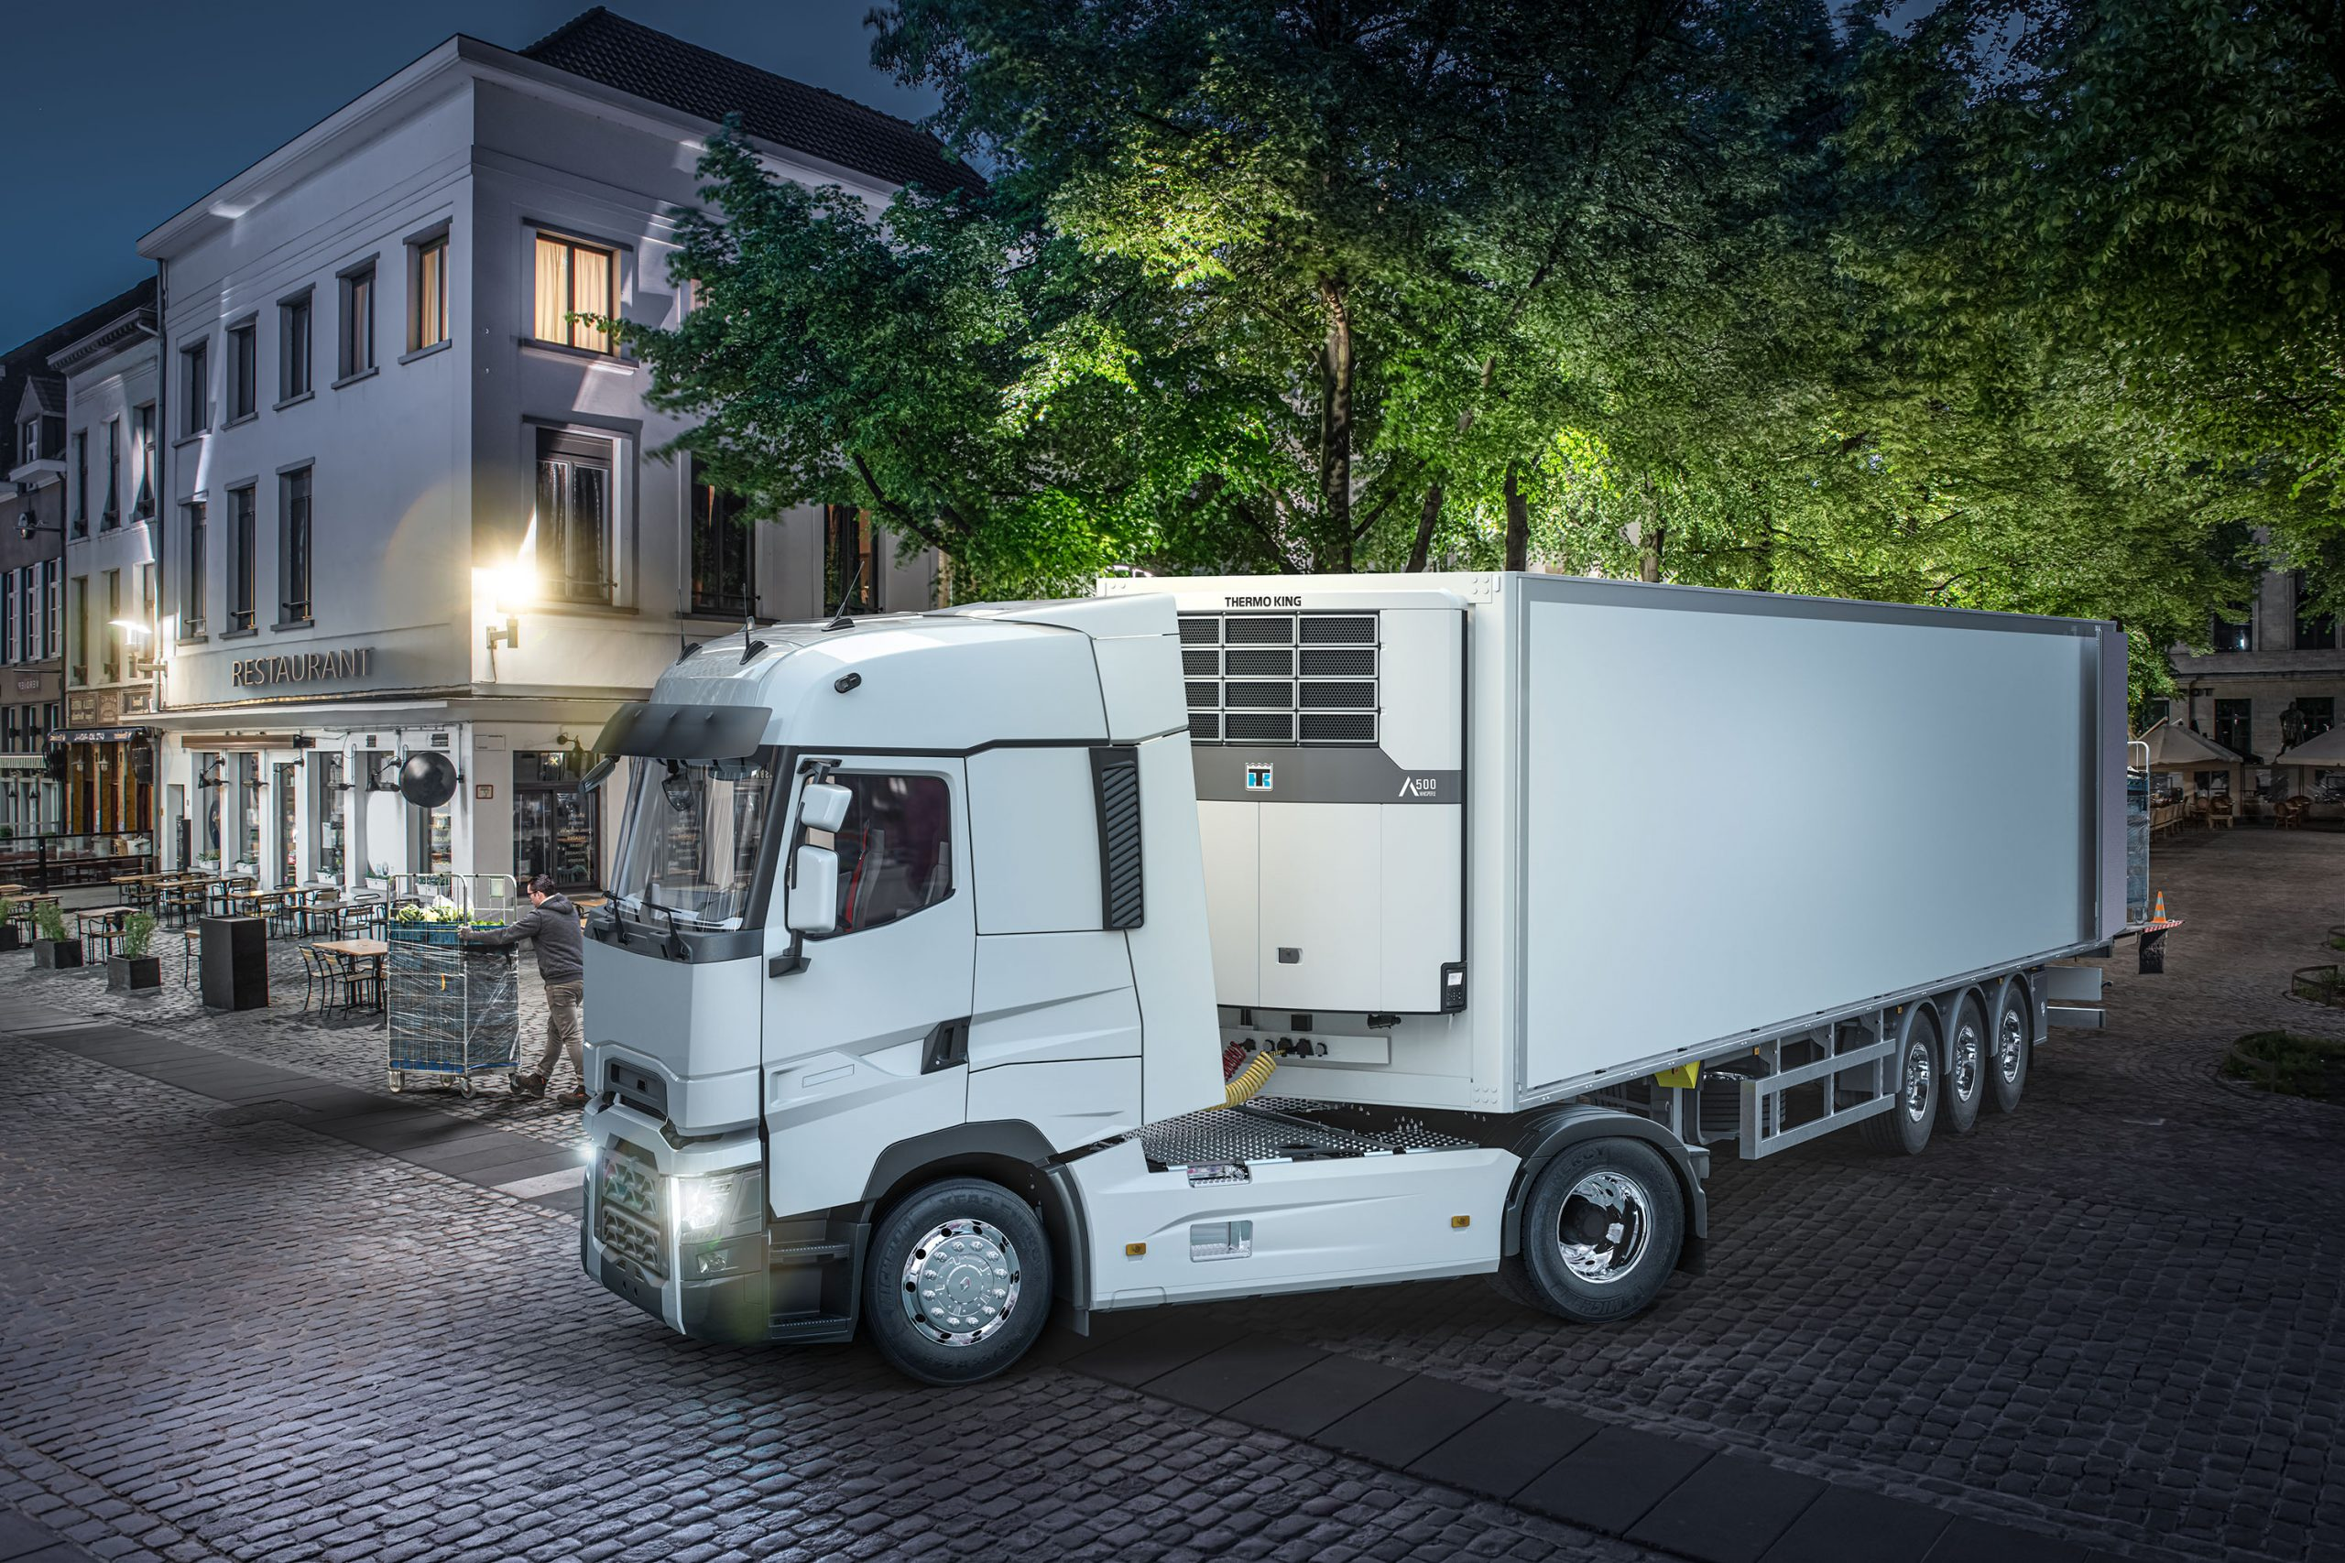
Advancer Sustainability
CO2 Emissions, Noise

Slide 32

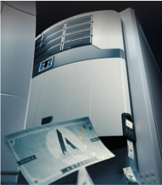
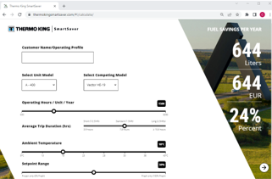
Advancer Spectrum -SUSTAINABILITY
Helping our customers meet their sustainability goals
Significant EMISSION REDUCTION
  Lower fuel consumption
  Carbon-neutral production process
Low Noise Operation – Designed into unit as standard
Low GWP Refrigerant Gas, R-452A

Slide 33
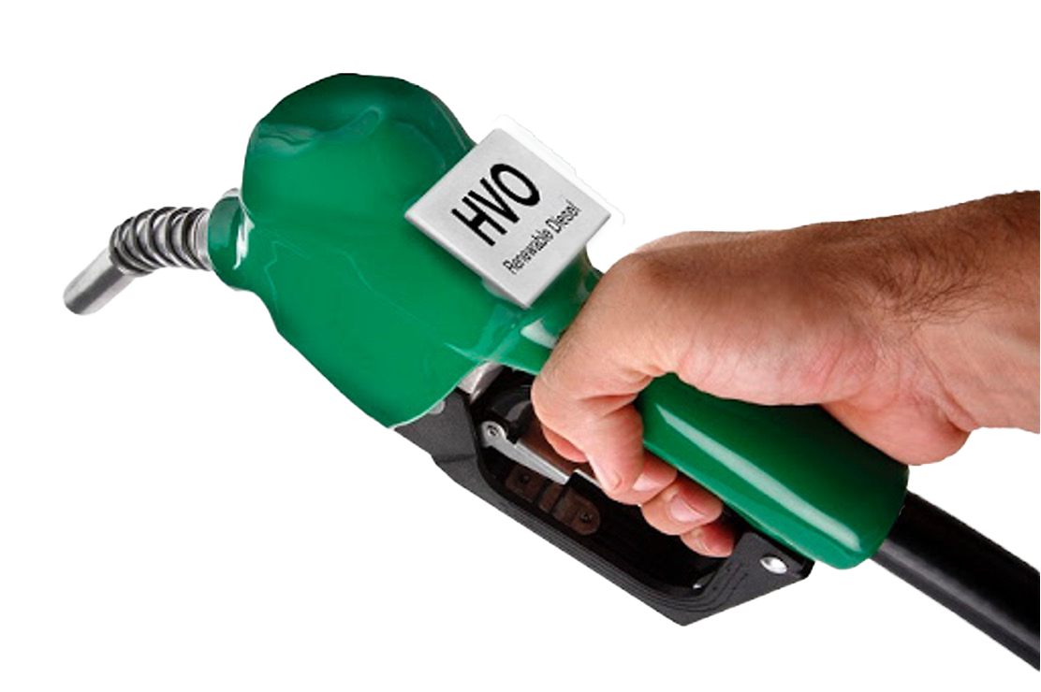
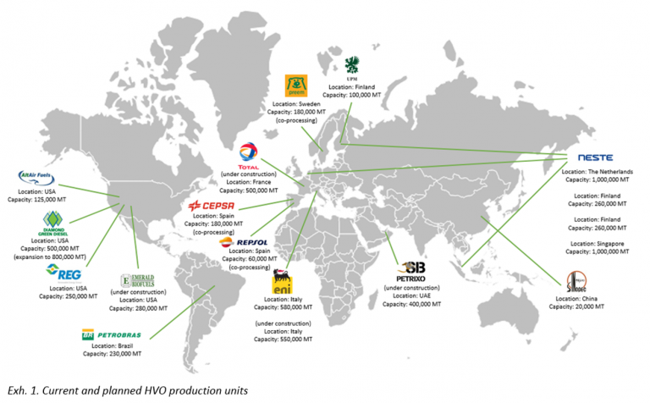
HVO COMPATIBLE & APPROVED
HVO = Hydrotreated Vegetable Oil is a low-carbon biofuel
Fully approved for use on Advancer ST and MT
90% reduction in CO2
No change in unit operation or maintenance
Approved by Truck OEMS
Biodegradable
Meets EN15940 standard for paraffinic fuels and Fuel Quality Directive 2009/30/EC
No special storage
Excellent cold weather operation
2022

Slide 34

Advancer Spectrum Benefits
Future-Proof & Compliant
Acoustic Performance

Slide 35
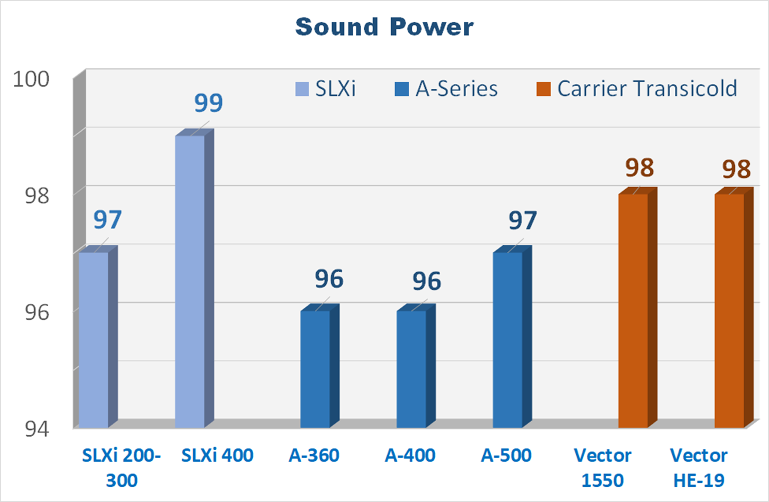
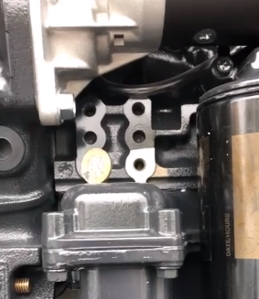

NOISE – ADVANCER THE QUIETEST UNIT ON THE MARKET
Why is Noise so important?
Driver comfort = Keep your drivers happy
Night time deliveries with minimal disruption, including Piek zones
Better more sustainable urban environments
Less complaints from residents to the transporters
Sound Levels lower by
1 to 2 dBA versus Main Competitor models
Significantly less vibration:
have you tried the Advancer coin test!

Slide 36
Advancer Spectrum
NOISE PERFORMANCE - A – 500 SPECTRUM SOUND LEVEL
A-500 Spectrum is the lowest noise standard TRU in the market
Standard Sound Levels
lower by
1dBA versus HE19
3dBA versus SCU MT
Note: Each time you double the power of sound source, the measured sound level is increasing by ~3 dB(A)
-3dB(A)
-1dB(A)

Slide 37
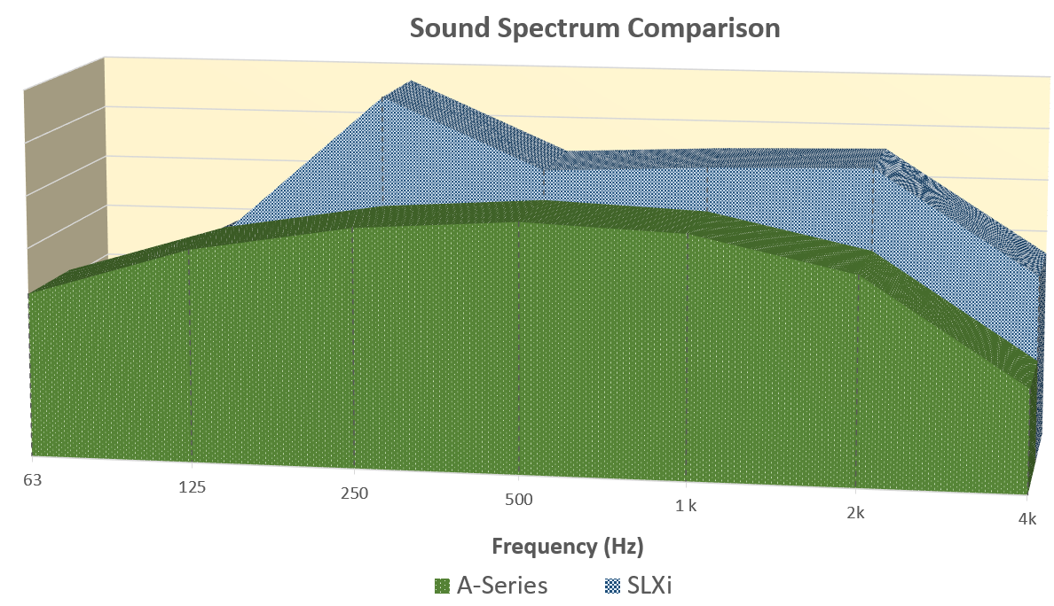
Advancer Spectrum
A – 500 SPECTRUM SOUND PRESSURE
In the overall sound-spectrum, which combines the contribution of the different components (engine, compressor, fans), there is no emergence of 1 single frequency.
The overall sound level will be perceived as less disturbing.
Sound Pressure | HE 19 MT @ 69 dBA
Diesel - High Speed | 67
Diesel - Low Speed | 66
Electric - Std/By | 64

Slide 38
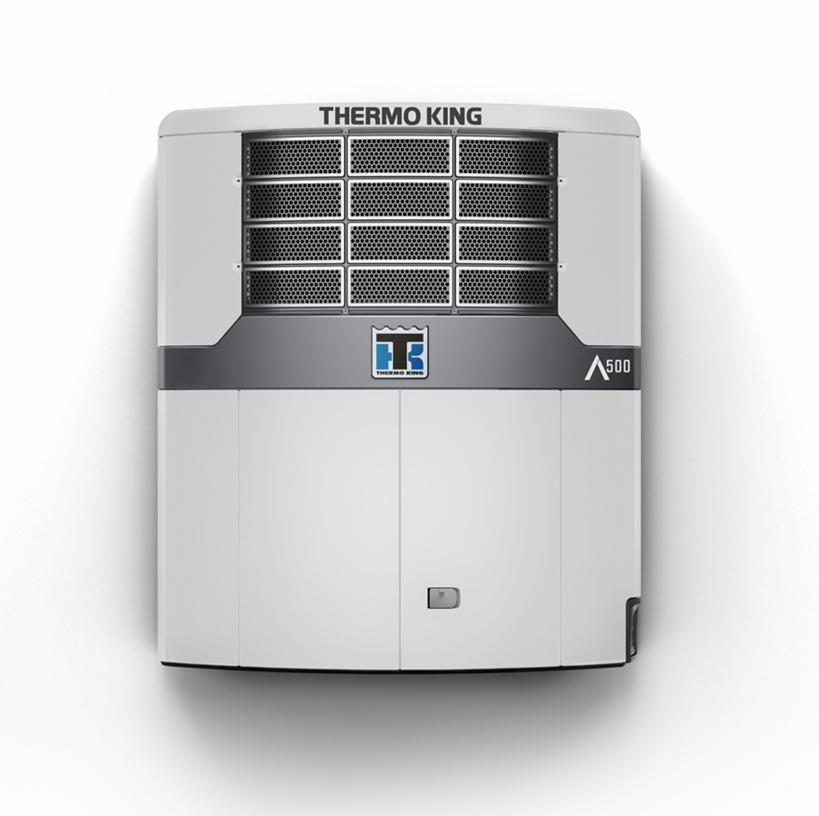


Advancer MT Benefits
July 2023
SUSTAINABILITY
Quietest unit in the market
Low speed Diesel Piek Operation
Electric Standby
Not only for Piek regulated customers

Slide 39
Advancer Spectrum
Service
Services and Solution

Slide 40

What the solution selling means for dealers
Gross profit
A-400
6 years, 9 000 run hours
Unit + TouchLog + Parts & Labour (with Std Warranty)
+19%
Unit + TouchLog + ThermoLite + Connect&SET + Parts & Labour (with Ext Warranty)
+56%
Unit profit
Parts & Services profit
Unit + TouchLog + ThermoLite
+ Connect&SET + Parts & Labour (with ComfortPlus)
Solution Selling secures customer relationship and higher profit to dealers over the lifecycle of the unit
* Gross Profit indication based on Thermo King internal data
Notes:
The solution sale means longer customer retention, higher customer loyalty, higher profit over lifecycle and increased opportunity for repurchase in the future.
Based on our internal data, for a A-400, we estimate 19% increase in dealer profit amount if it is offered with accessories, TracKing subscription and an extended warranty compared to selling only the unit.
If you upsell with a ComfortPlus, the profit you can capture from this unit goes up more than 50% over 6 years vs. unit sale only.
By capturing the customer longer in your reach, you can benefit from more business and deeper relationship with the customer.
Furthermore, such a relationship provides you in-depth knowledge in the customer's operation which will help you to offer more competitive and comprehensive solution which can lead to higher chance to sell the new units next time.
For Unit sales
General profit that the dealer will collect from selling & installing the unit
Profit from TK Parts & fluids from standard warranty jobs and scheduled service during first 2 years
Profit from labour (~30% margin) on associated jobs from above
For the first solution selling scenario
Unit sales profit +
Profit from TK Parts & fluids from standard warranty jobs and extended warranty jobs plus scheduled service during first 2 years
Profit from labour (~30% margin) on associated jobs from above
Profit from defined accessories
Profit from TracKing subscription (RRP-DNP)
For the second solution selling scenario
Unit sales profit +
Profit from TK Parts & fluids from standard warranty jobs and full maintenance & repair jobs plus scheduled service during 6 years
Profit from labour (~30% margin) on associated jobs from above
Profit from defined accessories
Profit from TracKing subscription (RRP-DNP)

Slide 41
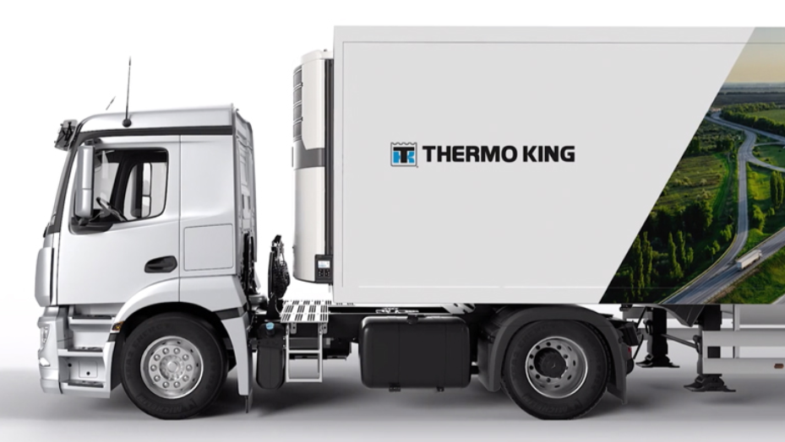
What the solution means for customers
Reduce Driver Dependency
Remote 2-way commands
Improve Uptime
Flash Load Over The Air
24/7 Fleet Monitoring
EBS/TPMS Solutions
Make Operations Leaner
Service Contracts
Connectivity as Standard
Enable Sustainability
PIEK Mode
Fuel Consumption Information
Understanding the customer’s needs is the starting point of Solution Selling
Notes:
Using a solution selling approach, takes us from having multiple sales conversations, one for the unit, one for the accessories, one for telematics and so on to one single sales pitch focused on understanding customers' needs and provide a tailor made solution. The services and solutions which accompany the unit, allows you to stay in front of the customer with a full package which boosts the value we are providing and the needs we can fullfill. While A-Series in isolation can fulfill key needs and significantly improve customers' operations, when sold as a part of a solution, it goes beyond unit performance and touches multiple pain points such as uptime or sustainability.

Slide 42
Thermo King uptime & fleet efficiency solutions
Connectivity as Standard
All Advancer units come with full connectivity for the first 2 years
ComfortPlus
An all-in-one solution especially for international long-haul customers; whenever, wherever
24/7 Fleet Monitoring
Thermo King experts monitor, respond and resolve whenever there is a problem with the unit
Extended Warranty
Peace of mind, seamlessly extends the standard factory warranty for up to five years
Trailer Assist Premium
EBS/TPMS solutions enable both an increase of the trailer uptime and the efficiency of your fleet
Thermo King offers various uptime & fleet efficiency solutions to serve the customer’s needs
Notes:
Let's zoom in and understand better some of the solutions we provide via aftermarket. We all know that uptime and fleet efficiency are vital for our customers and many times the buying decision is driven by these two variable. What if when selling an A-Series you do not focus only on the unit, but you direct the customer towards uptime and efficiency and use these two as USP. For example Comfort Plus or 24/7 monitoring directly impact the uptime of your customers, hence the value these can bring is significant. We are one of the few OEMs that provide the service of monitoring. Moreover, all A-Series come with connectivity as standard, customers can take full advantage of the benefits associated with telematics. Customers can go beyond monitoring TRU data, they can also have access to EBS information, and very soon to an improved version of it. All these can work as very solid arugments when your customers will evaluate Thermo King offer vs competition. Is key to go beyond the unit and use the other services and solutions that we have available to increase the likelihood of landing a sales. Moreover, as mentioned at the beginning, adopting a solution sell approach will allow you to gain revenue throughout the lifetime of the unit, rather than a one off payment. What we see on the slide is only one example, definately you can create your own bundle using both EMEA and local services.

Slide 43
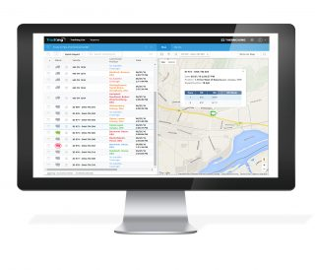
Advancer Spectrum
A-SERIES CONNECTIVITY AS STANDARD
A-Series units come with 2-years FULL connectivity
(hardware + subscription)
>80% of A-Series units get activated by customers
>78% contracts renewed to paying contracts at the end of the 2 years
Available MARCOM to further promote this package to your customers:
HTML email to inform customers about the package - HERE
Recommended on boarding process to increase the renewal chances - HERE
A-Series MT comes with a new feature: REMOTE ON/OFF at zone level
A detailed hot sheet can be found here
Notes:
As mentioned earlier all A-Series come with full connectivity for the first 2 years.

Slide 44
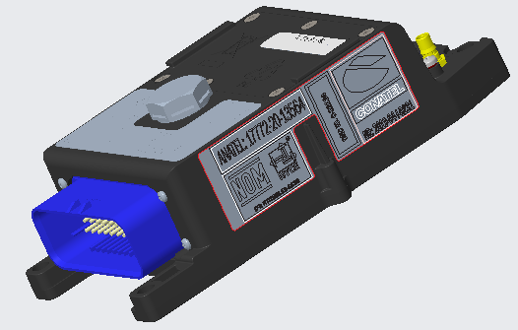
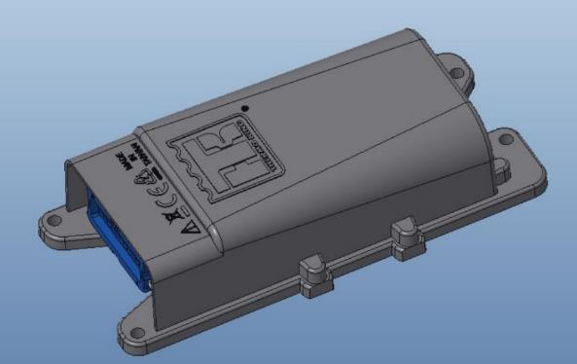
A-500 spectrum connectivity
BLUEBOX2 TELEMATICS: 2 YEARS CONNECTIVITY AS STANDARD
BlueBox1
BlueBox2
External Antenna
Located inside Reefer
Separate Antenna Harness
USB Diagnostics
Signal LEDs
4G – Future Proof
Internal Antenna
Located on top of Unit
No USB connection/antenna harness
Diagnostics over Bluetooth
No signal LEDs
BlueBox2 Location
Existing BlueBox Location
Notes:
As a novelty, the existing telematics hardware has been replaced last September with a new one. One key driver was the 2G/3G phase out which is scheduled for 31st December 2025.

Slide 45



A-500 Spectrum Connectivity
TELEMATICS FITTED AS STANDARD ON MT UNITS
Monitoring & Operation of Zones
  On/Off at zone level NEW
  Setpoint
  Return Air
  Discharge Air
  Zone doors configuration / monitoring
  Fuel consumption
Alarm Notifications per Zone
  Out of Range Alarms
  Door Alarms
iBox Support

Slide 46
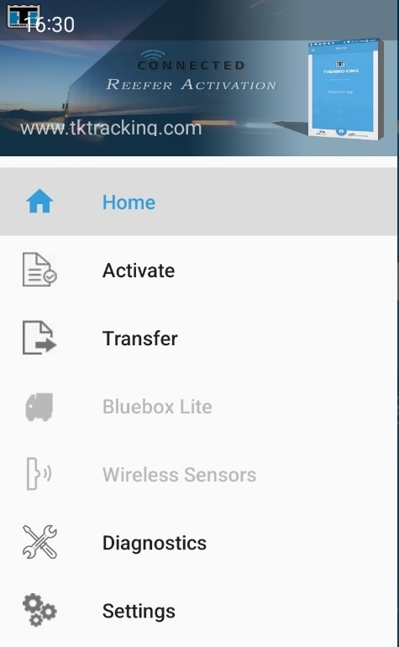
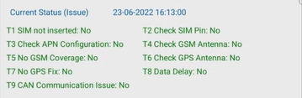
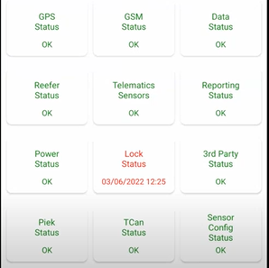


A-500 Spectrum Connectivity
Available on TK Technician
Only available for BlueBox 2
Via Bluetooth connection on Android only
Gives the Current status from T1 to T9 and the main information on BlueBox 2
For more details, please refer to Bulletin CS-013
Watch the How-to video – available on the Connectivity Toolbox – more languages coming soon
Notes:
You might have seen on the previous slide that the new telematics device doesn't have an USB port. Hence, the team developed inside TK Technician a new diagnostic module. While dependent on BT connectivity and the availability of a mobile phone, using mobile diagnostics comes with the advantage of diagnose on the spot, no need to carry a laptop or have the vehicle brought in the workshop where there is a laptop; TK Technical is a great tool for both technicians located on a workshop but also for mobile technicians. Also, because of the BB2 mounting position, TK Technician proves the right solution for proper diagnose.

Slide 47
Increase Fleet Efficiency
TRAILER ASSIST PREMIUM
Trailer Assist Premium is a TracKing feature that collects and presents a range of insights
related to a trailer’s EBS/TPMS and operational condition;
Extend the life-span of your tyres via direct access to tyre pressure data and alarms
Optimize fuel cost management by actively monitoring tyre pressure
Optimize transportation routes by analyzing weight information
Optimize logistic flow and avoid wrong trailer pickup
Optimize maintenance schedules by monitoring actual mileage
Notes:
When presenting you how an uptime & fleet efficiency bundle could look like, I was mentioning you about Trailer Assist Premium. Trailer Assist Premium is a TracKing feature that collects and presents a range of insights related to a trailer’s EBS/TPMS and operational condition;

Slide 48

Monitoring, Responding and Resolving
Improve Uptime and Cargo Protection with
24/7 Monitoring
TracKing Connected Solutions
Thermo King Experts
Thermo King Network
24/7 Fleet Monitoring
IMPROVED UPTIME AND CARGO PROTECTION
Notes:
When it comes to uptime solutions, 24/7 monitoring for sure leads the way. Thermo King experts are monitoring units on customers' behalf and make sure they react promptly when an excursion emerges. Thermo King experts are diagnosing the issue and propose the more efficient course of actions, they either contact the dealer/customer or remotely, via 2-way try to solve the issue. This is a great way to promote uptime and cargo protection and to differentiate the A-Series for all the other competitive models in the market.
If you wonder how 24/7 service is performed, here are the steps:
•24/7 real-time monitoring; enabled by TracKing, performed by Thermo King experts
•Remote diagnosis & analysis by Thermo King
experts
•Remote problem resolution via TracKing two-way communication
•Diagnosis information and arrangement of a technician intervention if needed
•On-time corrective actions by Thermo King dealer technicians
•Weekly fleet report and access to the TracKing website for all data records

Slide 49
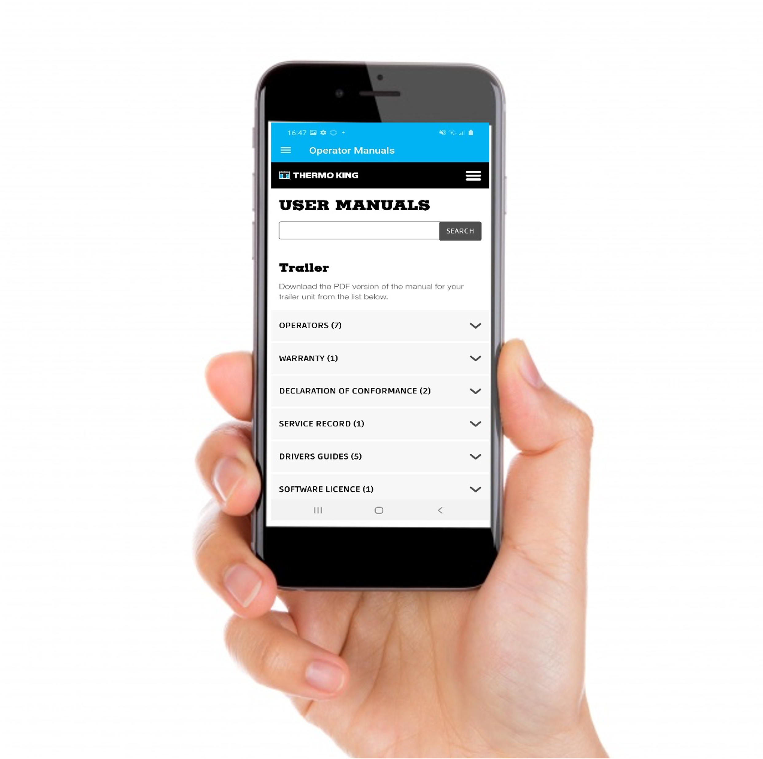
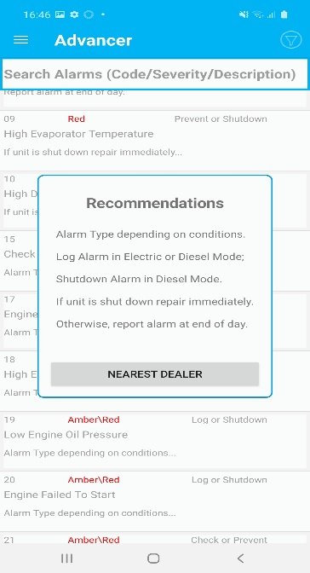
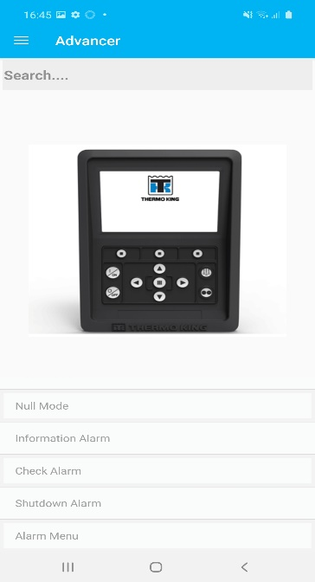
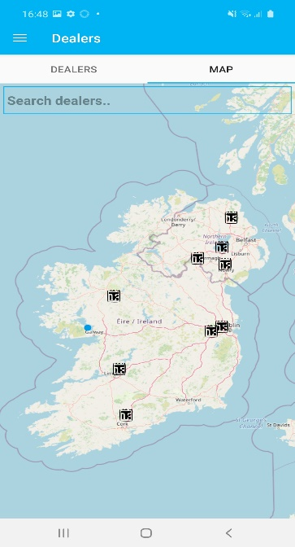
The New A-Series Spectrum Controller
CONNECTIVITY: NEW DRIVER APP
Easy access to learning
Genuine App (Available for Android and IOS)
List of alarms
Dealer Locator
Operator manuals at your fingertips
Interactive guide on how to use the interface
Notes:
49

Slide 50
Advancer Spectrum Benefits
Future-Proof & Compliant
Servicing Contracts - TKTK

Slide 51

Advancer Spectrum
THERMOKARE SERVICE AGREEMENTS
Customer can decide what’s best for Customer’s business
Choose between ComfortPlus, MaintenancePlus, PharmaAssist & AdminPlus then further customize depending on the customer’s specific needs
ComfortPlus: Full range of services with a package that covers all the costs of parts and service, scheduled or unscheduled, national or international.
MaintenancePlus: MaintenancePlus provides a cost-effective service to fully cover scheduled maintenance.
PharmaAssist: All the benefits of scheduled maintenance and full coverage in case of breakdown. Pharma-prioritised assistance and GDP renewal.
AdminPlus: Centralised invoicing for ad hoc repair
* Available unit upgrades may vary depending on selected unit
** TracKing subscription and 24/7 Fleet Monitoring require relevant
Thermo King Connected Solutions installed
Notes:
A-Series units come with a full suit of TKTK contracts. ThermoKare Service Agreements provide everything from basic maintenance to a full-on package of support, that can
be completely tailored to the customer’s needs.
•Uptime & peace of mind: We apply our expertise in keeping customer’s unit performing at its optimum.
•Fleet management & administration: We take on customer’s non-core tasks, allowing the customer to focus on their business.
Pharma solutions: Inspections & services adjusted to meet GDP guidelines, with prioritised treatment & follow-up

Slide 52
Advancer Spectrum
Services
All ThermoKare services are available for Advancer Spectrum
ThermoKare Service Agreements
  ComfortPlus
  MaintenancePlus
  PharmaAssist
ThermoKare Dealer Service Solutions
  AssistancePlus
  WarrantyPlus
  ProtectionPlus
ThermoKare 24/7 Fleet Monitoring
Premier+ in following countries
Germany, Austria, Poland, Netherlands, Italy

Slide 53
Advancer Spectrum
Options and Accessories

Slide 54
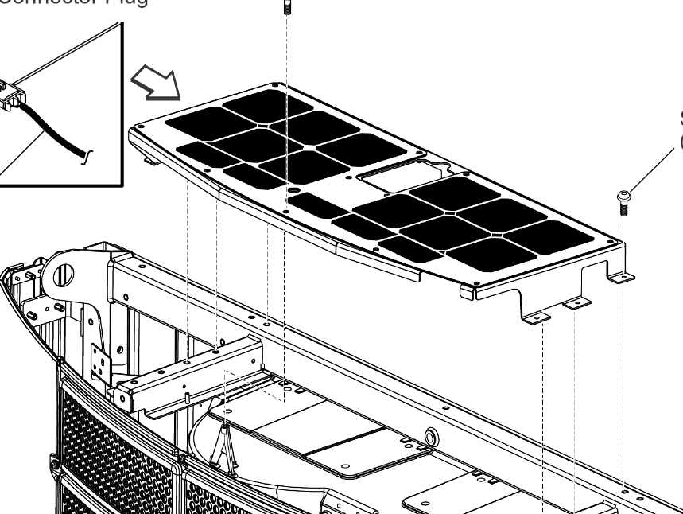
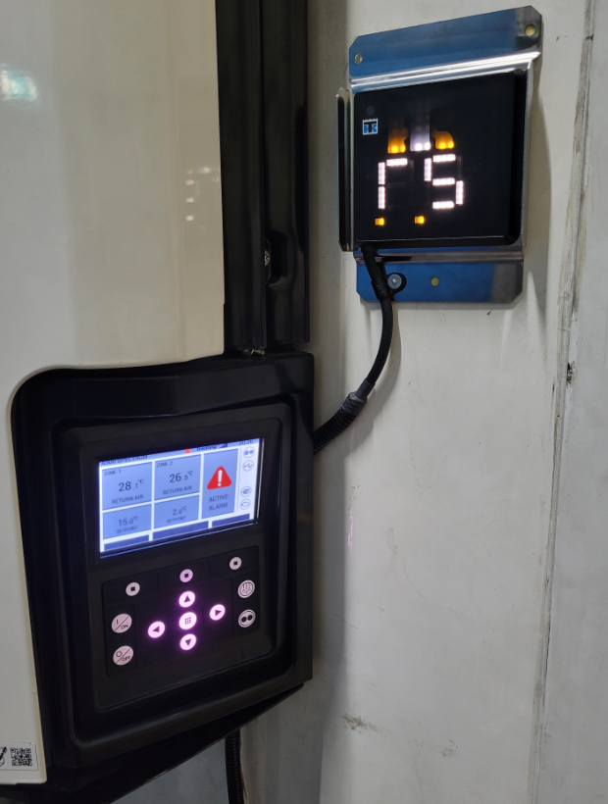
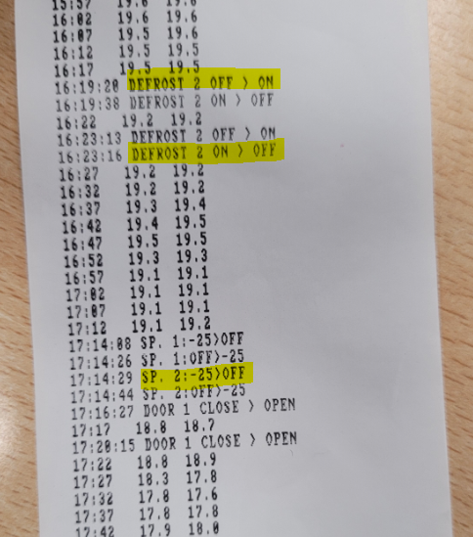
Advancer Spectrum - AFTERMARKET ACCESSORIES
Factory Fit Accessories
Solar Panel 50W
Triple Combo Display
I-BOX harness for 3rd party telematics
Other Accessories - No change from ST
Door Switch
Fuel Level sensor
Fuel Pump
Fuel Filter Heater
Air Straightener
Service Tools
New compressor support tool sample validated
New MT Simulator design in progress
Other tools same as ST
Aftermarket Options
Solar Panel Kits
Door Switch
TouchLog
Fuel Filter
Fuel Tank
Status Light
Rear Remote HMI
Snow Kit
Snow Cover
Air Straightener
Logger Sensors
Aftermarket Options - Post-Launch
I-BOX harness for 3rd party telematics
Wireless Sensors
Drop Down HMI
Zone 2 RA temp on Triple combo Display
TouchLog Ticket with zone 2 events

Slide 55
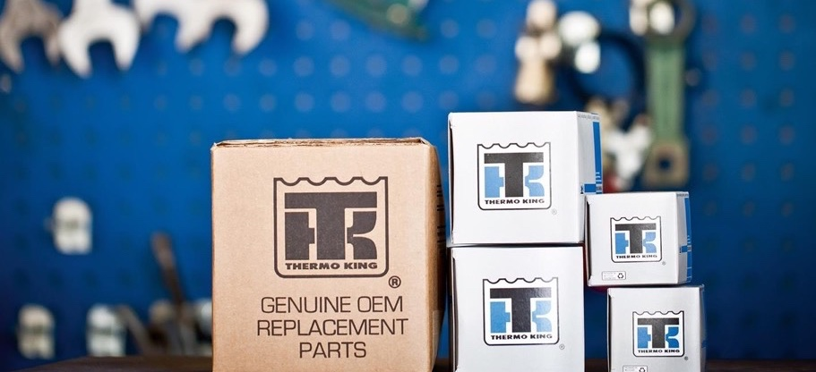
AFTERMARKET
Upgrades for More Uptime

Slide 56


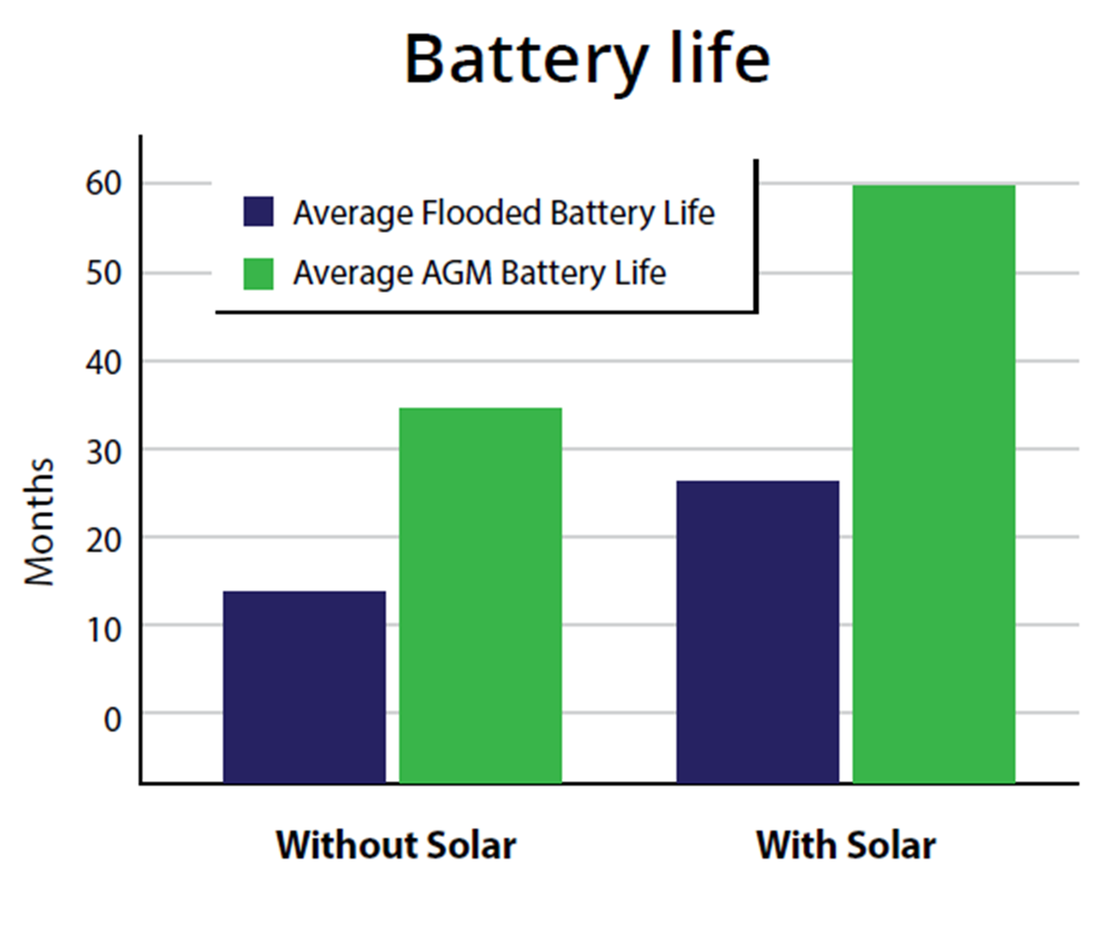
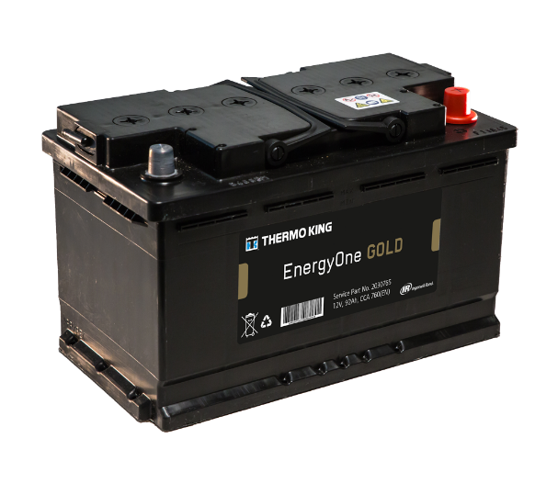


Battery Lifetime Optimization With Solar Power
SOLAR POWER BENEFITS
Extended battery life and savings
Reduced callouts
Reduced downtime and lost productivity
Reduced engine run-time and hence fuel savings
Maintenance cost savings for fleets
Environmental benefits: reduced CO2, reduced lead usage, and improved environmental credentials
  When charged with TK Solar Solutions,
  lead-acid battery life can double,
  and AGM batteries can last over 7 years.
  Every litre of fuel saved = reduction of 2.7 Kg of CO2.
  Every battery that is saved = 10-20 Kg lead saved.
  On a typical fleet, a 5% reduction in CO2 emissions can be achieved.

Slide 57
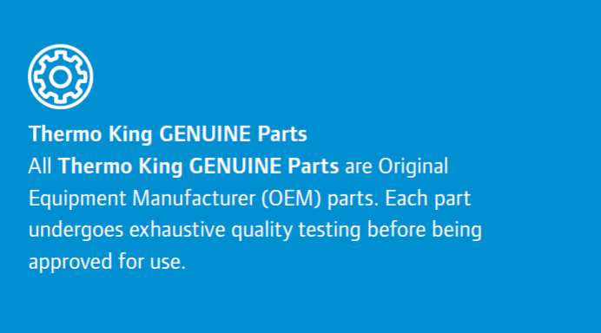
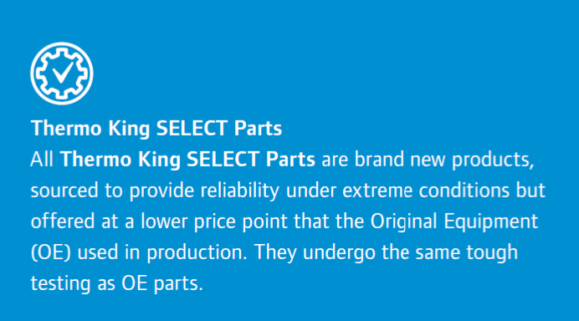
Two Brands
TAILORED TO CUSTOMER NEEDS
Thermo King GENUINE Parts
Thermo King Select Parts

Slide 58


Two Brands
TAILORED TO CUSTOMER NEEDS
Thermo King GENUINE Parts
For Trailer & Truck
Compatible with Advancer
Small Panels

Slide 59


Two Brands
TAILORED TO CUSTOMER NEEDS
Thermo King Select Parts
Side installation possible
Also available as an extension
Large Panels

Slide 60



Marketing Tools
Solar Panels Brochure:
Integration of Advancer panels and TK Select parts solar panels
Available on TK Europe Download Center and InfoCentral
Translated in 7 languages
LMS Solar Solutions Training
All sales tools and explanation on solar technology in one course
Solar Solutions Presentation
Summarizes all solar benefits
Includes customer success stories
Solar Savings Tool
Includes Advancer calculation
Determines optimum solar solution
Calculates payback period, annual savings, and CO2 reduction for the proposed solar solution.

Slide 61


ECS European Containers Ltd
ECS, based in the port of Zeebrugge, Belgium, is a leading provider of integrated supply chain logistics and intermodal transport solutions. ECS specialize in transport from UK and Ireland to mainland Europe.
Customer Needs
Fuel savings and CO2 emission reduction. ECS were not convinced by TK solar solution.
Customer Trial
Installed free-of-charge 4 x 110W and 2 x 40W panels on customer trailers. Monitored fuel savings via TracKing telematics for a 2-year period.
Trial Outcome
Trial units fitted with Thermolite panels showed fuel savings of 1000 litres per year, clearly demonstrating fuel savings and corresponding reduction in CO2 emissions.
Result
76 solar panels were sold.
Planning to retrofit 50 A-series with 50W solar panels in 2022.

Slide 62

Advancer Spectrum
INTEGRATED SOLAR PANEL
Protect your battery - Restart unit at any time
50W, 25% more power than SLXi
Charge level LEDs
Factory delivered option:
no install required from Dealer
Additional 40W or 100W trailer roof mounted panels can also be connected if required
Also available as aftermarket option

Slide 63

HEAD-TO-HEAD TEST
ADVANCER SPECTRUM

Slide 64

Advancer Spectrum
ADVANCER SPECTRUM VS SLXI SP VS HE 19MT

Slide 65
Advancer Vs. SLXi Spectrum
HEAD TO HEAD
Carried out with the same default unit settings
Advancer Spectrum, SLXi Spectrum, HE19
Data from Unit and Independent Data Loggers
Clear Fuel saving vs SLXi
Clear temperature management performance improvement
Fuel consumption appears similar compared to HE19, but…..

Slide 66

Advancer Vs. SLXi Spectrum – Diesel Operation
Advancer fuel saving = 1.21 litres
% Saving for Advancer = 25.51 %
3 °C Frozen CS Restart for both Advancer and SLXi.
Equivalent temperature control.
Advancer less time & fuel to CS Null.
Advancer fuel saving = 0.85 litres

Slide 67

Advancer Vs. SLXi Spectrum – Diesel Operation
Advancer fuel saving = 3.23 litres
% Saving for Advancer = 32.65 %
Default temp. control settings.
Excellent Advancer temp. control
SLXi Heat/Cool temp. control.
Advancer less time to setpoint.
Advancer fuel saving = 1.15 litres

Slide 68

Advancer Vs. Carrier Vector HE 19 MT – Diesel Operation
Similar Fuel consumption with default continuous settings
Advancer less time to setpoint
Default temp. control settings.
Poor Vector temperature control seen

Slide 69

Advancer Vs. Carrier Vector HE 19 MT – Diesel Operation
Poor Vector temp. control.
+3.3 C to -3.3 C from setpoint a
Compressor cycling on/off.
Equivalent to Cycle Sentry control.
Excellent Advancer temp. control.
Return air within 0.2 C of setpoint.
True Continuous temp. control
Advancer less time to setpoint

Slide 70



Head-to-Head
PROVE OUR PERFORMANCE
Defined Standard work in both ST and MT
Available on TK LMS (e-learning + documentation)
TK Service Team trained to support H2H testing
Identify Opportunities to prove Advancer value proposition
Share tests and results

Slide 71


Advancer
HEAD TO HEAD
Fuel Results
Noise power (at the source):
Verbrauch in Liter /h Betriebsstunde Diesel
GT-TR 4082 (Thermo King A-400) | 666hr | 1,44
GT-TR 3132 (Thermo King A-400) | 475hr | 1,53
GT-TR 3082 (Vector HE) | 847hr | 2,30
GT-TR 3081 (Vector HE) | 1,026hr | 2,42
GT-TR 9049 (Vector HE): | 771hr | 2,23
1,49 L/h
2,31 L/h
SLXi300 | 93,5 dbA
Vector | 91 dBA
Schmitz | 90 dBA
A-400 | 88 dBA

Slide 72


Advancer
HEAD TO HEAD
Fuel Results
  A400
    733 Hours
    0.76 Lt/Hr per hour
  Vector HE
    922 Hours
    1.44 Lt/Hr per hour
Easy to use and intuitive
Very Low Noise
Good Service access

Slide 73

Conquest Win - Samworth Brothers
Family-owned food manufacturing business
250 x Carrier units, including 6 x E-Cools
Order placed for 7 x A400, cancelling order with Carrier
How was this achieved?
Conducted a 2-week fuel trial using an A400 v Vector HE
A400 achieved a 51.6% fuel saving against Carrier with average consumption of 1.05 l/h
Visited the Advancer production line in Galway
What’s next?
Potential of 40 x units in Q4
Ongoing discussion, commenced in Galway to be first Axle Power order for UK

Slide 74
Place holder – Head to Head vs SCU d80

Slide 75



Advancer In the Press

Slide 76

Advancer
Sales Tools

Slide 77

Extensive Sales Tools Available - Through Info-central
Dedicated Advancer Toolbox

Slide 78

Extensive Sales Tools Available - Through Info-central
Extensive Sales Tools Availale - Through Info-central​

Slide 79

Extensive Sales Tools Available - Through Info-central
Advancer
Spectrum Toolbox

Slide 80

Advancer Spectrum
MASTERING MULTI TEMP TRANSPORT
REFRIGERATION
Highest Performance Multi Temp unit
Increased temperature control accuracy
Fastest pulldown
Up to 30% fuel efficiency over SLXi MT
Fuel consumption monitoring
Quietest standard unit in the Market
Fully Connected
Notes:
80

Slide 81
THANK YOU

Slide 82
Advancer
Why is it important?
System Efficiency and operational flexibility
48V DC MILD HYBRID ARCHITECTURE
Mechanical belt-driven airflow replaced by a 48V DC electrical architecture:
  48V DC mild hybrid architecture
  Shore power & hybrid ready
  Power agnostic for future sources
Key technologies within this architecture include:
  Motor generator combination machine
  Active Rectifier
  DC/DC converter
  48V DC fans
  Distributed electronics

Slide 83

8V DC MILD HYBRID ARCHITECTURE
Power pack Integrated drive system.
  Single belt 10 PK can handle maximum power
  Quiet and smooth (less noise)
  Single tensioner positioned on power pack
  No relative belt movements, hence better life
Power Pack Mounting
  3 Point mounting system
  Balanced weight distribution
  Reduced vibration

Slide 84


Advancer
VARIABLE AIR FLOW
What is it and Why is it important?
Lets the customer use the airflow they need when they need it

Slide 85


Advancer Spectrum
UNIT DESIGN
New and Modified Components
S3A
Shut-off valves
HGS
Cluster
Tubing Cover
Remote Evap. Tubing
Expansion module
and enclosure
SLHX assembly
X430 - DS
DC-DC Convertor
and Cooling fan
Power Distribution
Motor-gen belt and pulley
Controls
LLS

Slide 86
Advancer MT Benefits
LOWER FUEL CONSUMPTION – MOST EFFICIENT ARCHITECTURE
Minimal Environmental Impact: Fuel & System efficiency
The A-Series architecture with direct drive of the compressor, combined with a state-of-the-art refrigeration architecture, delivers a high overall drive efficiency
Benefit: A-500 SP refrigeration capacity is not compromised due to maximum engine power restrictions. A-500 Spectrum increased capacity vs. SLXi Spectrum.
Customers will see uncompromised pull-down times, better temperature control in both zones with reduced fuel consumption

Slide 87




Advancer Spectrum
THE NEW A-SERIES SPECTRUM CONTROLLER
Logically grouped alarms (info alarms, check alarms, shutdown alarms) will be now visible on the standard HMI display
Temperature displayed in tenths of degrees
Advanced temperature
control
Improved Customer
Uptime
Frozen:
CHECK alarm:

Slide 88

Advancer MT Benefits
Maximise Operational Saving, Minimise Environmental Impact
VS. SLXi Spectrum:
Up to 30% less fuel when running 2 zones
50% of protection hours on MT units are in Single Zone mode
Full Advancer fuel saving per Single Temp
Up

Slide 89

Advancer Spectrum
GREENTECH ENGINE
Engine emissions
Fuel consumption is reduced by 20-30% vs. SLXi Spectrum
CO2 emissions are reduced in the same proportion
GreenTech direct injection engines emissions are 50% lower than maximum allowed NRMM
Market Average*
Reduced
Fuel
Consumption
-25%
Fuel consumption
Environmental
Impact
-50%
Environmental
Impact
Reduced Emission Level
ENGINE EMISSIONS
Max Permissible
Emission Level

Slide 90



Carbon Neutral Production Line
•Thermo King Advancer production certified Carbon Neutral.
•Certified by NSAI (National Standards Authority of Ireland), Irelands official standards body.
•First Production facility to be certified in Ireland, in any industry.
•One of first, in any industry, in Europe.
•Process in place to continue certification of other production and parts facilities in Thermo King and Trane Technologies.

Slide 91

Advancer Spectrum
COMPLIANT FOR TODAY, AND TOMORROW
Compliant with legislation and best practices
NRMM stage V
Pharma GDP
Piek Certified
LEZ and ULEZ (Hybrid, AxlePower)
Low GWP R-452A (F-Gas)

Slide 92
Advancer Spectrum
Service

Slide 93



Advancer Spectrum
SERVICE
Easy access to main components aligned with Advancer Single Temperature architecture
  Expansion module external mounting (HMI viewable operation)
  Host HGS and HGBP, externally mounted for easier access
Additional hand valves
  Eases installation (ship with refrigerant)
  Improves diagnostic and service procedures
  Reduced install time (Host same as Adv ST)
  Reduced charging time (Shipped with charge)
  New installation procedures
Service intervals aligned with Advancer Single Temperature

Slide 94



Advancer Spectrum
LLS
REFRIGERATION VALVES – SOLENOID & SHUT-OFF VALVES
New Host Solenoid valves qualified as part of Advancer Spectrum project
  New higher cycle count LLS
  New higher cycle count HGS
  New solenoid valves will enable Advancer Spectrum to provide tighter temperature Control
New Shut-off valves
  Will facilitate shipping units with R452A for standard single S3A installation
  Will provide added benefit to service procedures for PV and HGS
HGS

Slide 95
Advancer Spectrum
SHIP WITH REFRIGERANT
Differences
  R452A is pre-filled in the Unit leaving the factory.
  The amount is 9.5 Kg vs the current 5.65 Kg (Advancer ST)
  Designed for standard S3A evap at rear of trailer
Benefits
  Reduces need for dealers to purchase refrigerant in the open market (which is open to price fluctuations)
  Charging is very accurate and repeatable in the factory
  Refrigerant tightly controlled for any loss in the factory – minus environmental impact
  Adds service valves to unit which will aid system diagnostic
  Reduces installation time

Slide 96
Advancer Spectrum
OEM Installation

Slide 97







Advancer MT
OEM (SCHMITZ) INSTALLS & APPROVALS
 | Test Install | Approved
 | ✓ | Pending
 | ✓ | ✓
 | ✓ | ✓
 | ✓ | ✓

Slide 98



Advancer MT
AFTERMARKET ACCESSORIES – COMPONENT LAYOUT/CONNECTION
Solar panel 50w
Rear Remote HMI Connector
Solar Harness
Door Switch connection Tails
Combo Display Flush Mount
Combo Display EU
ASSY Charge Controller (Solar)
Harness TouchLog A-series

Slide 99

Extensive Sales Tools Available - Through Info-central
Dedicated Advancer Toolbox

Slide 100
Extensive Sales Tools Available - Through Info-central
Extensive Sales Tools Availale - Through Info-central​

Slide 101

Extensive Sales Tools Available - Through Info-central

Slide 102


Smart Saver

Slide 103


Advancer Hotsheets

Slide 104


Salesforce - Visual Configurator

Slide 105

Visual Configurator - Salesforce

Slide 106

Visual configurator

Slide 107
No Matter What Advancer You Select
Exceptional Performance
Unrivalled Uptime
Lower Total Cost of Ownership
Future Proof Intelligence
Sustainable Innovation

