Slide 1

WELCOME
DEALER SALES SCHOOL 2023
VILLAMOURA ALGARVE
25 –26 APRIL 2023

Slide 2
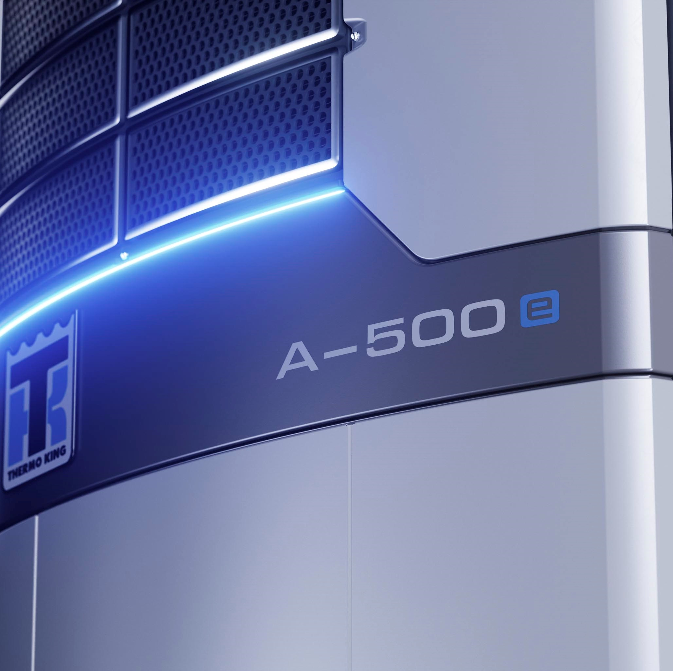
Electric trailer
Agenda

Slide 3
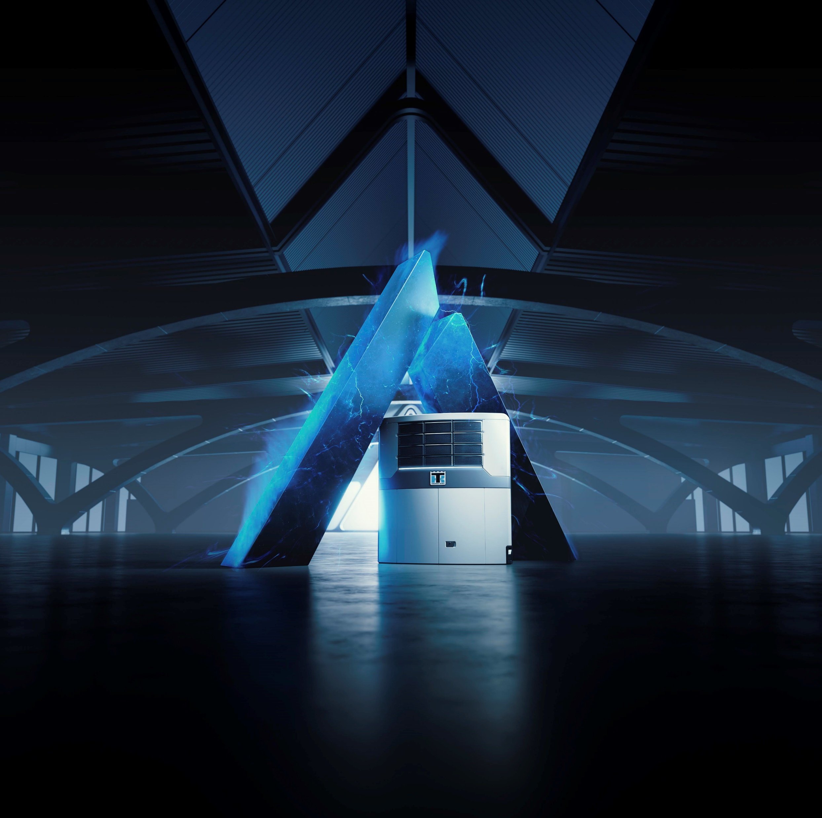
Agenda
Electric Trailer Introduction
Power solutions
Electric TRUs
Practical Information
Sales Tools Available

Slide 4

Electric Trailer Introduction
What is an Electric Refrigerated Trailer?
Why Electrification?
  Current and Pending Legislation
    EU
    Market Trends
    Local
  Market Trends
Customer Concerns and Needs
Thermo King Electric Trailer Options

Slide 5

What is an Electric Refrigerated Trailer?
Trailer with TRU that can operate electric while on the move
Thermo King commitment to have electric solution in every segment of the EMEA market by end of 2023
We’re already there
And we continue to innovate
Different market drivers including legislation, end user sustainability, sustainable cities, and Thermo King/ Trane Technologies Gigaton Challenge
Thermo King needs to lead and guide our customers during this time of positive change

Slide 6
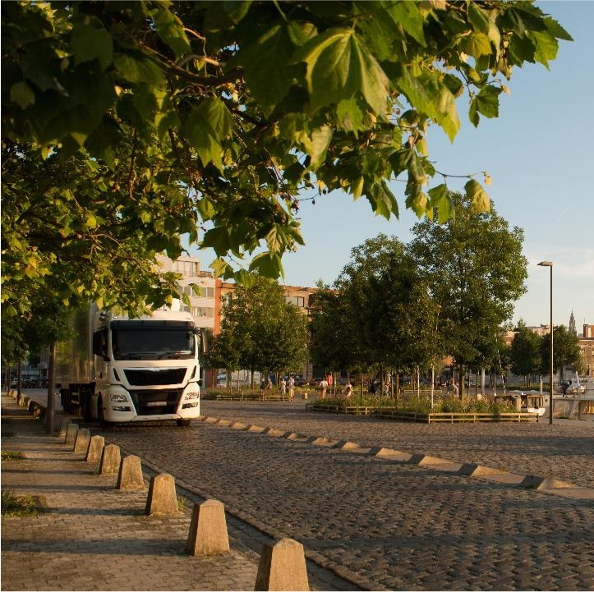
EU Market Trends
Long Term / Pan-European
Fit for 55
  Current EU commission target of 30% GHG reduction by 2030 expected to increase to 55% GHG reduction and be put into legislation
ICE ban
  Ban of sales of Passenger cars
    Ban of sale of new ICE cars from 2035
  Commercial vehicles
    Will follow same directions as passenger cars
    Will oblige Truck Manufacturers to consider alternatives to diesel power trains
    Question: If tractor acquired in 5-10 years from now is no longer powered by diesel engine, what about the TRU drive train?
Notes:
To achieve target of 55% GHG reduction by 2030 the industry will need to:
Improve diesel technology (by 10-15%) of long-haul trucks
Increase share of Battery Electric Truck (BET)/ Fuel Cell Electric trucks (FCET)
Around 50-60% of all new HDV (Heavy duty vehicles) sales being zero emission vehicles

Slide 7
Local Legislation (PLACEHOLDER)
Trainer to include bans/ restrictions which are relevant to their region

Slide 8
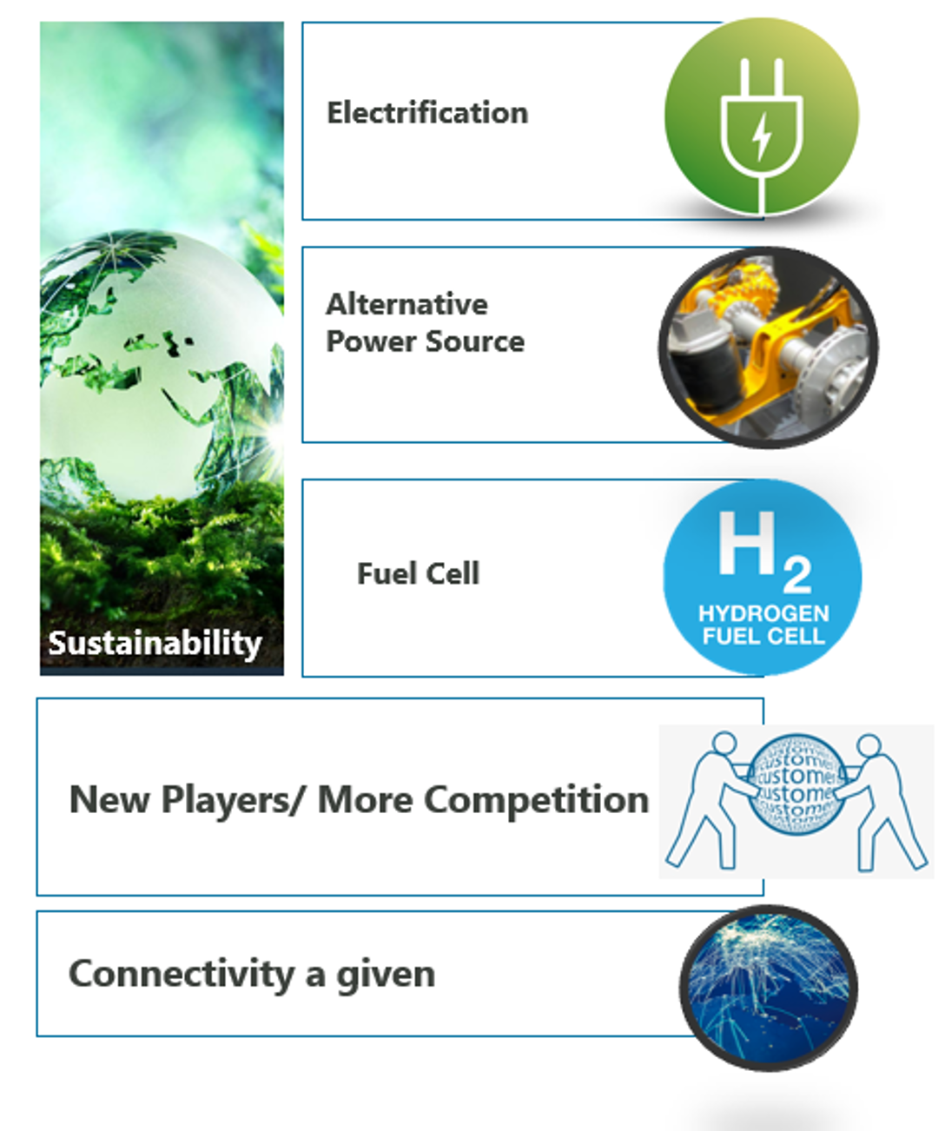
Market Trends
Communities and End users
Retailers
  Key retailers have specified the use of non-diesel solutions for their deliveries e.g.:
    Tesco
    Sainsbury
    Ahold
    Carrefour Casino
    +others
Noise restrictions in urban zones (and around supermarkets)
  Countries which have adapted PIEK standard
    UK
    France
    Germany
    Belgium
Notes:
Example: Mercedes eActros 300 (current) = 220km range autonomy + 1h15 charging time è eActros Long Haul 2024 = 500km range autonomy + <0h30 charging time
Significant development to solutions ready for the market
Noise reduction for access to LEZ and ULEZ and lighter units
Autonomous solutions for the trailer independent to the tractor
Axle power, Full Battery, Solar panel…
Fuel cell technology on both the tractor and TRU
Electrification allowing more entries in small, medium and large trucks
Competitors going towards offering telematics as standard e.g. Carrier
All players looking for value add with connectivity

Slide 9
Customer Concerns & Needs
Why Trailers cannot be replaced in the logistic chain
Trailers Advantages
Highly Flexible
  Suitable for both Long Haul/Short haul
  Independent of Tractor Brand and Engine technology
Cost Efficient
  Higher tonnage per trip vs. Rigid truck
Last 12-15 years
  As opposed to tractors = 3-5 years
Notes:
Earlier we talked about how ICE bans and how this will impact the sales of new HDV from 2030. With electrification of Smaller transport vehicles being developed quicker – why should the customer continue using Trailers?

Slide 10
Customer Concerns & Needs
Why Trailers cannot be replaced in the logistic chain
Trailers Drawbacks
Today: consumes Diesel fuel
  Impacted by ICE restrictions
Noisy
Last 12-15 years
  Need to anticipate long term impact of new regulations
Notes:
Earlier we talked about how ICE bans and how this will impact the sales of new HDV from 2030. With electrification of Smaller transport vehicles being developed quicker – why should the customer continue using Trailers?

Slide 11
Customer Concerns & Needs
Why Trailers cannot be replaced in the logistic chain
Key Questions
What type of technology shall I consider for my future trailers?
  To guarantee the perennity of my operations
  To secure my investments
Answer
Electrified refrigerated trailers
Notes:
Earlier we talked about how ICE bans and how this will impact the sales of new HDV from 2030. With electrification of Smaller transport vehicles being developed quicker – why should the customer continue using Trailers?

Slide 12
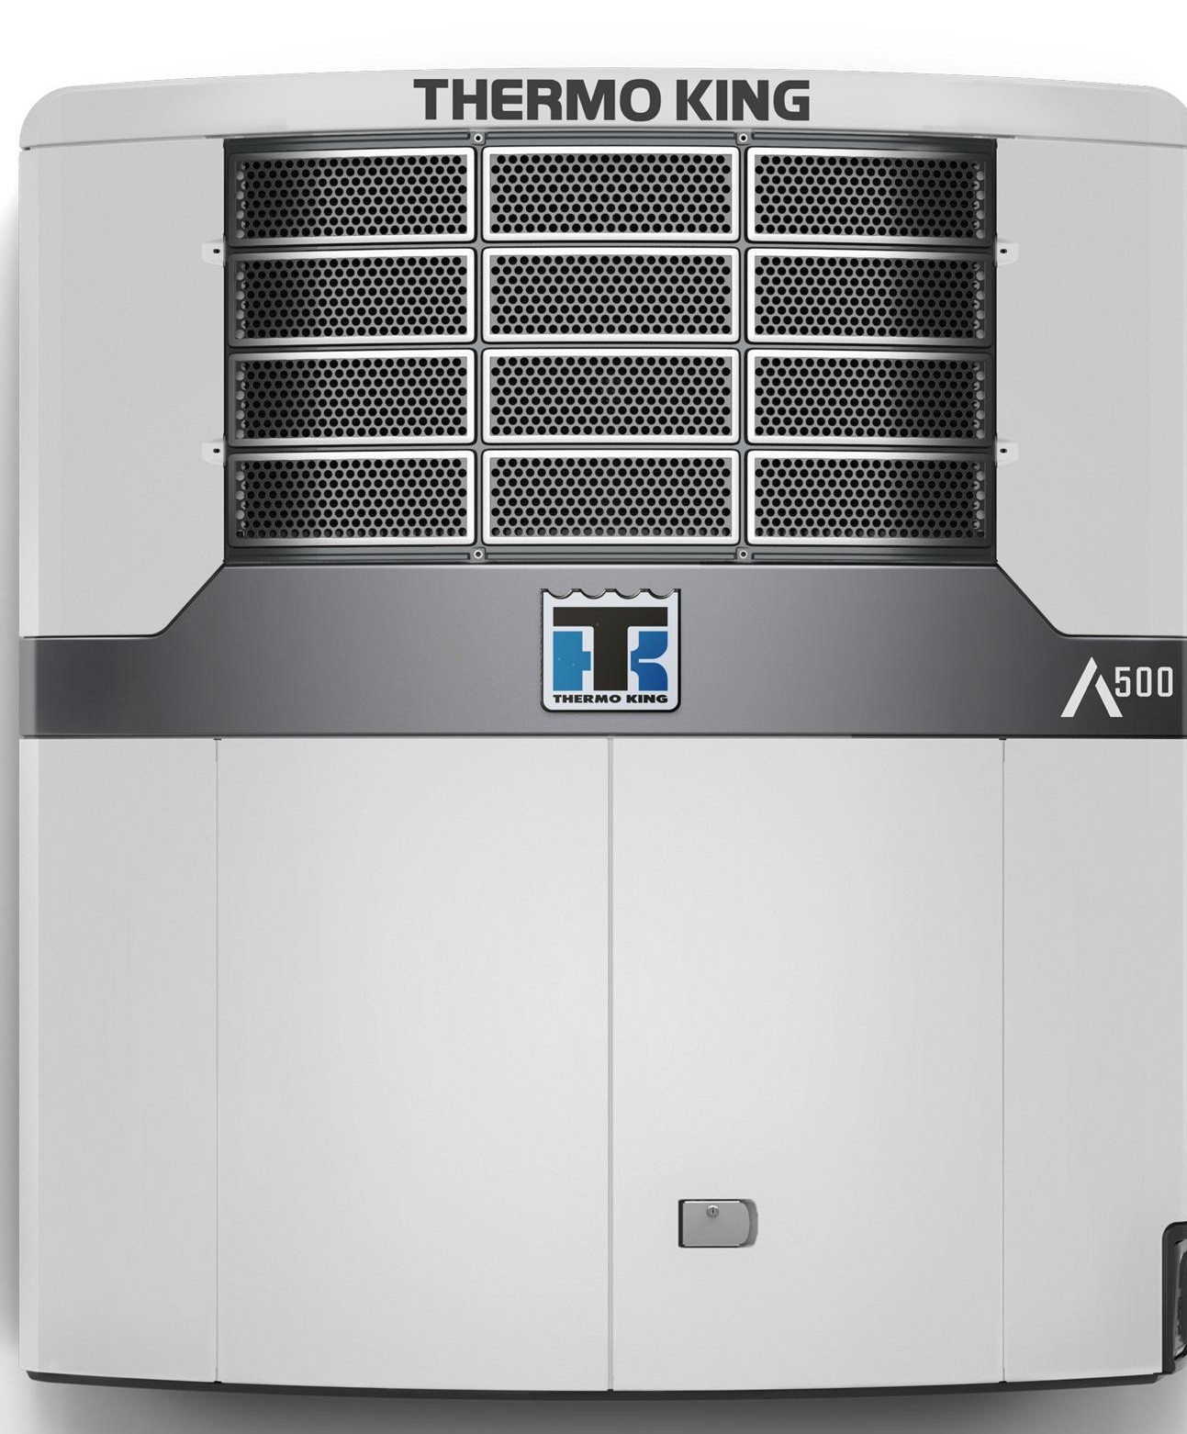
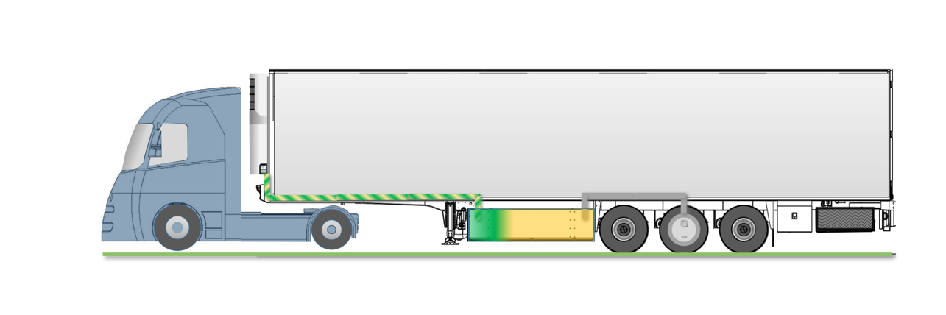
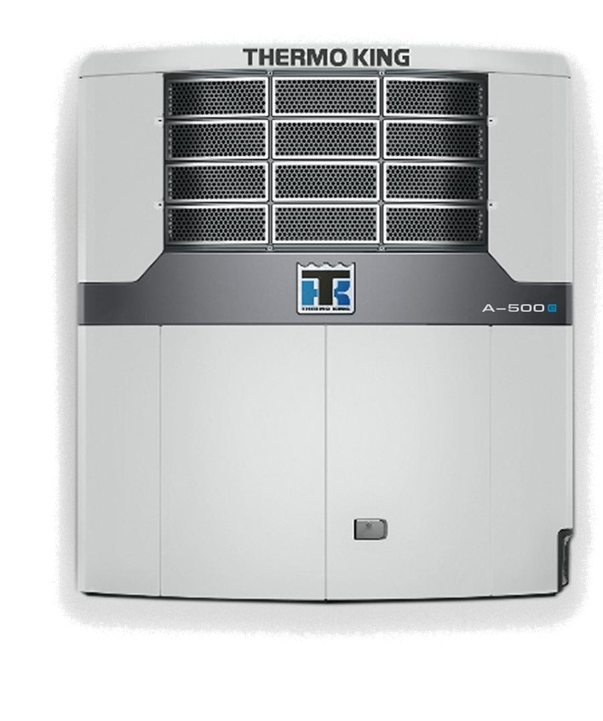

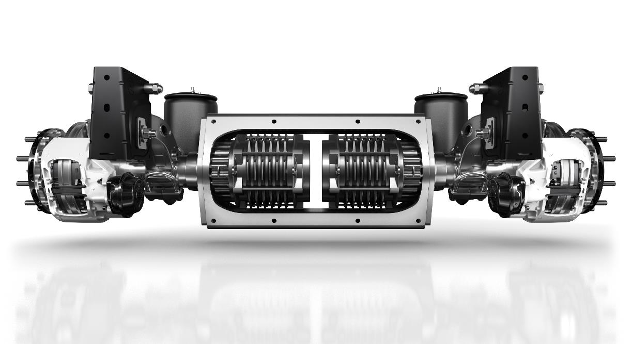
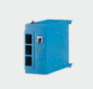
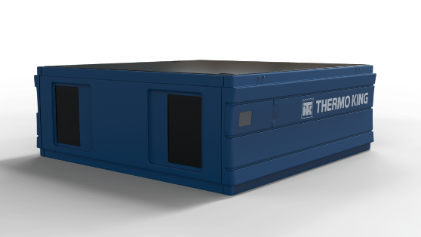
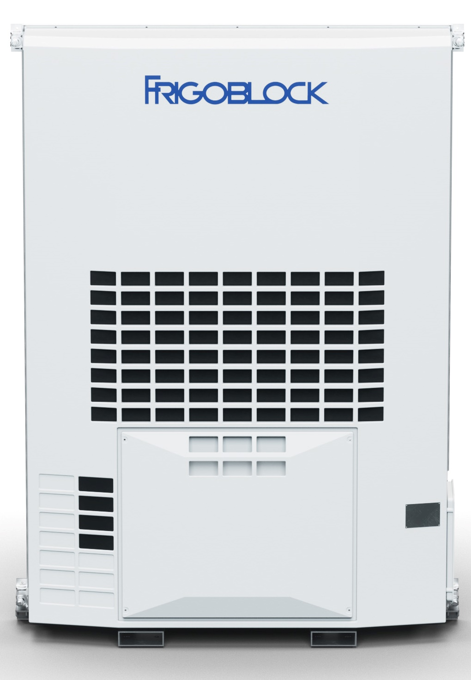
Thermo King Electric Trailer –Many options!
Integrated and connected!
TRU
Advancer Hybrid
Advancer-e
HK
ADVANCER-e
HYBRID
AXLEPOWER
FB Alternator
FB Inverter
Energe-e Pack
E- axle
Notes:
3 different units available for electric operation
Advance Hybrid - Advancer + Envirodrive ( FB Alternator + FB Inverter)
The next two offer fully electric solutions
Advancer E – available with Envirodrive, EnergE pack and Axle Power
HK - – available with Envirodrive, EnergE pack and Axle Power
As you can see we all components to make different solutions which is what we will cover in the presentation today.

Slide 13
Agenda
Electric Trailer Introduction
Power solutions
Electric TRUs
Practical Information
Sales Tools Available

Slide 14
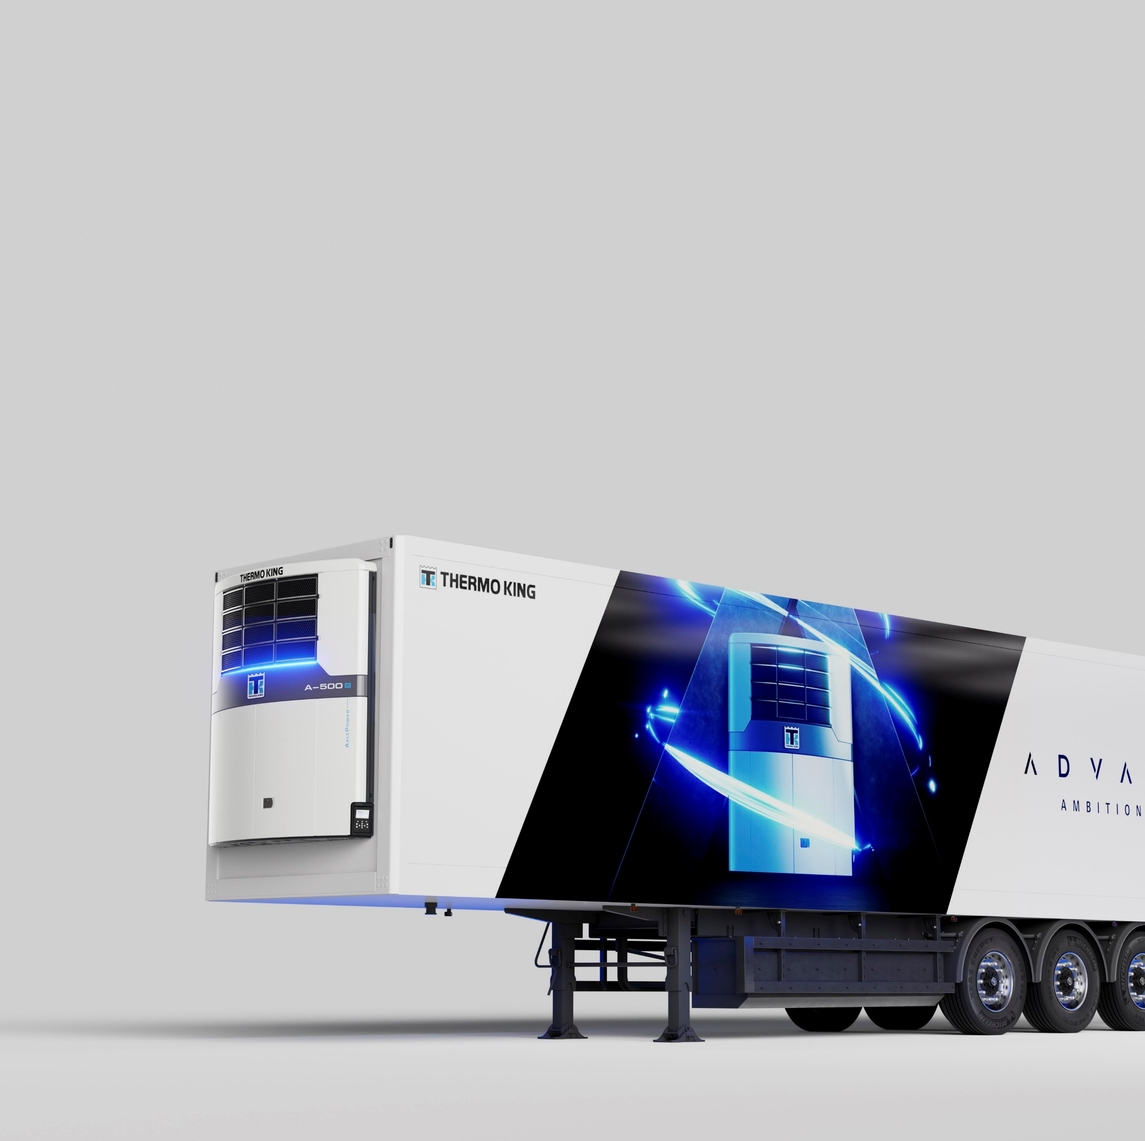
Power Solutions
AxlePower
Energ-e Pack
Envirodrive

Slide 15
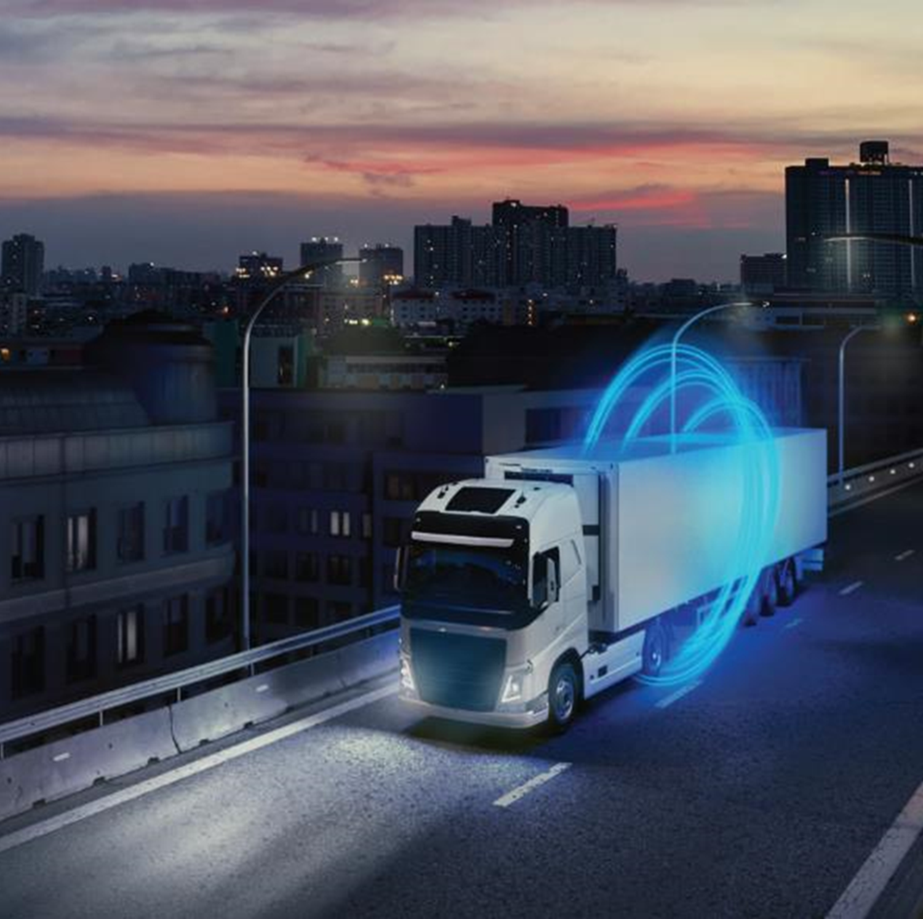
AXLEPOWER
Description of the system
Architectures comparison
Smart power management
Benefits
Unique features

Slide 16
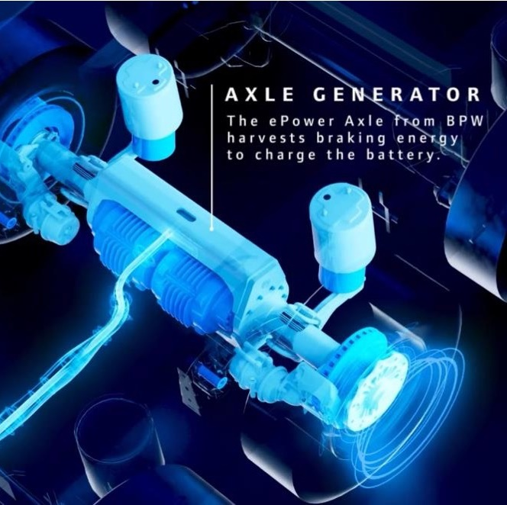
AXLEPOWER
DESCRIPTION OF THE SYSTEM
ePower Axle
Developed by BPW
Integrates 2 independent generators which provide AC current, depending on demand:
  Only during braking or downhill driving phases
  Or also while driving on flat road
Easy installation: same fixing points as standard axles
Generously sizes generators to maximise energy recovered during braking phases and guarantee fast recharging of the battery when needed

Slide 17
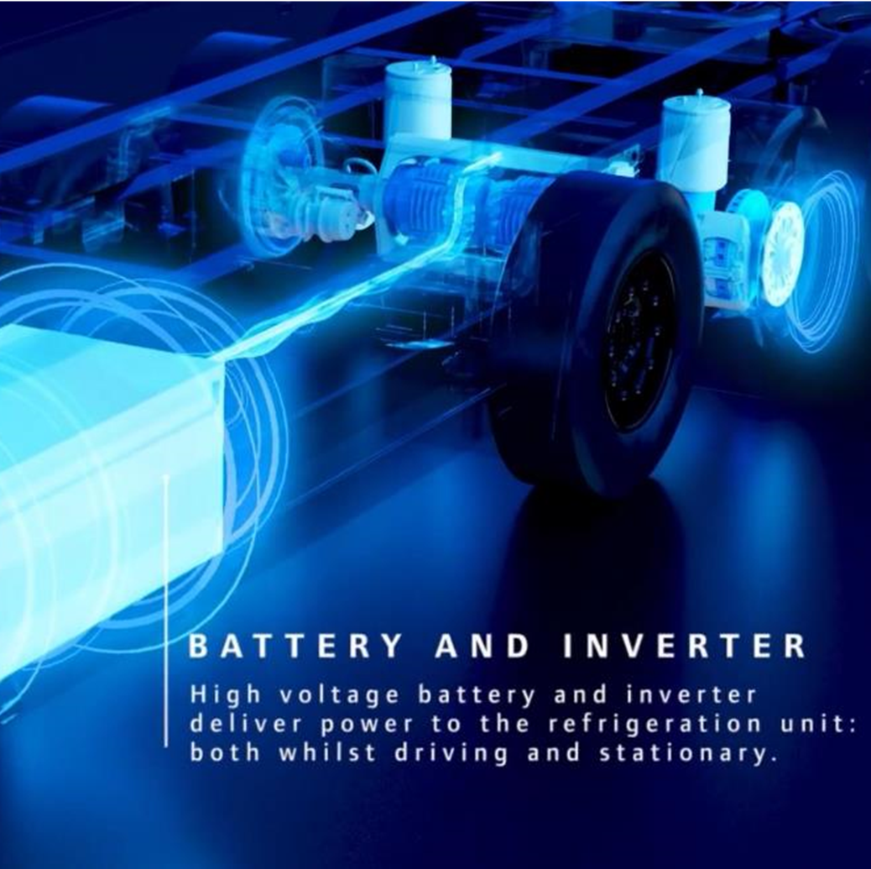
AXLEPOWER
DESCRIPTION OF THE SYSTEM
ENERGe Pack
Developed by Thermo King
Converts AC power coming from the ePower Axle into DC current to charge the High Voltage battery
Stores energy / 2 autonomy options
  Standard
  Extended autonomy
Converts DC power stored I the HV Battery into AC current to power the refrigeration unit
Allows to simultaneously recharge the battery pack and run the TRU when parked at loading dock and connected to shore power

Slide 18
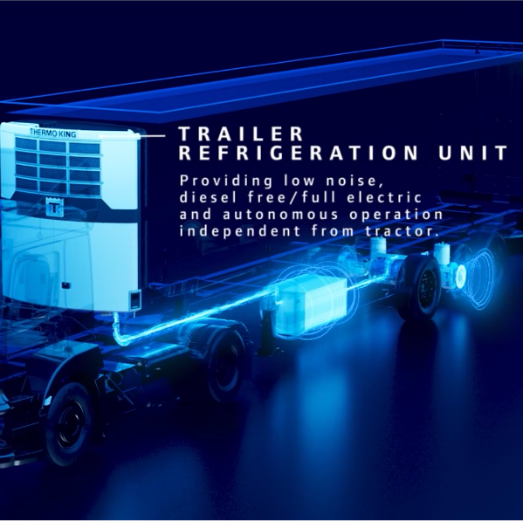
AXLEPOWER
DESCRIPTION OF THE SYSTEM
The refrigeration unit
Standard refrigeration unit
Can operate in Electric mode while driving
  Powered by Energe Pack
    Full Electric of Hybrid configuration
Can operate in Diesel Mode when needed
  Long haul / night stops
    Hybrid configuration only

Slide 19
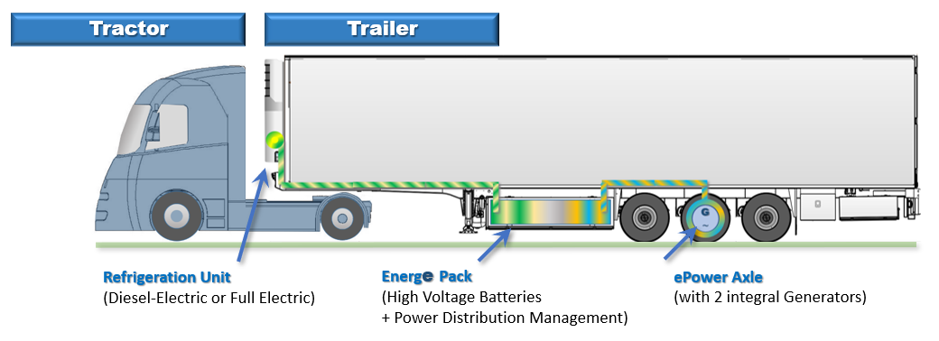
AXLEPOWER
DESCRIPTION OF THE SYSTEM
Key Points
The AxlePower system is independent of the tractor
The trailer is fully autonomous
  In Electric Mode
  In Diesel Mode (Diesel Electric configuration)

Slide 20
AXLEPOWER
DESCRIPTION OF THE SYSTEM
Configuration |  | Standard Autonomy | Extended Autonomy
Battery Capacity |  | 19 kWh | 38 kWh
Minimum Stationary Autonomy (most demanding conditions / to be considered for system sizing) |  | 2 Hours | 4 Hours
Average Autonomy (under mild ambient conditions) |  | 4-8 Hours | > 8 Hours
Charging Time / Shore Power |  | 0-80 % = 60mn / 0-95% = 90mn
Charging Time / While Driving | Unit ON / Max Capacity | 0-80% = 4h | 0-80% = 8h
 | Unit OFF | 0-80% = 1h50 | 0-80% = 3h40
Additional Weight | Battery Pack | 720 kg | 940 kg
 | ePower Axle | 300 kg | 300 kg
 | Total | 1 020 kg | 1 240 kg
Weight savings / Full electric unit (vs. Std Advancer / including fuel tank) |  | Advancer-e = – 400 kg / HK25-e = – 720 kg
Battery Life Time |  | 2 000 Full cycle w/o significant impact of autonomy Expected to be 6-12 years depending on trailer usage
Warranty |  | Battery = 5 years / Other Components = 2 years
Connectivity |  | 2 years included

Slide 21
AXLEPOWER
Description of the system
Architectures comparison
Smart power management
Benefits
Unique features

Slide 22
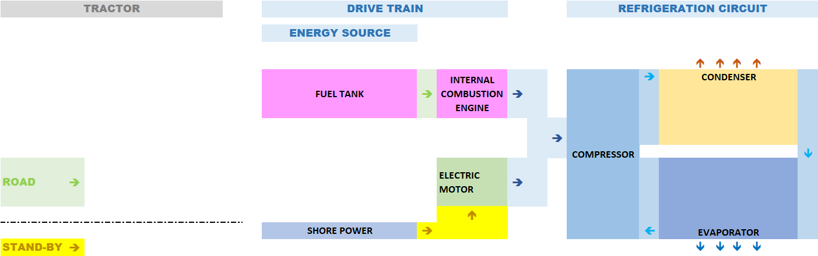
AXLEPOWER
ARCHITECTURES COMPARISON
Conventional Architecture

Slide 23
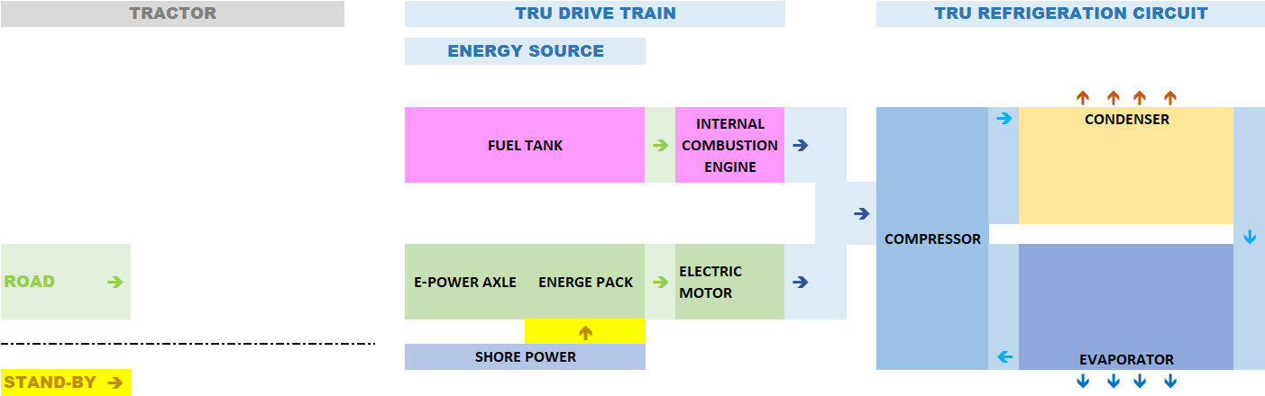
AXLEPOWER
ARCHITECTURES COMPARISON
Conventional Architecture
AxlePower Diesel-Electric TRU

Slide 24
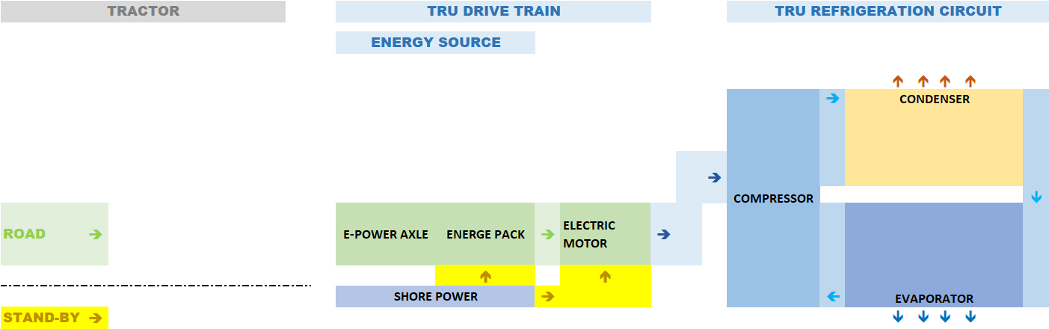
AXLEPOWER
ARCHITECTURES COMPARISON
Conventional Architecture
AxlePower Full-Electric TRU

Slide 25
AXLEPOWER
ARCHITECTURES COMPARISON
AxlePower Diesel-Electric TRU
AxlePower Full-Electric TRU
Autonomy > several days (Electric + Diesel operation)
Suitable for long haul (with overnight stop)
Ease of resell
Ease use by any driver
Diesel Engine still on board (weight and maintenance cost penalty)
No Diesel Engine on Board (weight and maintenance cost benefit)
Autonomy once stationary : 2 hours (std autonomy) to 4 hours (extended autonomy) in less favorable cases
Not suitable for long haul (with overnight stop)
Less easy to resell (short term)
Minimum drivers training required (respect of good practices)

Slide 26
AXLEPOWER
Description of the system
Architectures comparison
Smart power management
Benefits
Unique features

Slide 27
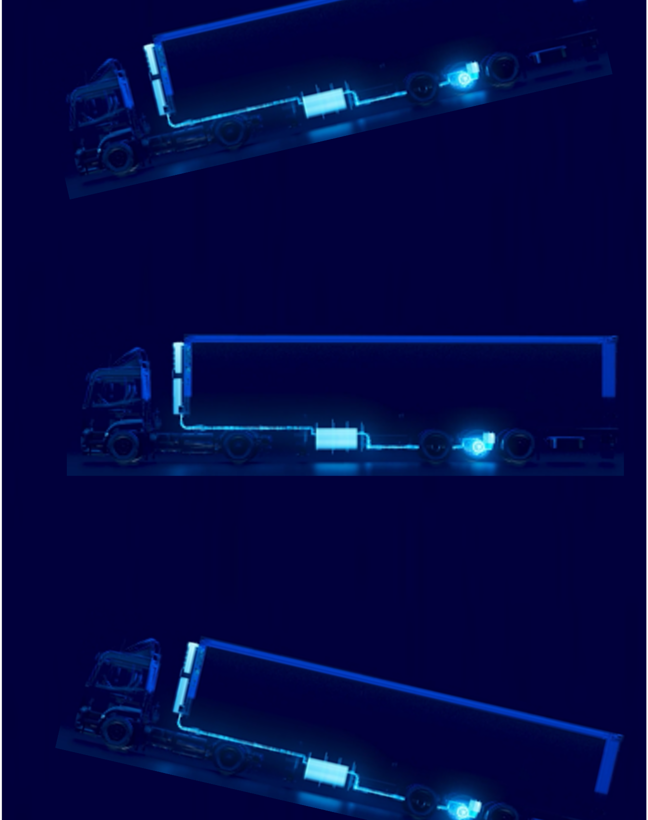
AXLEPOWER
SMART POWER MANAGEMENT
From 300kW / 400 HP supplied by the tractor engine
36% are used to overcome rolling resistance
32% are used to overcome the aerodynamic resistance
25% are used to compensate braking losses
  The refrigeration unit requires
    ≈ 10kW power input to perform a temperature pull down,
    then 2 to 4 times less power to maintain the temperature inside the trailer
  Only a fraction of the energy dissipated during braking phases needs to be recovered to power the reefer unit

Slide 28
AXLEPOWER
SMART POWER MANAGEMENT
The Smart Power Management system
3 Charging Modes to maximize the energy recovered while braking and minimize the impact on tractor fuel consumption
Disconnect the recuperation mode as soon as it detects that the trailer starts climbing a ramp
Depending on the battery State of Charge and the charging mode selected: activates the generators while driving on flat road
Minimum impact on tractor fuel consumption
The refrigeration unit is mainly using waste energy to keep the temperature inside the trailer
Reduced wear of trailer + tractor brake pads

Slide 29
AXLEPOWER
Description of the system
Architectures comparison
Smart power management
Benefits
Unique features

Slide 30
AXLEPOWER
BENEFITS
A system
Which makes the trailer autonomous
To be able to run in Electric mode while driving
With the following benefits
Affordable
Flexible
Silent
Dependable
Sustainable Innovation
Complete Range

Slide 31
AXLEPOWER
BENEFITS
Affordable
The purchase price is offset by reduced fuel use and maintenance costs
For the transport companies: the TCO (over the trailer lifetime) is not higher than the one of a conventional trailer
Dependable
Axle generator, energy storage and management systems developed by BPW and Thermo King.
  Tested and qualified according to most stringent industry standards + Unequalled service presence across Europe
Flexible
The system is completely tractor independent, suitable for all journey-types and does not require a dedicated charging infrastructure
  The standard 32 Amps CE plugs can be used [1]
  Compatible with fast charging stations (for Electric vehicles)
Silent
Engineless operation gives both drivers and delivery points a break from the noise of the city
Sustainable operation
By preventing long periods of operation with Reefer Diesel Engine operating at minimum loads, the fuel consumption required for the refrigeration of the trailer is reduced by 60% minimum.
  Customers who purchase “green electricity” will be able to maximize the fuel savings (if daily connection to shore power is possible)
Complete Range
Compatible with “Hybrid” Diesel-Electric & 100% electric units (Frigoblock & Thermo king) reefer units
  Maximum flexibility for the fleet owner / operator
  [1]: Specification to be respected: 1) RCD type B 2) 3Phases + Neutral + Earth

Slide 32
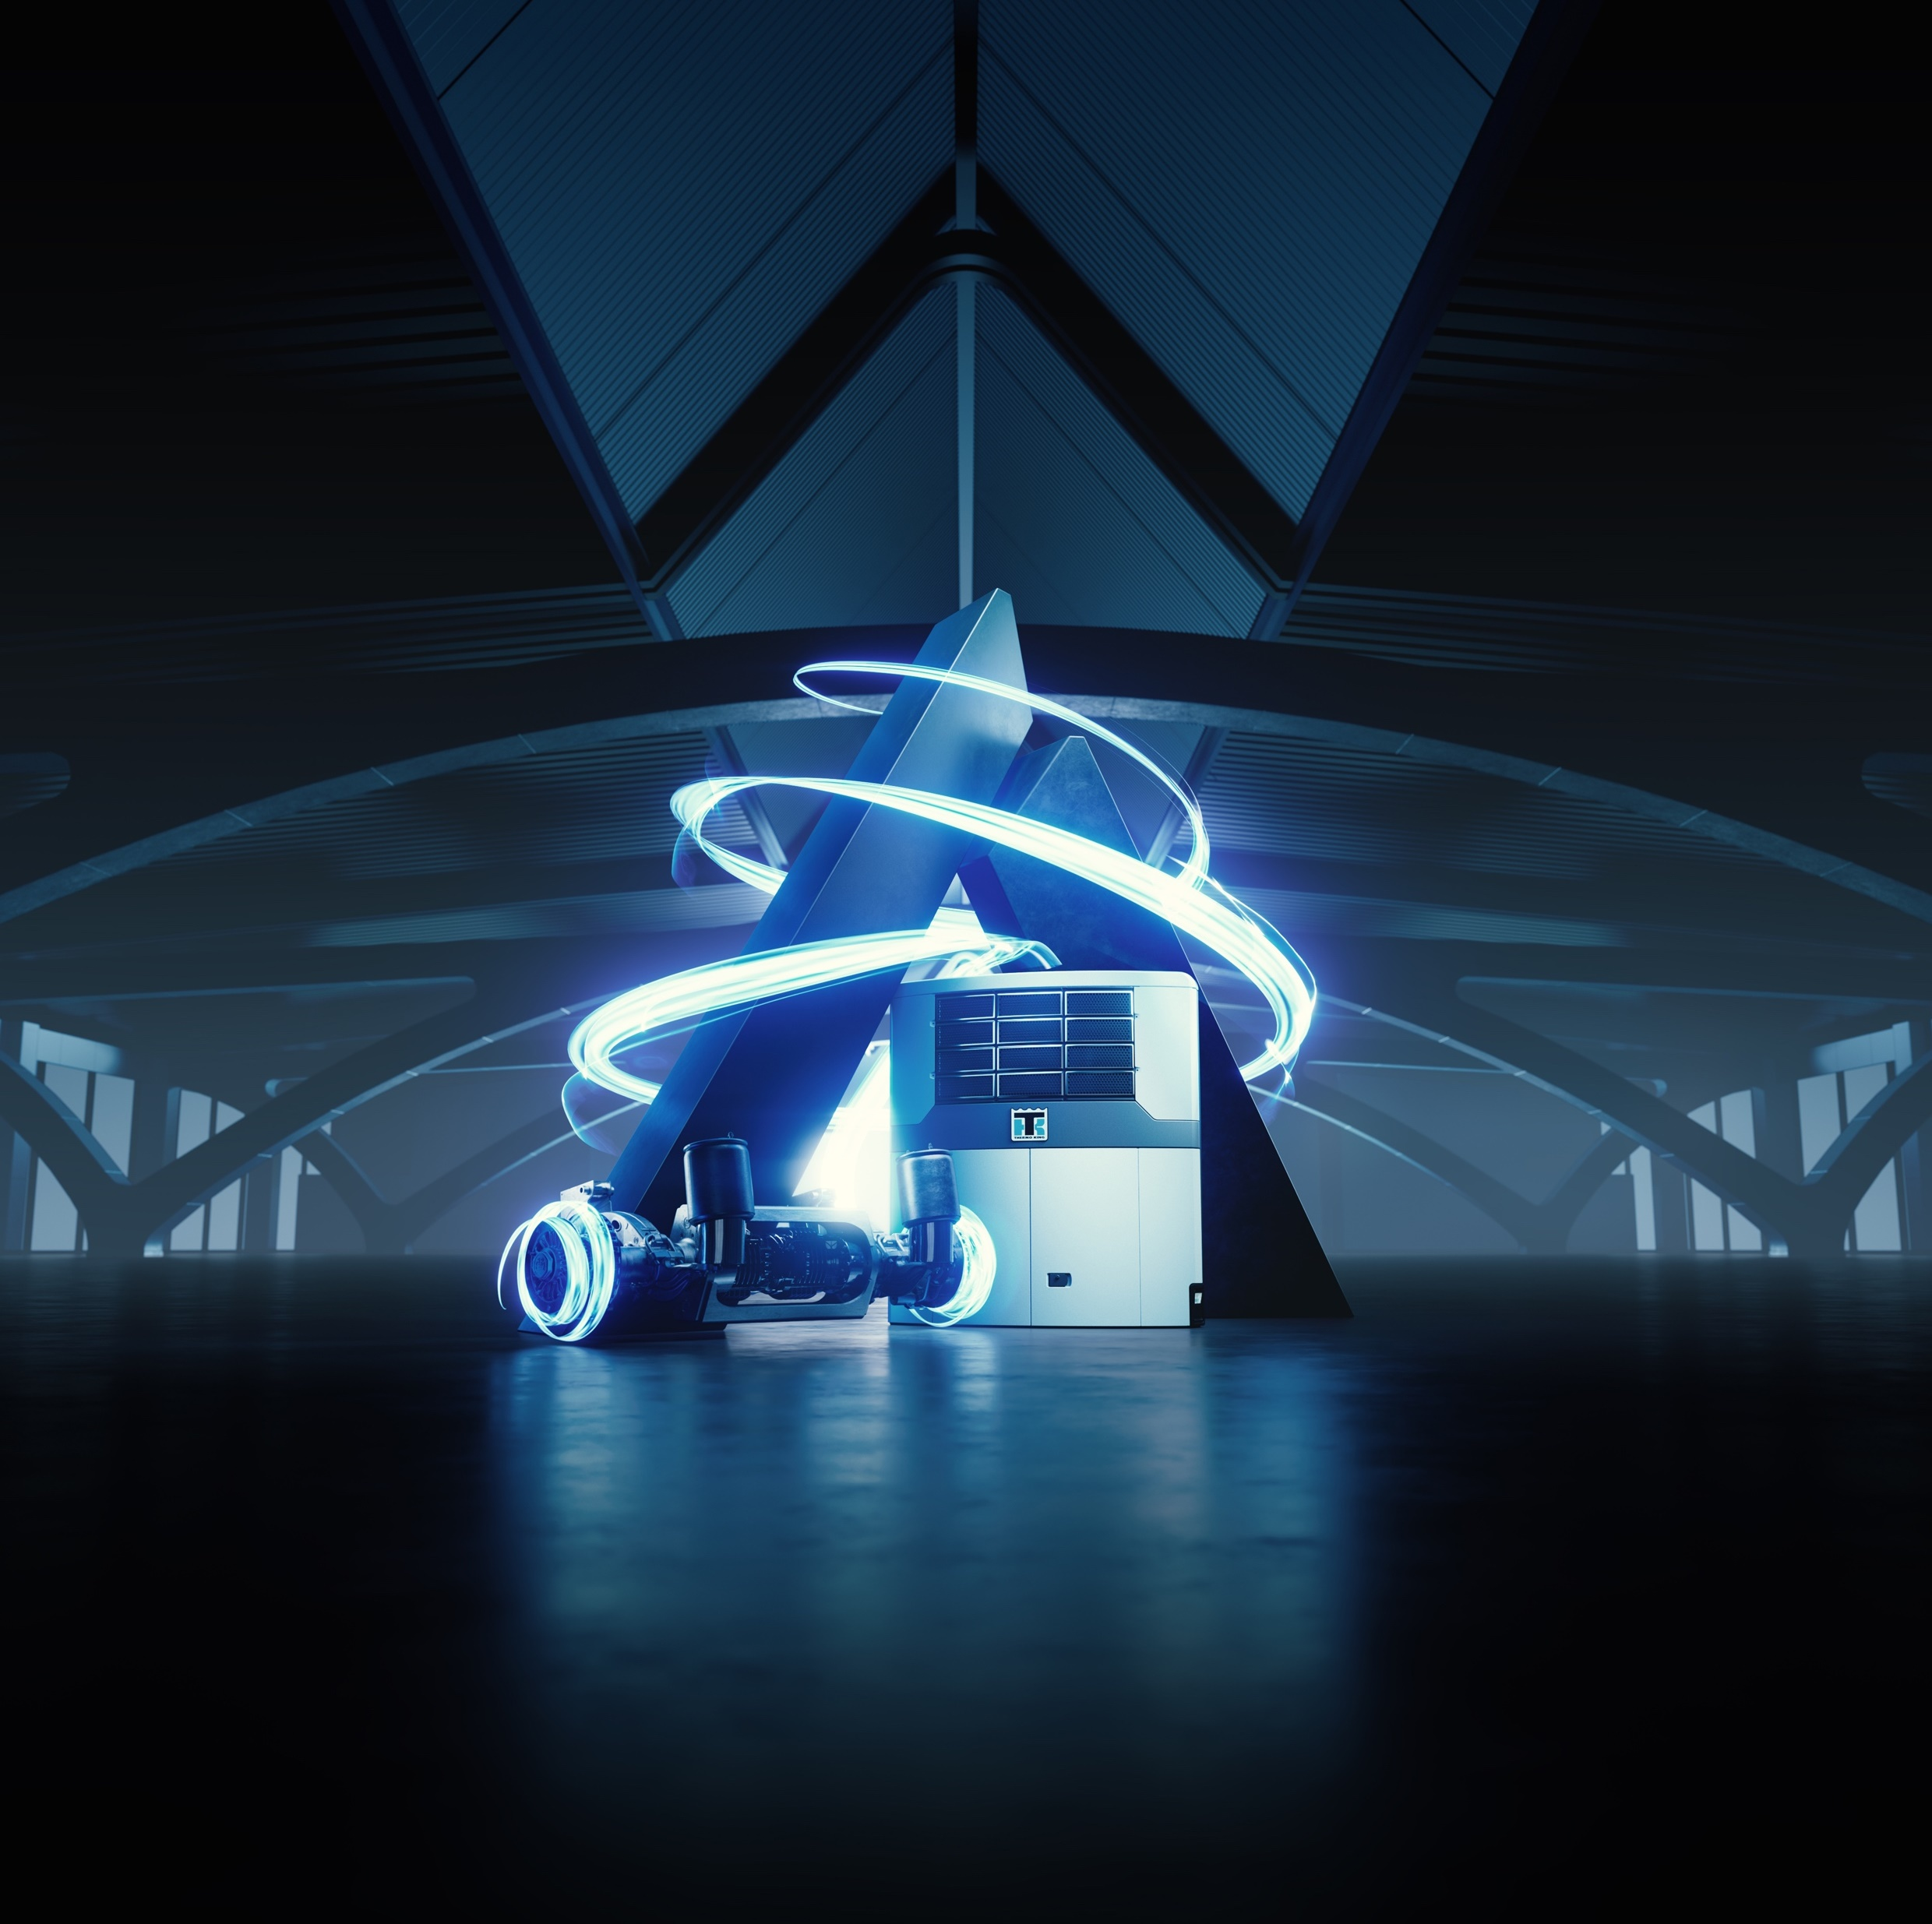
AXLEPOWER
Description of the system
Architectures comparison
Smart power management
Benefits
Unique features
  What is different with Thermo King AxlePower vs. Competition?
  Why should your customer choose Thermo King AxlePower?

Slide 33
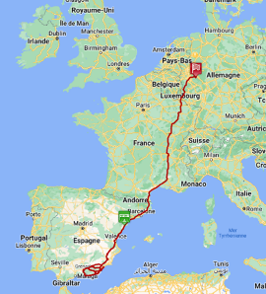
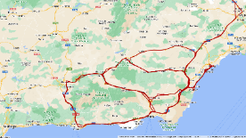
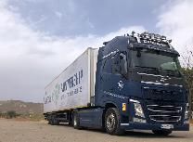
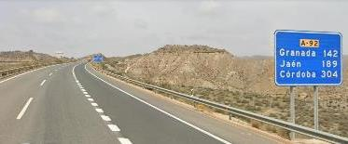
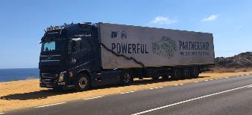
AXLEPOWER
UNIQUE FEATURES
A Solution qualified
  According to most severe industry standards
  Under most extreme conditions
  From EU hottest conditions (Spain/Andalusia)…
    With temperatures up to 45°C

Slide 34
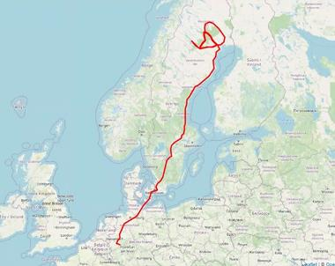
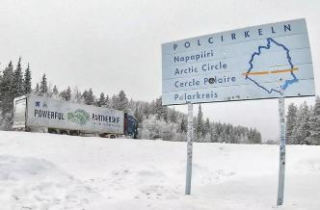
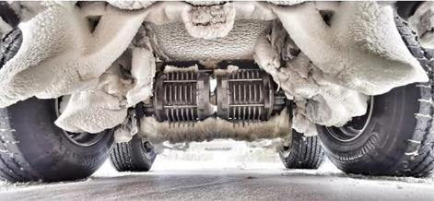
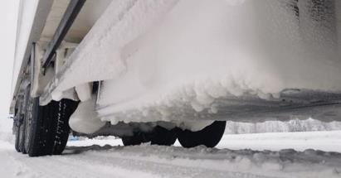
AXLEPOWER
UNIQUE FEATURES
A Solution qualified
  According to most severe industry standards
  Under most extreme conditions
  From EU hottest conditions (Spain/Andalusia)…
    With temperatures up to 45°C
  …To EU coldest conditions (Sweden/North of Polar Circle)
    With temperatures down to -25°C
  To guarantee trouble free operation all year round

Slide 35
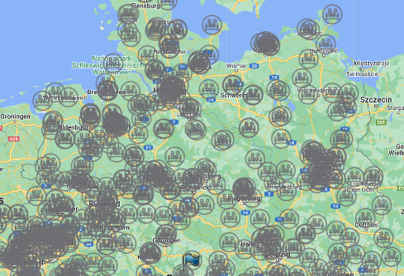
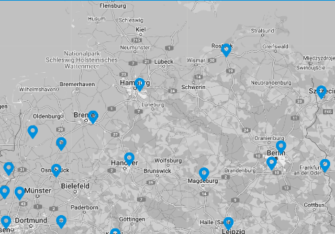
AXLEPOWER
UNIQUE FEATURES
  A Solution Supported by the service network of 2 industry leaders
  Across EU…
  … and the rest of the World
  To support our customers (and the second owner of the vehicle) in all their operations

Slide 36
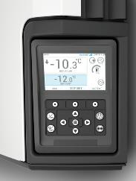
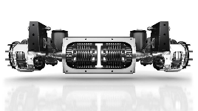
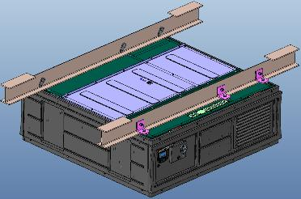
AXLEPOWER
UNIQUE FEATURES
  A Solution resulting from the cooperation of 2 industry leaders
  With a unique design
  Optimized components sizing
  and Smart Management control
    To maximize recovered energy usage / minimize impact on tractor fuel consumption
    To optimize Ease of use
  Only 1 single button to push to activate the refrigeration unit and the AxlePower system
  Fast charge capability when driving ➔ no need to connect to shore power periodically
  Balancing of HV battery (if needed) can be activated remotely via Telematics 2-way command

Slide 37

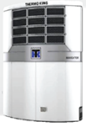
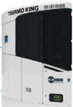
AXLEPOWER
UNIQUE FEATURES
  A Solution developed with your needs in mind
  With adjustable battery capacity
  Compatible with all TK-FB trailer refrigeration units
  To guarantee full electric operation for urban deliveries
  Without any additional constraints in the management of the fleet
  The same trailer can be used on Distribution and Long-Haul journeys
  No immobilization time reducing vehicle profitability
  No need to invest in specific charging infrastructure
— A-Series —
Full Electric and Hybrid
ST & MT
— SLXi —
Hybrid
ST & MT
— HK —
Full Electric
MT

Slide 38
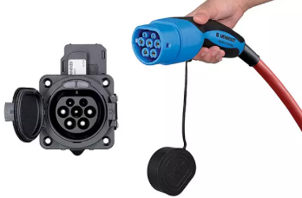
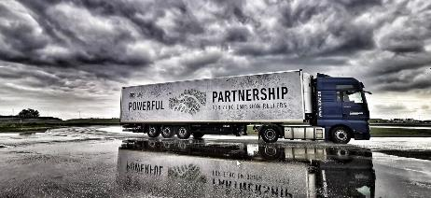



AXLEPOWER
UNIQUE FEATURES
  A Solution complying with current and future standard coming with a full homologation granted by national road authorities
  Compliant with IEC 61851-1
  Connection via Type 2 plug
  Immobilizer function compatible with all EBS suppliers
  Driving and braking behavior on various adherence surfaces witnessed and tested by RDW (NL) and TÜV SGS (DE)
  Homologation of the full system in progress with KBA (DE) and CNRV/UTAC (FR)

Slide 39
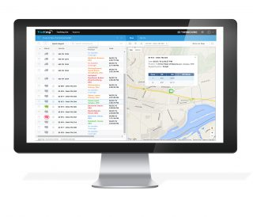
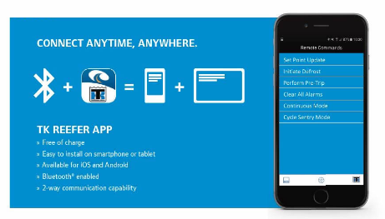


AXLEPOWER
UNIQUE FEATURES
  A Solution coming with an integrated tracking platform to supervise the entire system, via 1 single access point
  Supervision via Thermo King
  BPW/Idem
  Or other 3rd party or corporate portals

Slide 40
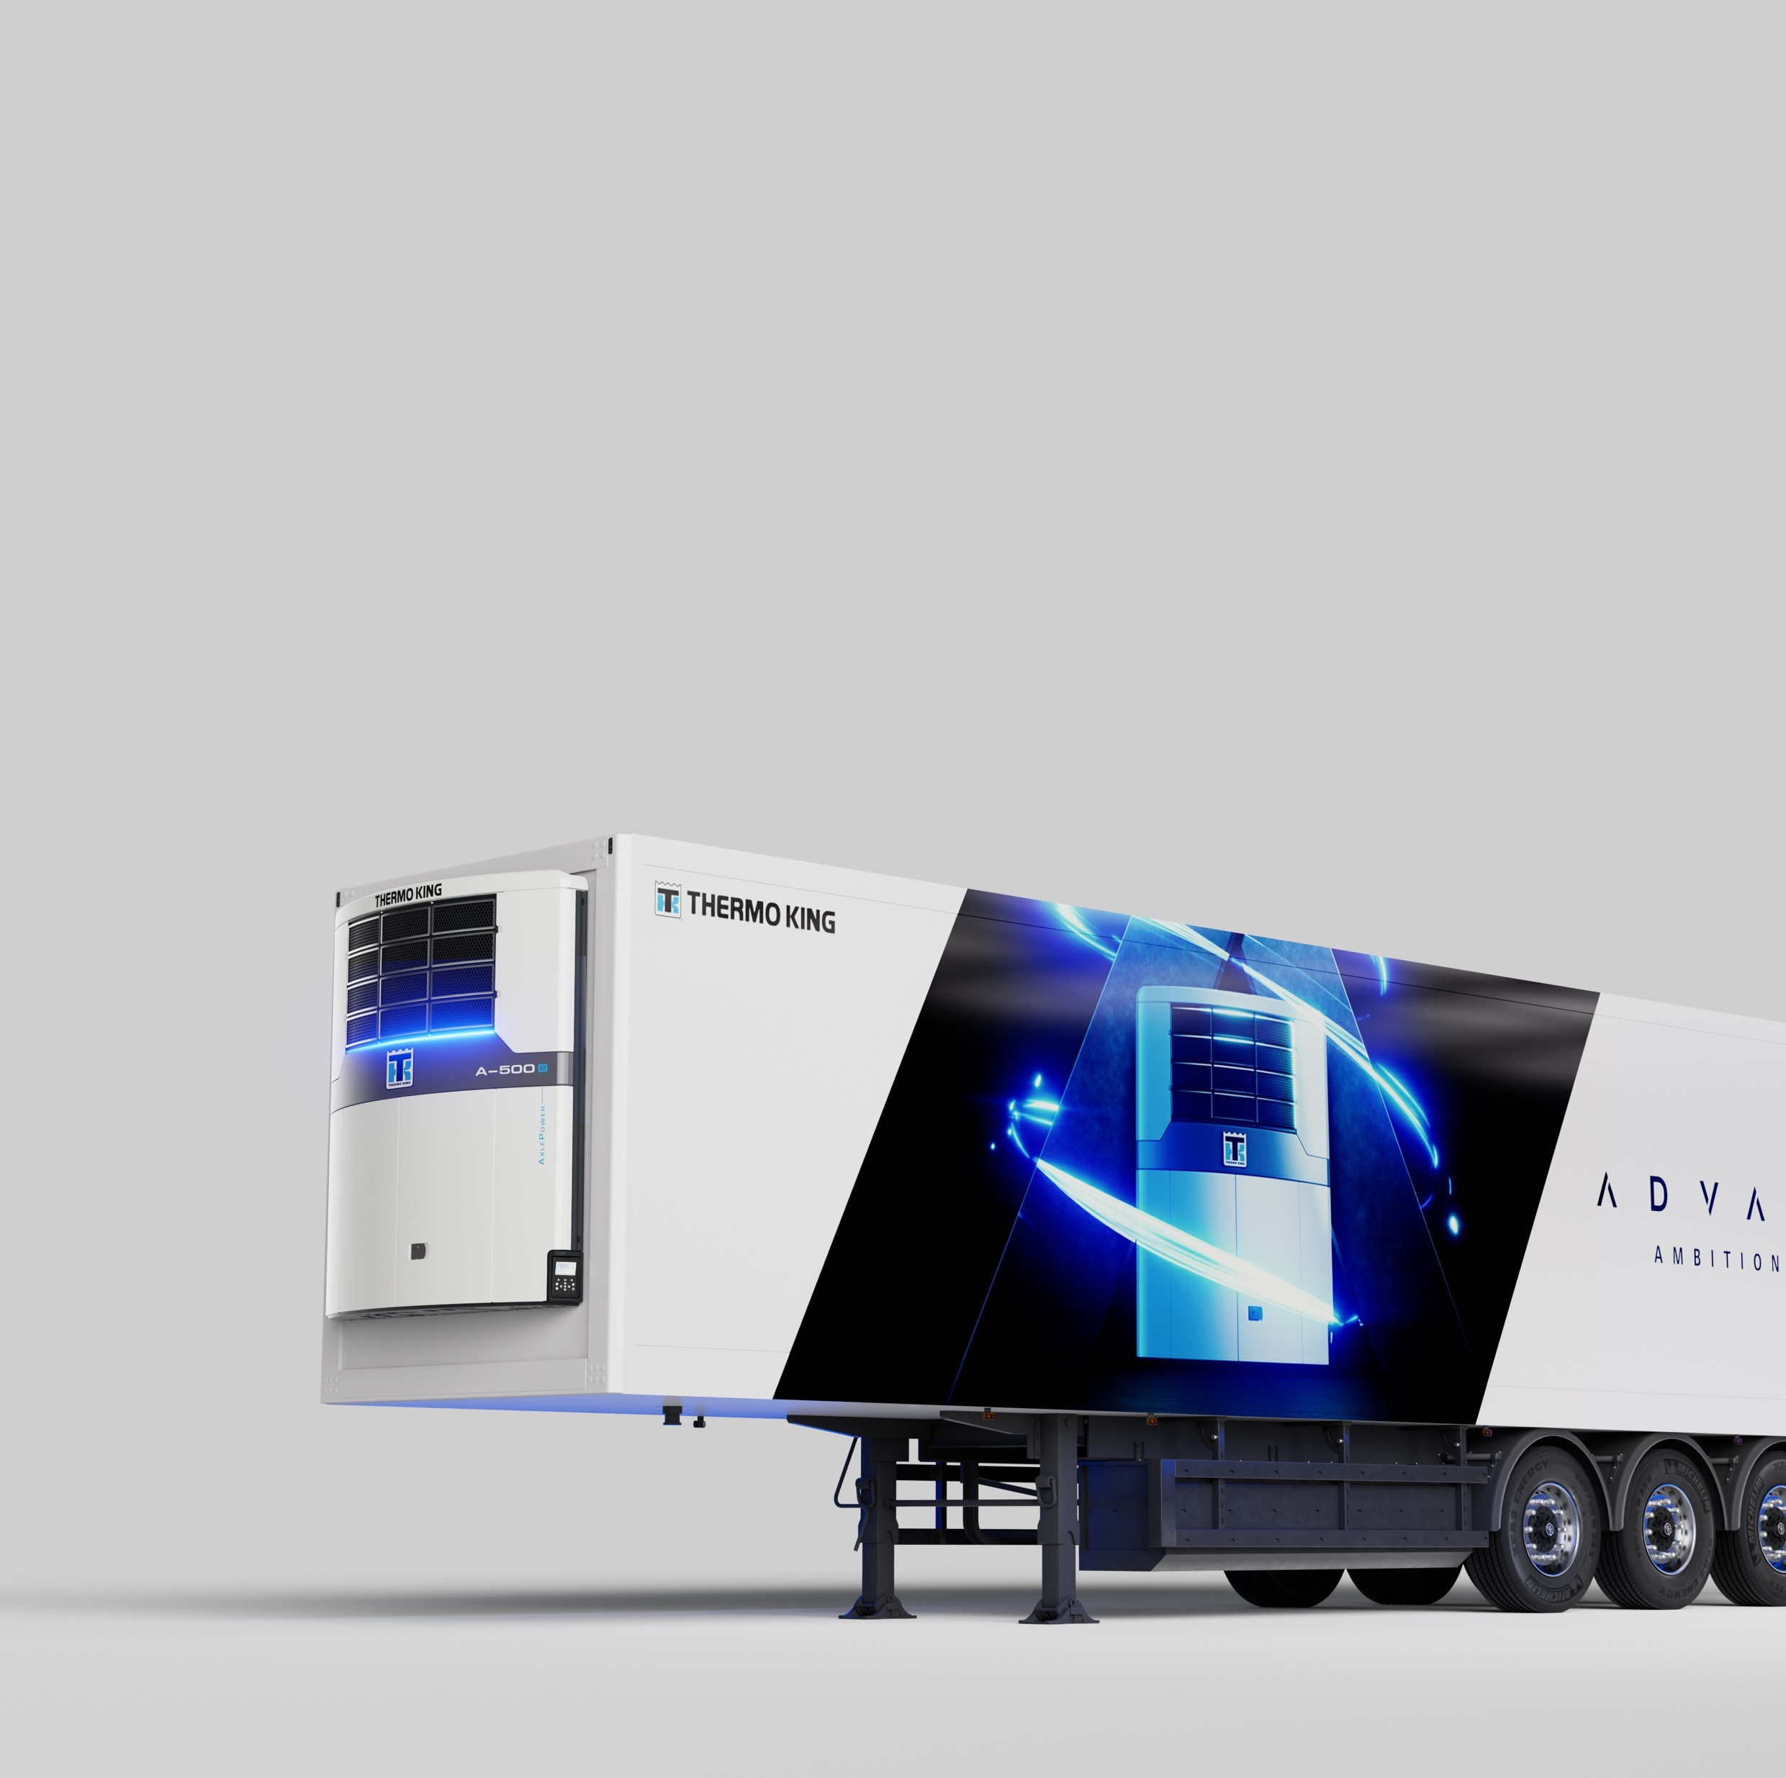
Power Solutions
AxlePower
Energ-e Pack
Envirodrive

Slide 41
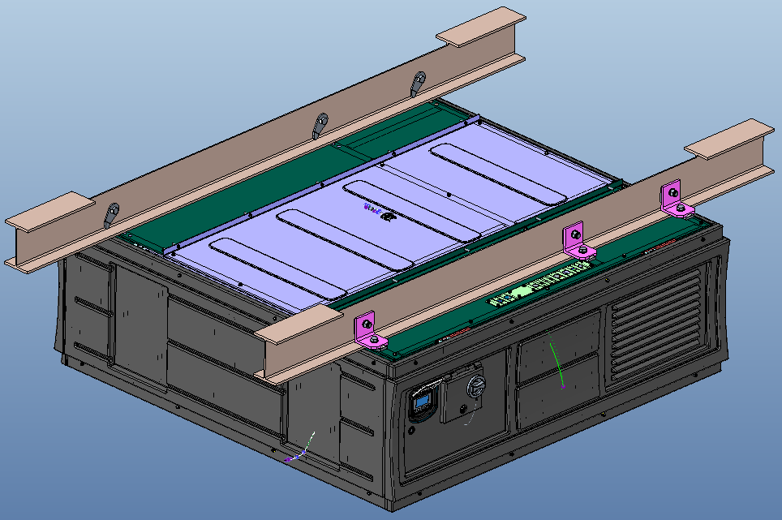
ENERG-e PACK
Different Offering to meet Specific Needs
Service Contracts

Slide 42
ENERG-e PACK
Customer A
Operating both short haul and interregional (or sometime long haul)
or
2 or 3 shifts per day, loading at various places (not all w/ shore power connection available)
or
Rental company supplying trailers to transport company for distribution activity (but w/ full visibility or control on the organisation of the delivery journeys: duration, nb of stops, etc.)
AxlePower meet all needs

Slide 43
ENERG-e PACK
Customer A
Customer B
Operating both short haul and interregional (or sometime long haul)
or
2 or 3 shifts per day, loading at various places (not all w/ shore power connection available)
or
Rental company supplying trailers to transport company for distribution activity (but w/ full visibility or control on the organisation of the delivery journeys: duration, nb of stops, etc.)
AxlePower meet all needs
Only Short haul operation
And
Daily scheduling with regular stops at loading facilities w/ shore power connection available
And
Good visibility and control on the organisation of the distribution activity (ex: proprietary fleet of retailer or food producer company)
AxlePower meet all needs…
…But another solution might be also suitable
Notes:
Competition = Addvolt battery pack managed via a specific supervision portal (¹ from the one used to monitor tempertures)

Slide 44
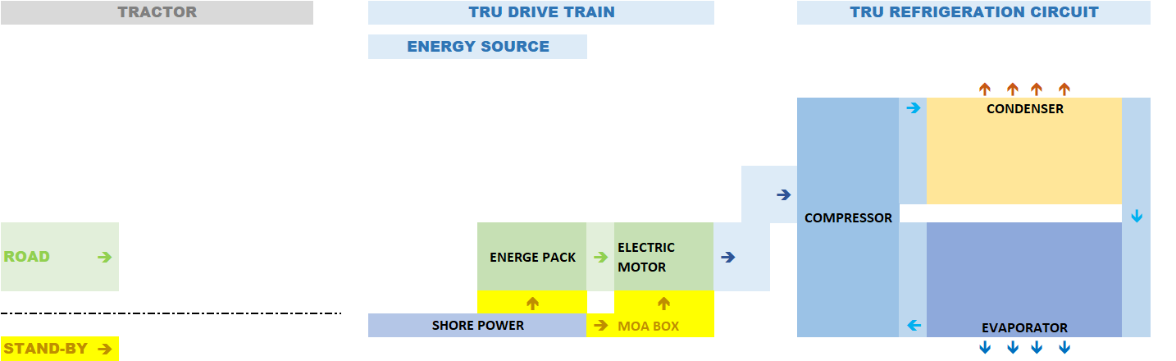
ENERG-e PACK
ARCHITECTURES COMPARISON
AxlePower + Full-Electric TRU
Energ-e Pack + Full-Electric TRU

Slide 45
ENERG-e PACK
WHEN SHOULD IT BE PROPOSED?
Energ-e Pack + Full-Electric TRU
Energ-e Pack + Diesel-Electric TRU
Customer operating only Short Haul with maximum 2 to 4 hours stationary autonomy to be covered
Others?
Customer operating mainly national or interregional routes with from time to time the need to deliver in LEZ’s areas
Others ?
Rule nb1 = clearly identify the needs of your customer

Slide 46
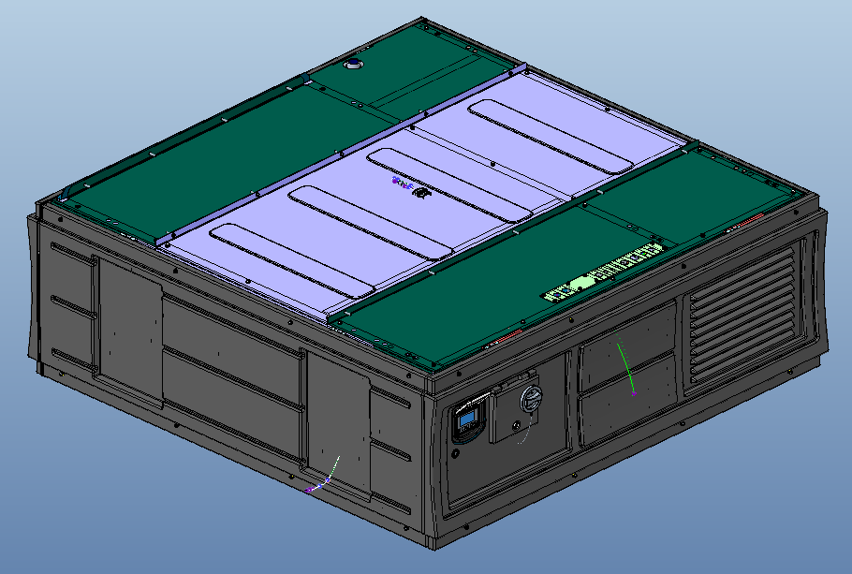
ENERG-e PACK
UNIQUE SELLING FEATURES
Same components as AxlePower
Alternative Competitor Solutions
Fully Qualified
Fully Certified
Installation validated on chassis of major trailer manufacturers
Integrated telematics supervision
Consistent support
  In case trailer is transferred to another region
  For secondhand owner (impact on resell value)
?
?
?
?
?
  ?
  ?

Slide 47
Power Solutions
AxlePower
Energ-e Pack
Envirodrive

Slide 48
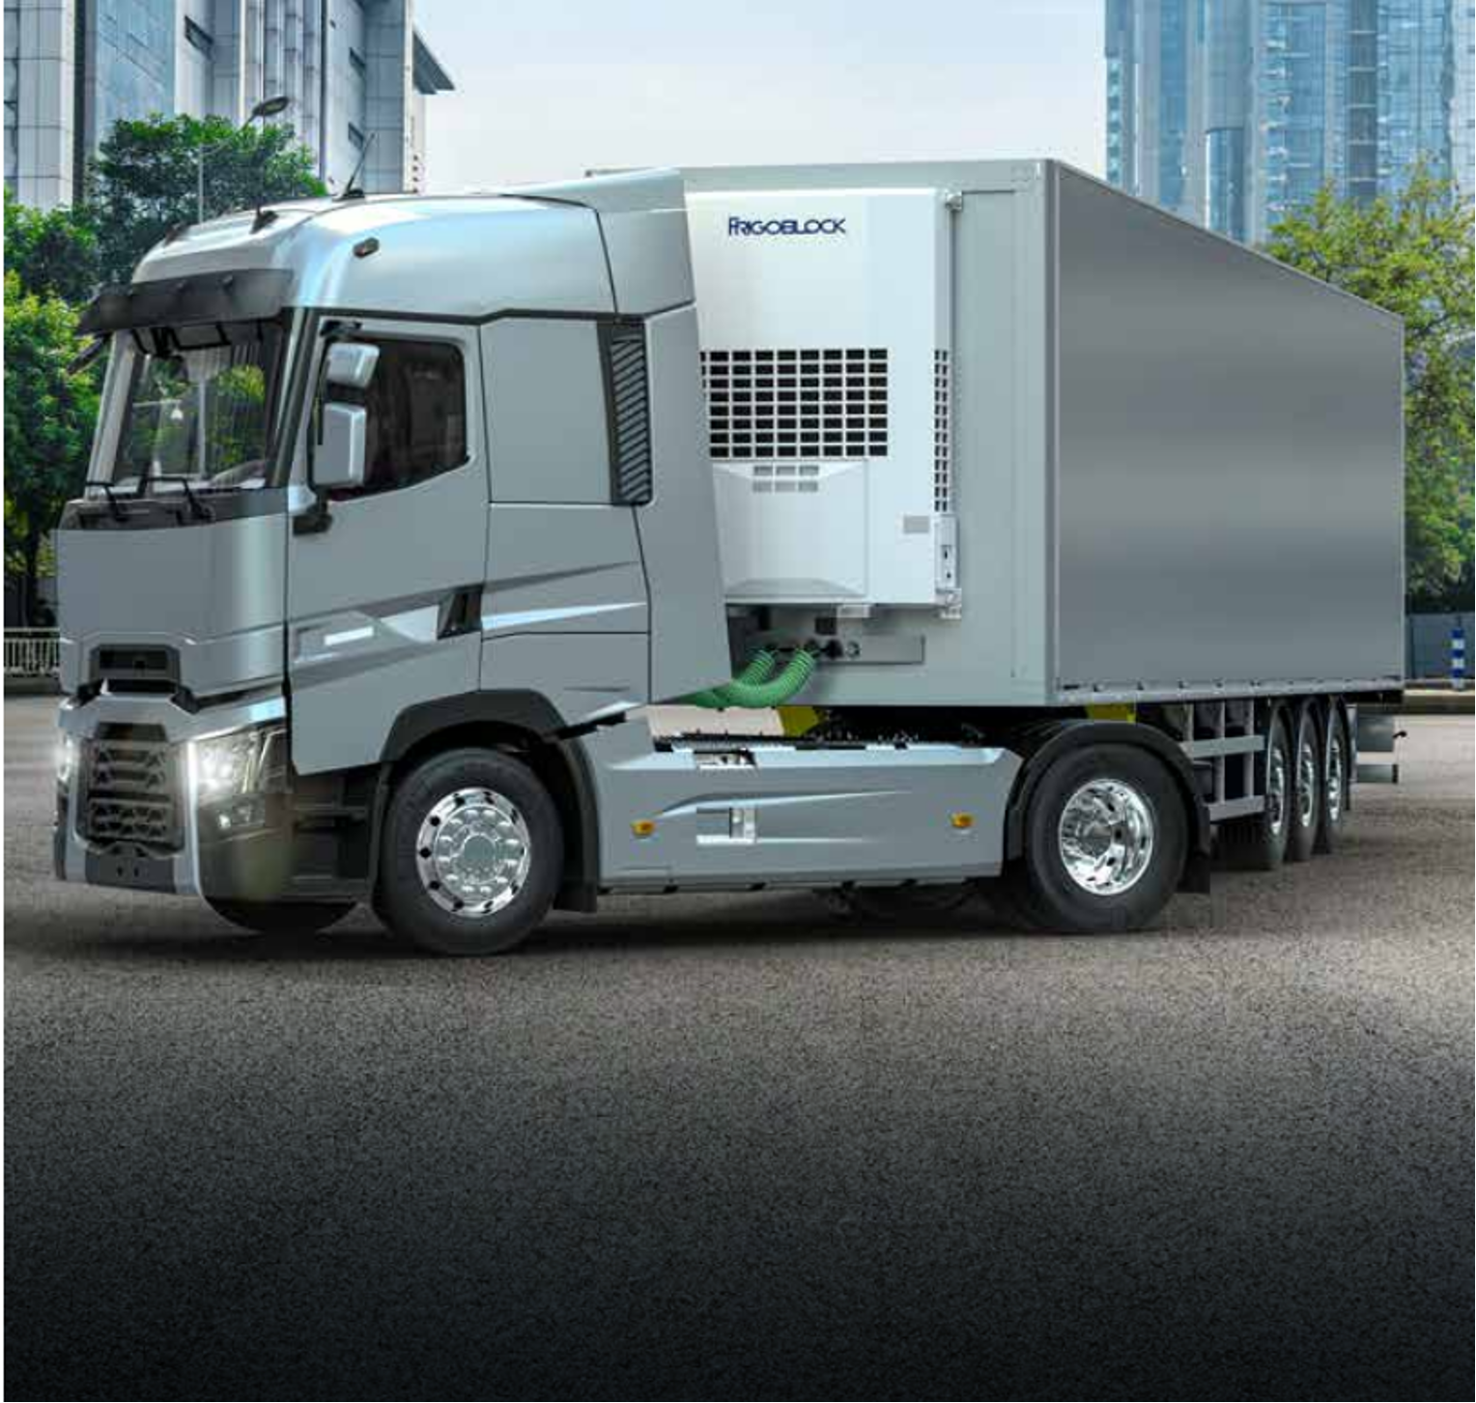
Envirodrive
What is it and unit compatibility
Component positioning
Benefits
Competitive solutions
  Competitive comparison

Slide 49
Envirodrive (Hybrid)
WHAT IS IT AND UNIT COMPATIBILITY
Compatible Units
Advancer Hybrid
(ST and MT (April 2023))
Advancer E (ST)
HK (MT)
Envirodrive Components
Alternator
+
Inverter
Power the TRU
+
FB Alternator
Converts power from tractor engine into electricity
FB Inverter
Transforms electricity from alternator to power the Advancer Hybrid. Provides constant voltage delivery to the unit, regardless of vehicle engine speed

Slide 50
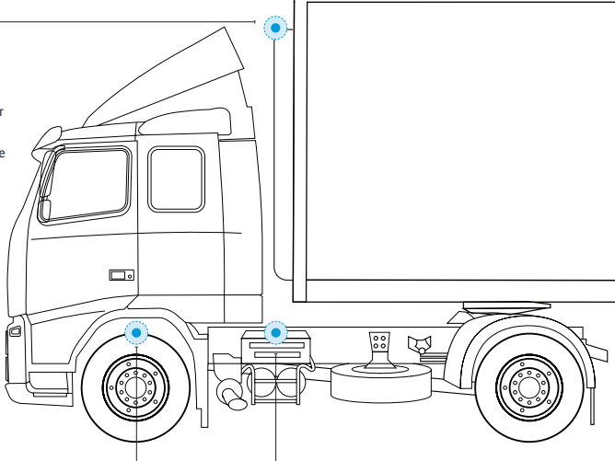
Envirodrive
COMPONENT POSITIONING?
FB Alternator
Installed in the tractor engine Compartment
Compatible
TRU
FB Inverter
Installed behind front 2 tractor wheels

Slide 51

Envirodrive
BENEFITS
Retrofittable so no need to wait for new equipment purchases
Total flexibility in choosing alternative fuels
Full support from the most extensive Dealer service network in the industry

Slide 52
Agenda
Electric Trailer Introduction
Power solutions
Electric TRUs
Practical Information
Sales Tools Available

Slide 53
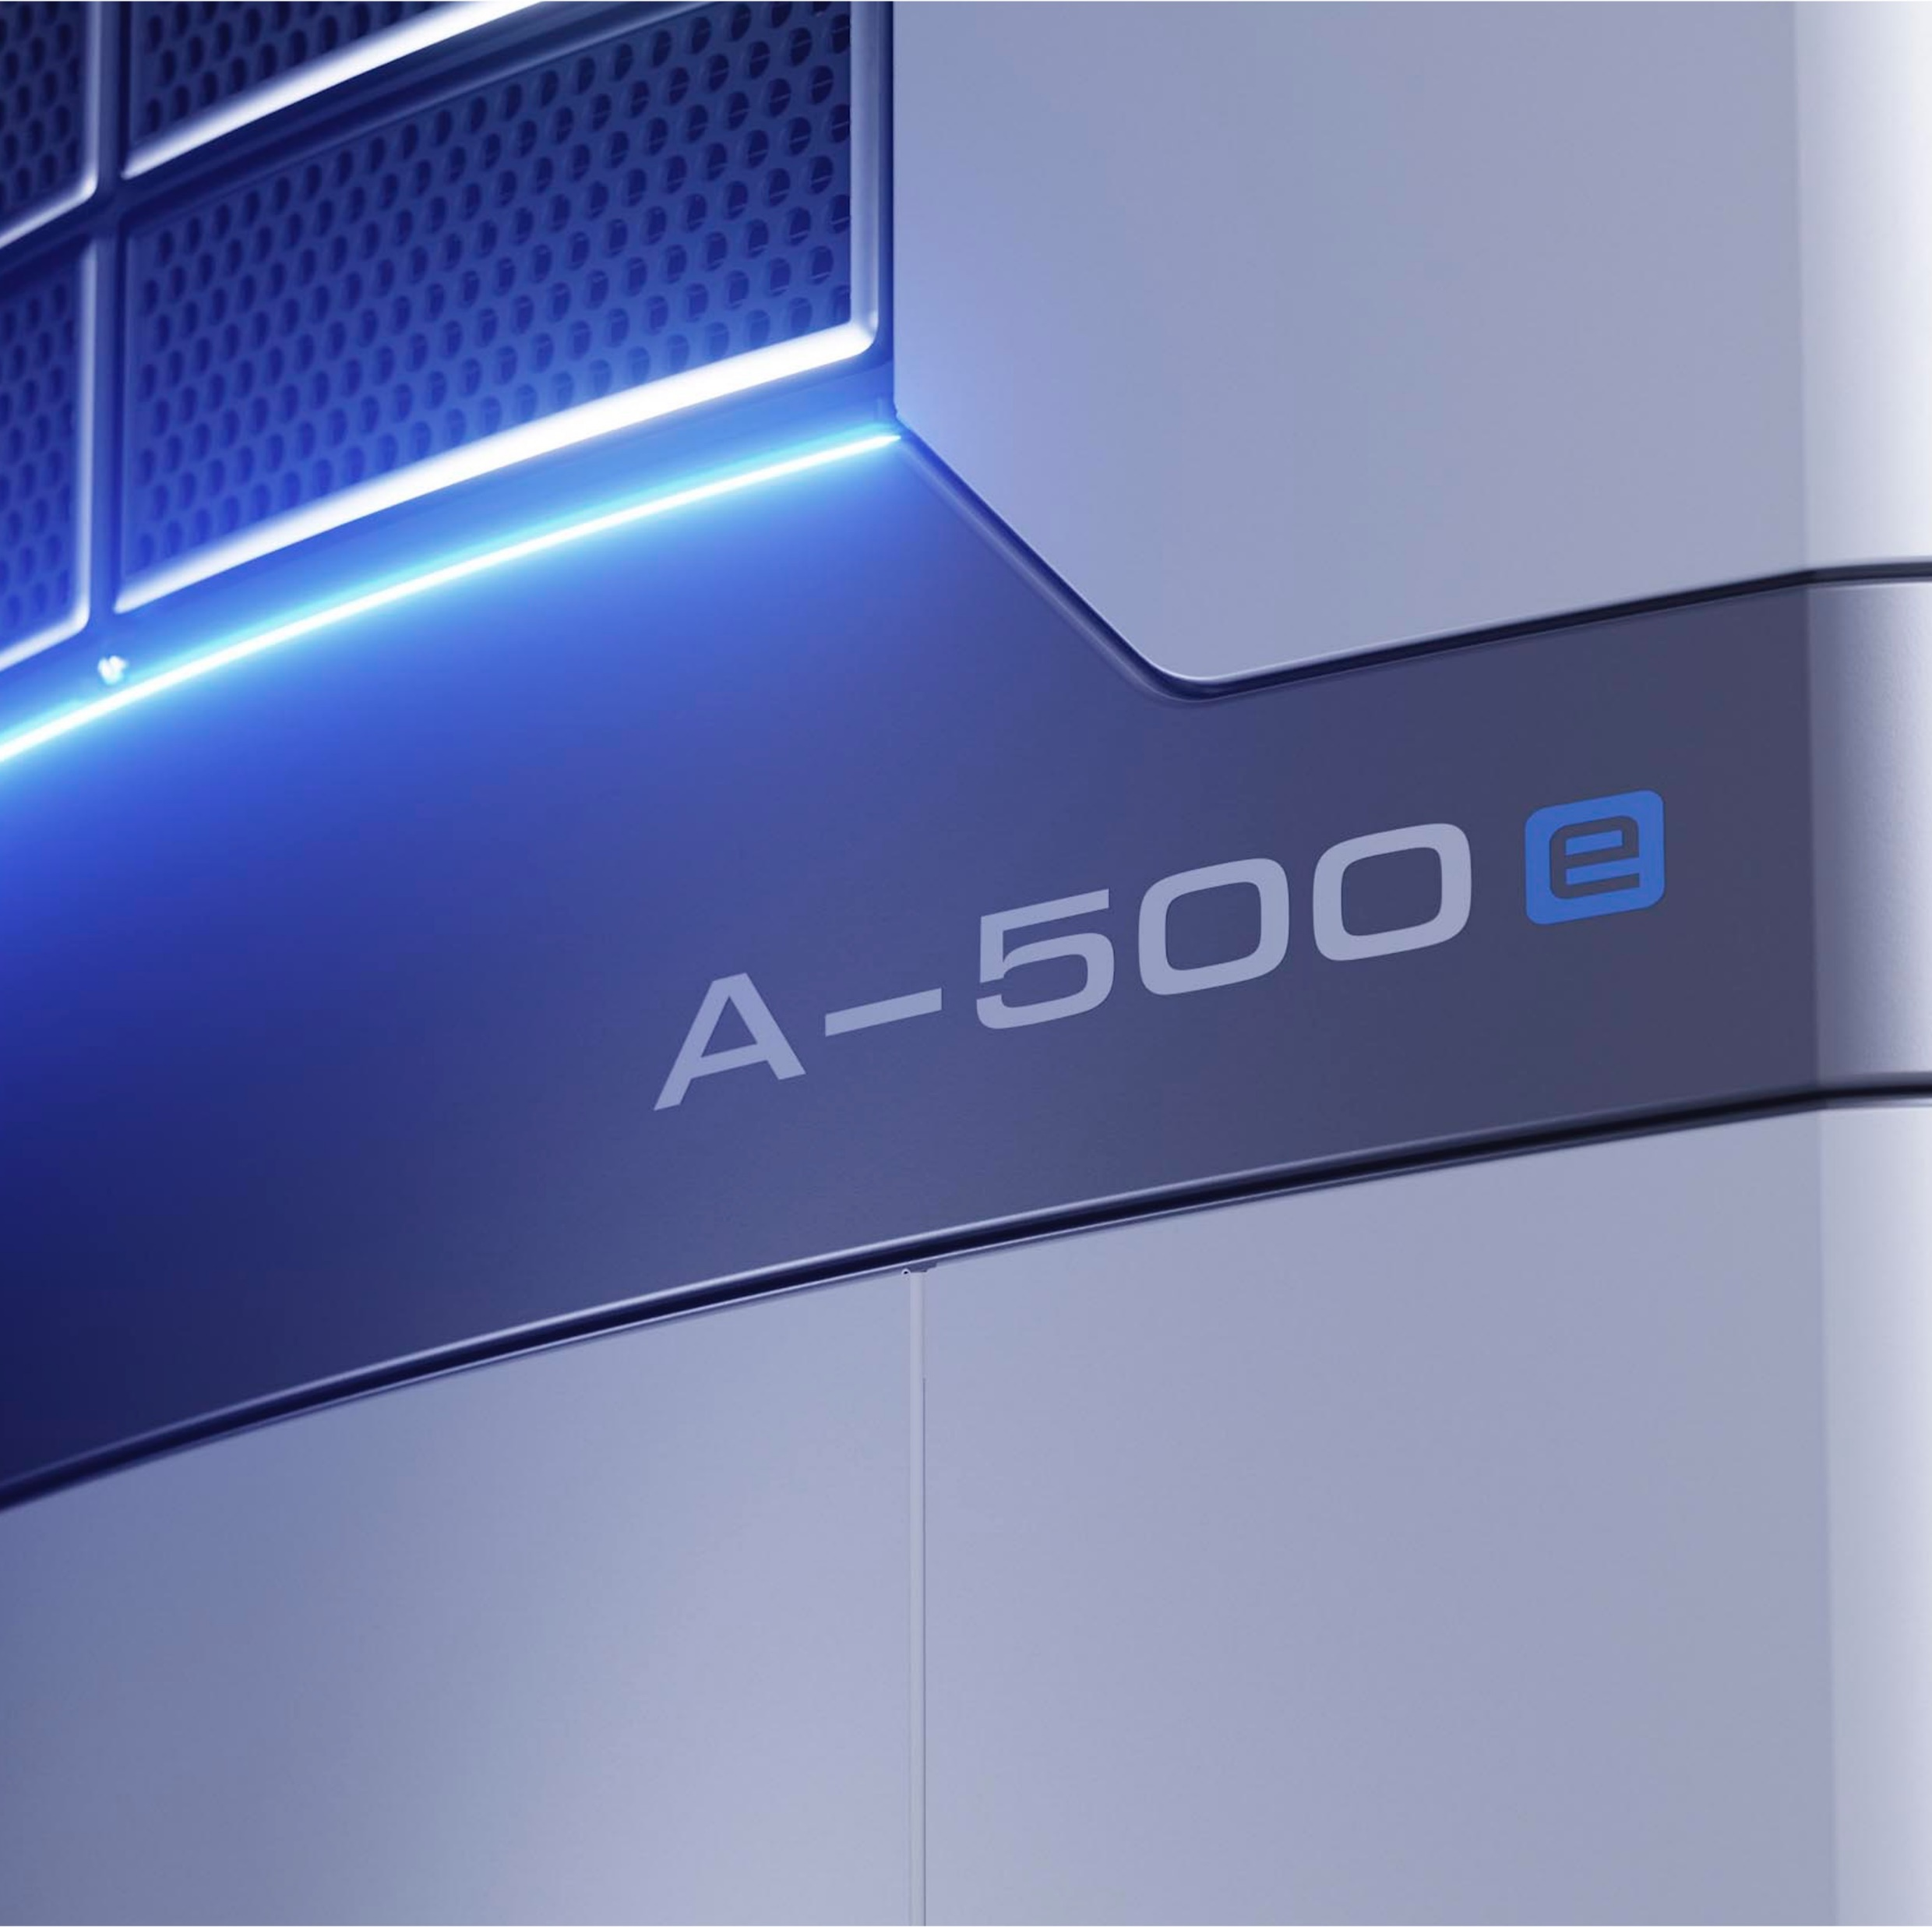
Electric TRUs
Advancer-e
Advancer Hybrid
HK
Electric experience
Fully electric unit competitive comparison

Slide 54

Advancer-e
Introduction
  Offerings
Key Features and Unit design
Advancer controller and integrated connectivity
Sustainability
Key benefits takeaway

Slide 55

A-500e
OFFERINGS
A full-electric advancer for sustainable, Zero-emission trailer refrigeration
Thermo King Advancer fully electric offering:
Advancer-e with AxlePower
Advancer-e with Energ-e Pack
Advancer-e with Envirodrive (Frigoblock Alternator and Inverter)
Also Compatible with:
Shore Power
Future sustainable alternatives such as hydrogen fuel cells
Scope | Comments
Advancer-e (Standard ST) | Standard Advancer-e to be available for initial launch (Q3 2023)
Advancer-e PIEK ST | Advancer-e PIEK to be available post launch (Q1 2024)

Slide 56

A-500e
KEY FEATURES AND UNIT DESIGN
Features
48 V DC Fans – Increased efficiency
Emissions free operation
Future-proof fleet operation
Energy consumption monitoring
Increased temperature control accuracy
Fastest pulldown
Quietest standard unit in the Market
Lower maintenance cost
Key Feature | Value
Capacity 0/30⁰C (50 Hz) | 15 200 W
Capacity (W) -20/30⁰C (50 Hz) | 8 000 W
Airflow | Max: 4 500 m³/hr High: 4 000 m³/hr Default: 3 400 m³/hr
Adjustable Airflow | Yes
Sound Pressure | 63 dB(A)
Connectivity Package | 2 – Year free subscription
Notes:
56

Slide 57
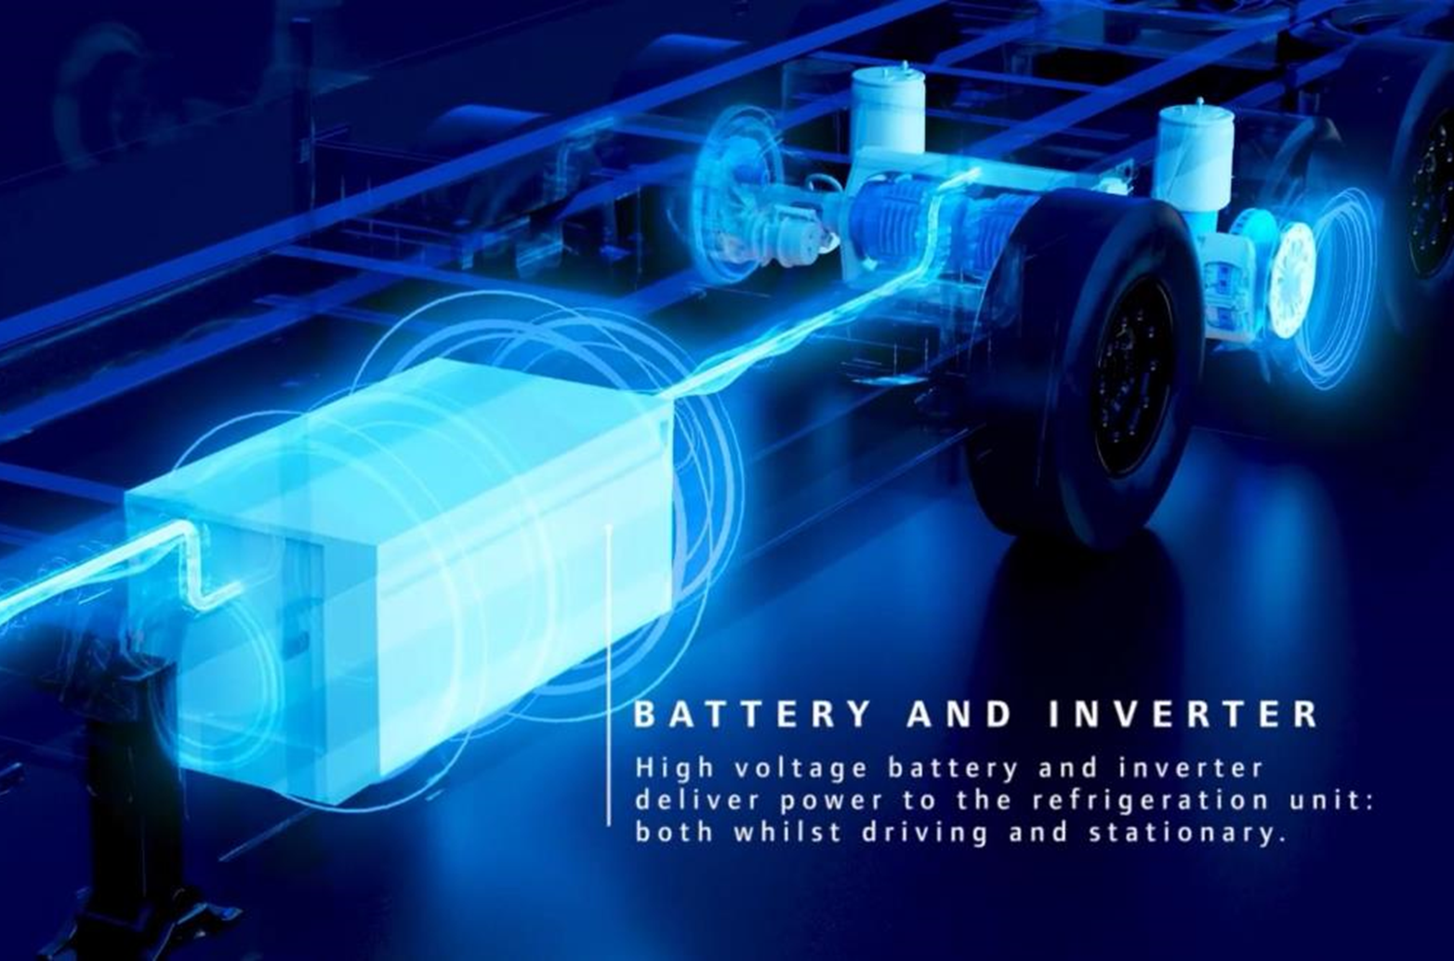
A-500e
Compatible Power Sources
UNIT DESIGN
We removed the engine and
kept the best of Advancer technology!
A-500 | A-500e
Engine | Removed
Motor Gen Combo | Highest efficiency Motor Gen Combo
A-Series controller | Intelligent A-Series controller
Distributed Electronics | High quality distributed electronics
Compressor | Bullet proof compressor
48 V DC Fans | Efficient 48 V DC Fans
Frame | Robotically welded frame
AxlePower
Energ-e Pack
+
Envirodrive

Slide 58

A-500e
UNIT DESIGN CONT.
48 V DC electrical Architecture
(Power agnostic for future source)
Adjustable Airflow (unique to Thermo King!)
  Direct drive of the compressor
  (combined with a state-of-the-art refrigeration architecture)
Delivers highest overall drive efficiency

Slide 59

A-500e
ADVANCER CONTROLLER & FULLY INTEGRATED SYSTEM CONNECTIVITY
A-500e controller
As a result, our customers benefit from:
Driver-friendly interface
Rugged design to withstand any environment
Energy consumption & cargo monitoring (Tracking)
Optimized functionalities (2022-2023)
Advanced temperature control
23 languages
Reduced TCO
Increased Uptime
Reduction of driver error
Fully integrated
telematics
Greater Peace
of Mind!

Slide 60


A-500e
SUSTAINABILITY CONSIDERATIONS
Unit will allow customer to comply with local legislation regarding travel in LEZ and ULEZs.
Unit will contribute to Gigaton Challenge savings in the magnitude of up to 10 t per unit per year
Low emission units allow customers to avail of local government subsidies/ grants/ tax breaks (region dependent) e.g. CEE – France
Reduction of carbon footprint by up to 10 tonnes per unit per year!
Equivalent to: Driving 60,000 km in the average diesel car (1.5 times around the world)

Slide 61

A-500e
KEY BENEFITS TAKEAWAY
All electric cooling, including the following existing Advancer benefits:
With the added benefits of:
Energy Efficient 48 V DC fans
Precise temperature control
  Accuracy up to 0.5 °C
Variable airflow
Fast pulldown / Temperature recovery
Synergy Control & Interface
Integrated Telematics available for full electric solution solution
Low noise
  Perfect for urban and late-night deliveries
Lower weight (200kg less weight than standard unit)
  Reduced energy consumption on the tractor
Zero direct emissions
  Emission free refrigeration from refrigeration unit
  Access to LEZ and ULEZ
  Reduced carbon footprint
  Reduction of carbon footprint by up to 10 tonnes per unit per year!
Lower Maintenance Cost

Slide 62

Electric TRUs
Advancer-e
Advancer Hybrid
HK
Electric experience
Fully electric unit competitive comparison

Slide 63

Advancer Hybrid
What is it?
How does it work and compatibility?
Key benefits and Sustainability

Slide 64
Advancer Hybrid
HOW DOES IT WORK AND COMPATIBILITY?
Electric operation - Constant power provided through electric motor allows unit to run on electric standby (as long as Truck engine is on)
Unit can be connected to shore power when tractor engine is off for load protection
No access to shore power? - Diesel mode can be used when Tractor engine is off to ensure load is always protected
Solution is compatible with multiple tractor power sources e.g. LNG, CNG and Biofuel
Compatible with all Advancer models
*Tractor Model compatibility needs to be checked

Slide 65
Advancer Hybrid
KEY BENEFITS AND SUSTAINABILITY
Compatible with all tractor alternative energy sources
Access to LEZ and ULEZ for inner city deliveries
Automatic Geofencing – Advancer Hybrid can switch from diesel to electric operation without manual intervention when entering LEZ or ULEZ
Extended equipment life due to reduced diesel operation
Lower Noise Operation
Up to 90% TRU Emission reduction - 13,500 kg of CO₂
  ➔ ~Equivalent of a car driving around Earth 1.3 times!

Slide 66
Electric TRUs
Advancer-e
Advancer Hybrid
HK
Electric experience
Fully electric unit competitive comparison

Slide 67
HK
Introduction
  What is it?
Key Features and unit design
Key benefits and Sustainability

Slide 68
HK-e
A Full-Electric MT solution for Sustainable, zero emission Trailer Refrigeration
Optimised to be suitable for all European markets
Fully electric MT unit
  2 and 3 zone configurations
Launch date
  Q3 2023 (Aligned to AxlePower availability)

Slide 69
HK-e
Compatible Power Sources
WHAT IS IT?
AxlePower
Energ-e Pack
+
Envirodrive

Slide 70
HK-e
KEY FEATURES AND UNIT DESIGN
Features
New model with following improved features:
High Ambient Operation
  Lower noise (63 dB(A))
  ATP Certified
  MT available
Compatible with shore power connection to ensure load protection when tractor engine is off
Key Feature | Value
Capacity 0⁰/30⁰C (50 Hz) | 16 000 W
Capacity -20⁰/30⁰C (50 Hz) | 10 000 W
Sound Pressure (dB(A)) | 63 (TBC)
Connectivity Package | Connectivity contracts available
Notes:
70

Slide 71

HK-e
KEY BENEFITS AND SUSTAINABILITY
Compatible with all tractor alternative energy sources
Access to LEZ and ULEZ for inner city deliveries
Lower Noise Operation
Up to 50% Fuel consumption reduction
Notes:
71

Slide 72
Electric TRUs
Advancer-e
Advancer Hybrid
HK
Service and Solutions - Electric Experience
Fully electric unit competitive comparison

Slide 73

Services & Solutions - Electric Experience
A SOLUTION SALE SECURES FUTURE EMBEDDED REVENUES
Extended Warranty
Upgrades &
Accessories
UNIT SALE
SOLUTION SALE
Service Contracts
Spare Parts
Packages
VS.
Connectivity
Services
Connected
Assets
Notes:
If we take a step back, let's talk about what the solution sale is.
Consider you have 2 scenarios for sales. Selling a unit only then lose the customer as soon as the standard factory warranty expires vs. selling a solution to the customer which includes not only the unit, but also different services and solutions tailored for the specific needs of the customer.
A solution sale also means a value sale. Based on the customer's specific needs and concerns, you can come up with different solution by combining different services and solutions.
For example, for the customer who is concerned about unexpected downtime, you can offer the unit with a ComfortPlus combined with 24/7 Fleet Monitoring, while you can offer TracKing Electric Experience for the customer who is interested in power management solution.

Slide 74



Services & Solutions- Electric Experience
ADDRESSING THE FULL LIFECYCLE OF A TRANSPORT REFRIGERATION UNIT
New Unit Purchase
& Warranty Service
Uptime Services
New Life
Year 0 – 2
Year 3 – 6
Year 7 +
“Purchase a complete solution from a single supplier”
“Maximize unit availability,
efficiency, 100% plannability”
“Increase value of used units, upgrade to latest technology”
Customer
“Grow share and services revenue by offering a solution at POS”
“Grow parts and services revenue
by improving customer retention
and TK dependency”
“Grow parts and services revenue by offering modernization solutions”
Thermo King
Notes:
We'd like to remind you about the full lifecycle of a transport refrigeration unit. The life duration may vary depending on customer or market or application, but we can think of 3 phases.
The first phase starts with the delivery of the unit. During this phase, customer would purchase our solution and would want to ensure that they have competitive pricing and comprehensive solution for their business. At this stage, we have our opportunity to offer a tailored solution for our customers per their needs, which can help us to grow the share in the market and secure the long term relationship with the customer that can reward you with more business for longer period, instead of only stopping at selling the unit.
The second phase is what we can call as first life of the unit where customer would want to ensure that they make the best use out of their investment. Therefore the uptime of the unit becomes an important aspect as well as operation efficiency. By fully capturing this phase, we can secure customer loyalty and also increase the potential service opportunity within our network that we can maximise customer satisfaction as well as profit at your workshop and service teams.
After serving the first life, typically in line with end of the first ATP certificate, the unit may face the next phase where the needs of the customer becomes somewhat different from previous phases. Dealers can offer the customer different solutions to maximise customer's value out of the unit in the second life such as ATP re-certification, Thermo King Select Parts portfolio, upgrade with accessories or extension of service agreements.
It is very important that we recognise those different phases of unit lifecycle that we can propose right solution to our customers along with their specific needs.

Slide 75

Services & Solutions- Electric Experience
WHAT SOLUTION SELLING MEANS FOR DEALERS
Gross profit
HK 25
6 years, 9 000 run hours
Unit + Parts & Labour
(with Std Warranty)
+12%
Unit + BlueBox + Connect&SET + Parts & Labour
(with Ext Warranty)
+60%
Unit profit
Parts & Services profit
Unit + BlueBox + Connect&SET + Parts & Labour
(with ComfortPlus)
Solution Selling secures customer relationship and higher profit to dealers over the lifecycle of the unit
* Gross Profit indication based on Thermo King internal data
Notes:
Solution sale means longer customer retention, higher customer loyalty, higher profit over lifecycle and increased opportunity for repurchase in the future.
Based on our internal data, for an HK 25 with AW generator and inverter, we estimate 12% increase in dealer profit amount if it is offered with BlueBox, TracKing subscription and an extended warranty compared to selling only the unit.
If you upsell a full service contract, the profit you can capture from this unit goes up by 60% over 6 years vs. unit sale only.
By capturing the customer longer in your reach, you can benefit from more business and deeper relationship with the customer.
Furthermore, such a relationship provides you in-depth knowledge in the customer's operation which will help you to offer more competitive and comprehensive solution which can lead to higher chance to sell the new units next time.
Unit profit contribution level is high due to long installation hours.
Unit including Inverter & AW Generator
How the above numbers were calculated?
For Unit sales
General profit that the dealer will collect from selling & installing the unit
Profit from TK Parts & fluids from standard warranty jobs and scheduled service during first 2 years
Profit from labour (~30% margin) on associated jobs from above
For the first solution selling scenario
Unit sales profit +
Profit from TK Parts & fluids from standard warranty jobs and extended warranty jobs plus scheduled service during first 2 years
Profit from labour (~30% margin) on associated jobs from above
Profit from defined accessories
Profit from TracKing subscription (RRP-DNP)
For the second solution selling scenario
Unit sales profit +
Profit from TK Parts & fluids from standard warranty jobs and full maintenance & repair jobs plus scheduled service during 6 years
Profit from labour (~30% margin) on associated jobs from above
Profit from defined accessories
Profit from TracKing subscription (RRP-DNP)

Slide 76

Service & Solutions - Electric Experience
POINT OF SALE – SERVICES & SOLUTIONS TO ENHANCE UNIT VALUE
Enhanced power management
Battery Contract (ComfortPlus)
TracKing Electric Module
Downtime prevention
Battery and Axle generator alarms notification & recommendations
24/7 Fleet Monitoring
Load protection
State of Charge
Battery Autonomy
Low Battery Alarm
Fleet efficiency
Power Source
Reporting capabilities
Battery Charging time
Understanding the customer’s needs is the starting point of Solution Selling
Notes:
Our electric experience starts with the purchase of an electic trailer, which while a great product, can be even better and provide even more added value if coupled with a full suite of services and solutions. Such as:
- Electric TracKing experience which allows you to put data at work
A full service contract for both the electric trailer and the battery pack.
And this is just the beginning, we aim to add more and more services as we are aware that electrification comes with opportunities and concerns. We want to provide a complete solution to our customers and position ourselves as electrification leaders.
Let's go into some greater details on the two services mentioned above.

Slide 77

Connectivity – TracKing Electric experience
ENHANCED POWER MANAGEMENT SOLUTIONS
Through an intuitive, customizable, user-friendly and action-based user experience, you make the most of your electric unit
Monitoring, Reporting and Automation data and tools are at few clicks away within TracKing and TK Mobile Apps.
Notes:
From our conversations with customers, access to electric data is critical for the adoption of electric TRUs. Customers are mainly concerned if the range provided by the battery is sufficient to reach the final destination without a loss in goods quality. Moreover, they are interested in understanding historic data about their reefer unit and in case of excursions to be able to remotely intervene. A key request was to have a simple and intuitive driver interface.
With this in mind, we have designed an intuitive, customizable, user-friendly and action-based user experience

Slide 78
Connectivity – TracKing Electric experience
ELECTRIC DATA & INSIGHTS
Status | Monitoring | Reporting | Automation | Troubleshooting/ servicing
Battery level (%) | Battery Power Sources display and notification in case of change | Axle generator mode change in Event Report | Remote Axle generator mode change | Customizable Low Battery level notification
Battery Charging time- time to full charge | Axle generator mode and notification in case of change | Shore Power mode change in Event Report | Remote Shore power priority change | Battery alarms codes and notification
Battery Autonomy (time left) | Customizable Low Battery notification | Electric Pack Operating Report |  | Service Intervals
Odometer (Km) | Battery alarms in real-time (High Batt Temp, Low Batt Temp, Low Batt, Empty Batt Defective Batt) | TRU Electric Operating Report |  | Electric Unit alarm codes, notifications and recommendation
Total Electric Hours / Shore Power (in hour, Operational Battery data) | Shore power priority display and notification in case of change | Energy Supplied by generators |  | Service Providers recommendations
Operational Battery data- Total Electric Hours / Battery Pack | Modes of Generating Energy – Recuperation only /Permanent pulling | Energy consumed by the refrigeration unit
Σ Shore Power Energy Input | Error codes defect of GTU (generators) | Battery Pack Alarm Report
Σ Axle Generator Energy Input |  | Build my own report- report builder
Σ EnergE Energy Output
Notes:
We are not providing you only an electric trailer, but we provide you a connected and smart axle package which allows you to fully grasp the benefits of electrification while delivering your cargo on optimal conditions;
A connected and smart axle package allows you to, among others:
Downtime prevention
•Having full visibility on the alarms, you can take immediate action to prevent further damage and decrease downtime
•We do not only tell you what is happening, we also provide you with a recommendation
•24/7 monitoring services
Enhanced Power management solutions:
•What would be an electric unit without a proper interface, website and mobile app designed to enhance your electric experience and alleviate any anxiety due to range or load loss;
•
Fleet optimization
•By always knowing critical battery status information such as autonomy , full charging time or power source, you can better manage your fleet utilization
•It allows you to monitor your electric reefer fleet by always knowing reefers on the move/stand-by/charging
•Full reporting module which allows you to analyze your electric reefer past operation. You have full traceability on your electric reefer fleet operations.
Load protection
•Visibility on your Electric Reefer battery level that allows you to take the best proactive measures for protecting the load

Slide 79




Connectivity – TracKing Electric experience
SOME INSIGHTS FROM COMPETITION
Carrier Transicold (via Addvolt)
  Limited data: State of Charge, Last Charge, Battery Level
  No mobile app
  No 2-way communication
Maxwell+Spark
  Limited data: State of Charge, Last Charge, Battery Level
  No mobile app
  No 2-way communication
Schmitz Cargobull
  No electric module available on their telematics platform

Slide 80

Enhanced Power management solutions
BATTERY SERVICE CONTRACT (COMFORTPLUS)*
An all-in-one solution for Energ-e battery pack
Full repair & maintenance contract on battery pack (=ComfortPlus) for up to 10 years
Battery State of Health guaranteed at ≥70%
Up to 2500 or 5000 full battery cycles
Add on to ComfortPlus for Thermo King /
Frigoblock Transport Refrigeration Unit
24/7 Fleet Monitoring to maximize uptime and
cargo protection
Notes:
Together with EnergE battery pack, a ComfortPlus service agreement will be offered which can cover the complete repair & maintenance on the EnergE pack up to 10 years.
It covers up the guarantee on battery state of health at 70% level throughout the contract and the customer can opt in for higher number of full battery cycles.
Also this can be combined into one contract together with our TRUs that the customer can have one invoice for complete coverage on both reefer and EnergE pack for the duration.
Together with 24/7 Fleet Monitoring, the customer can ensure maximum uptime, cargo protection and battery condition with real time monitoring performed by Thermo King experts.
* eAxle not covered
* If the usage deviates from initial input, additional charge may apply
* Details of service contract may change prior to the launch of the EnergE pack

Slide 81
Electric TRUs
Advancer-e
Advancer Hybrid
HK
Connectivity - Electric experience
Fully electric unit competitive comparison

Slide 82






Fully electric unit competitive comparison
Solution | Availability | Power Source | Configuration (ST vs MT) | Adjustable airflow | Telematics | PIEK Compliant | Comparison
 | Advancer-e | AxlePower Energ-e Pack Envirodrive | ST | Yes – 48 V DC Fans leading to increased efficiency | Fully integrated with EAGER and Energ-e pack | PIEK - post launch
 | HK-e | AxlePower Energ-e Pack Envirodrive | MT | No | Fully integrated with EAGER and Energ-e pack | PIEK - post launch
 | 2021 (Vector HE 19 E City) | eCool Solution | ST and MT | No | Available on different platforms | Yes
 | 2022 (SCU.e / SCU.ep) | SCU.ep version includes e-axle 22 kW generator. Standard version for distribution. ePTO available or mains. | ST (MT expected to come) | No | Yes (confirm) | Yes
 | 2022 | ECOOLTEC Alternator | ST and MT | No | confirm | confirm
Notes:
Other incoming units to watch out for are Mitsubishi and Daikin which are coming to Market with fully electric units.
Further information on competitive units to come for specific unit training.

Slide 83
Agenda
Electric Trailer Introduction
Power solutions
Electric TRUs
Practical Information
Sales Tools Available

Slide 84
Practical information
PRODUCTION, PRICING AND ORDERING SYSTEM
Further information on Pricing and ordering process to be available in Q2 for:
  AxlePower
  Energ-e Pack
  Advancer-e
  HK-e
  * Please contact you local ASM for further information
The following solutions are already available for ordering
  Advancer Hybrid
AXLEPOWER
Solution | AxlePower | Energ-e Pack | Advancer-e | HK-e
Launch date (shipment from) | Q3 2023 | Q3 2023 | Q3 2023 | Q3 2023
Energ-e Pack
E-Axle

Slide 85
Agenda
Electric Trailer Introduction
Power solutions
Electric TRUs
Practical Information
Sales Tools Available

Slide 86
Sales tools available
Tool | Description | Where to find
Advancer Tool Box | Includes Brochures, videos , presentations on Advancer , Advancer-e and AxlePower as well as any other Advancer marketing asset | Infocentral
Smart Saver TCO tool | Allows you to calculate the fuel savings between Advancer, other TK units and competitive units OR calculate the total TCO savings based on maintenance, telematics, fuel and residual value savings against other TK units | Infocentral
TK ComCom – NEW and IMPROVED | Compare TK and competitive units based on their specifications | Infocentral
TK Windeal | Compare TKTK contracts | Infocentral
Salesforce Unit Configurator | Allows you to pick units and select available options and accessories compatible with that unit | Salesforce
AxlePower Configurator (name tbc) | Allows user to determine size of battery required for customer application | Infocentral
HK Brochures | Highlights unit benefits and specification | Currently available on FB Website
Notes:
Other incoming units to watch out for are Mitsubishi and Daikin which are coming to Market with fully electric units.
Further information on competitive units to come for specific unit training.

Slide 87

Extensive Sales Tools Available - Through Info-central
Dedicated Advancer Toolbox

Slide 88

Extensive Sales Tools Available - Through Info-central
Extensive Sales Tools Availale - Through Info-central​

Slide 89

Extensive Sales Tools Available - Through Info-central

Slide 90


Smart Saver

Slide 91

TK COMCOM

Slide 92

TK EMEA WINDEAL

Slide 93


Salesforce - Visual Configurator

Slide 94

Visual Configurator - Salesforce

Slide 95

Visual configurator

Slide 96

Sales tools available: Axle Power savings calculator
Work in Progress
Input / Output Sheet Example

Slide 97
THANK YOU!

Slide 98

Appendix
DEALER SALES SCHOOL 2023
VILLAMOURA ALGARVE
25 –26 APRIL 2023

Slide 99

AXLEPOWER
SMART POWER MANAGEMENT- IN BRIEF
Dry Product transported during several days or weeks
➔ No impact of tractor fuel consumption
For return trips with TRU OFF
➔ Tops up the battery SoC by using “free” braking energy
Maintain min. 50% SoC (Active) or 90% (Active fast charge), then disconnects generators when targeted SoC level is reached
➔ Customer can select the % of reserve capacity to cover stationary periods and guarantee 100% Electric operation
Active / Active Fast Charge Mode

Slide 100
AXLEPOWER
SMART POWER MANAGEMENT- IN BRIEF
Case 1: Active Mode selected
➔ Trailer connected to shore power every night / no stationary time
50% SoC

Slide 101
AXLEPOWER
SMART POWER MANAGEMENT- IN BRIEF
Case 2: Active Mode selected
➔ Trailer connected to shore power every night / stationary time before start of trip + at delivery point arrival
50% SoC

Slide 102
AXLEPOWER
SMART POWER MANAGEMENT- IN BRIEF
Case 3: Active Mode selected
➔ Trailer not connected to shore power / stationary time before start of trip + at delivery point arrival
50% SoC

Slide 103
AXLEPOWER
SMART POWER MANAGEMENT- IN BRIEF
Case 4: Active Fast Charge Mode selected
➔ Trailer not connected to shore power / Multi drops with stationary time at delivery point arrival
90% SoC
Min SoC always available to ensure Electic operation during unexpected stationary time

Slide 104
AXLEPOWER
EXPECTED BATTREY LIFE – PARAMETERS TO TAKE INTO ACCOUNT

Slide 105



AxlePower – Unique features – Summary vs. Competition
Feature | Thermo King | Competition
Reliability | Qualified in BPW & TK labs + under extreme conditions | Initially = Customer development
Service Support | Consistent pan-European service support | Limited service support
System Optimisation | Design based on real life data Flexible design to cover various needs High overall efficiency for optimum TCO | Temporary version proposed? Future developments w/ different axle manufacturer (SAF)? Poo system efficiency reported by customers
Product Offering | Full Trailer range compatible | No Diesel-Electric option for customers requiring maximum flexibility Limited Multi-T options
Homologation | Fully homologated system | Homologation = still WIP
Integrated Connectivity | 1 single portal to provide full supervision 2 years connectivity as standard | No integrated telematic platform Battery Pack managed via a separate portal

Slide 106
Advancer Hybrid
WHAT IS IT?
FB Alternator
Advancer
Diesel drive remains available when the tractor engine is turned off
FB Inverter

Slide 107



A-500e
Architecture
Vibrasorbers
Cradle
Tubing & bracket
Compressor
Belt Cover
HV Module
Belt Drive
Harnessing
Controls and Software

Slide 108


EnviroDrive – Competitive Solutions
COMPETITIVE COMPARISON
FB Envirodrive
Carrier Ecodrive

Slide 109


EnviroDrive – Competitive Solutions
Solution | Description | Comparison
Carrier – EcoDrive | Power module fitted to the side of the truck's chassis. Hydraulic pump, which is connected to the truck engine via a PTO (power take off), is also fitted to drive the generator inside the power module which delivers a constant 400V/3/50Hz. Compatible with all Vectors units. | Higher complexity compared to Envirodrive leading to: Reduced system efficiency High Maintenance Cost Higher reliability risk from hydraulic system
HULTSTEINS – Ecogen 2 | Clip on Hydraulic Generator. The Hydraulic pump provides constant flow regardless of engine speed. Mounted between the box and cab. Provides Mains connection of 400 V 50 Hz. Available in low line and slimline Compatible with all fridges – includes competitor units (Thermo King (inc. FB) and Carrier) | Launched 2022 Field trials still ongoing

